Slide 1
Scale Up
Alireza Ghassempour
Professor of Analytical Chemistry
Medicinal Plants and Drugs Research Institute
Shahid Beheshti University
Sept 2020

Slide 2
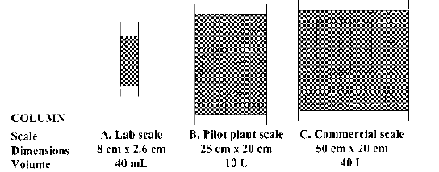
THEORETICAL CONSIDERATIONS IN SCALE-UP
In order to have a successful scale-up it is desirable to maintain kinetic (particle size, pore size, ligand chemistry, temperature and mobile phase) and dynamic (bed height, flow velocity and packing density) equivalence between the chromatography columns used in the laboratory and the pilot plant. This objective can be accomplished by using identical stationary and mobile phases in the two columns and operating them at identical bed height, linear flow velocity, protein loading (mg protein per mL of resin), feed conditions, gradient length, and gradient slope. The most common procedure used to increase column volume is to increase the column diameter so that the column volume increases proportion at el.

Slide 3
20
Purification of Picrocrocin
C18-30 µm-500*100mm
Loading:3gr
Flow rate:236 ml/min
C18-30 µm-300*19mm
Loading:60mg
Flow rate:8 ml/min
C18-30 µm-250*4.6mm
Loading:3mg
Flow rate:0.5 ml/min
Scale up
Scale up
Scale up
Notes:
بدین صورت که ابتدا شرایط جداسازی در مقیاس تجزیه ای با ستونی که مشاهده میکنید بهینه شد سپس برای scale up کردن وخالص سازی با ستون تهیه ای احتیاج به یک گام میانی یا به اصطلاح یک ستون حد واسط بود که ستونی با ابعاد 300*19 طراحی ساخته و داخل پژوهشکده پر شد پس از تایید مراحل scale up از ستون هدف در مقیاس نیمه صنعتی استفاده شد

Slide 4
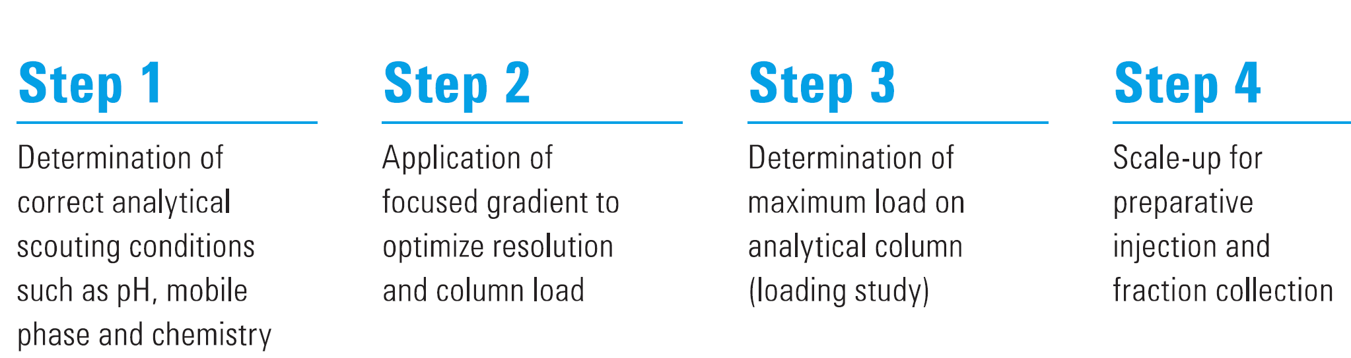

Slide 5

Physical Overview

Slide 6
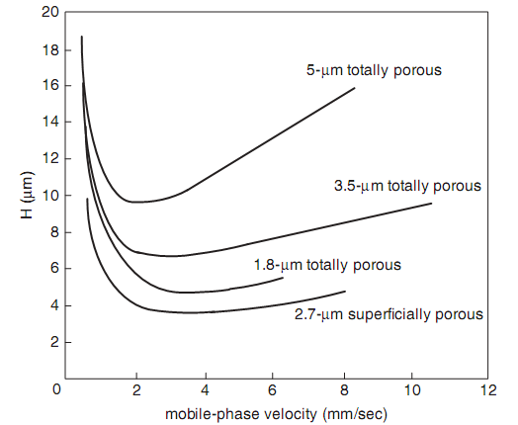
Column efﬁciency as a function of particle size and type. Sample, naphthalene.
Conditions: 50 × 4.6-mm, C18 columns; mobile phase is 60%acetonitrile-watermobile phase; 23◦C.

Slide 7





Simple Scale-Up Calculation
A typical scale-up from laboratory to pilot plant is on the order of 50–100-fold. This is frequently followed by a 10–50-fold scale-up from pilot plant to final commercial manufacturing scale.
The usual approach is to hold the plate count constant upon scale-up and increase the feed volume and column volume proportionately. This approach was originally based on the assumption of linear adsorption.

Slide 8
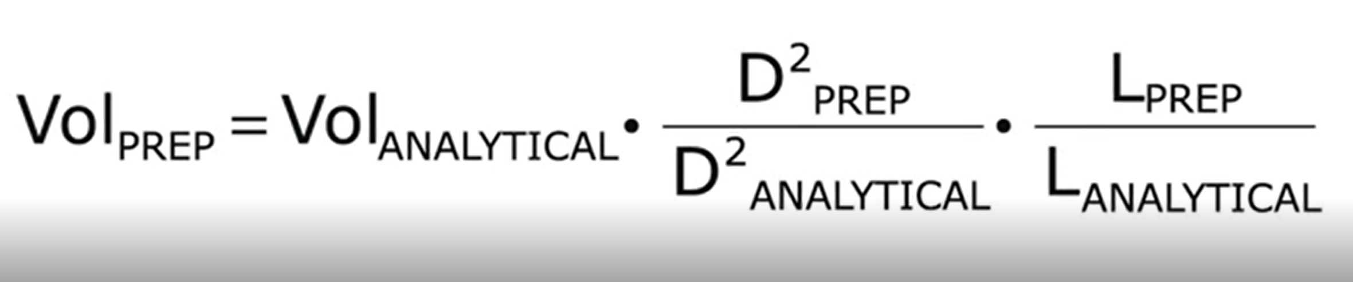
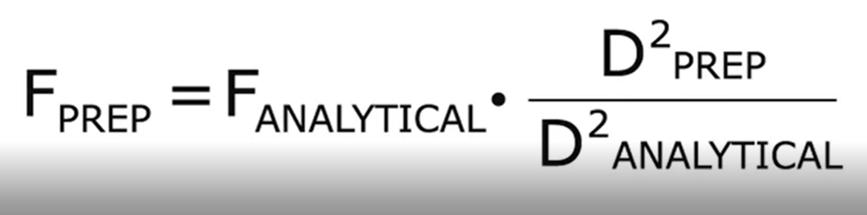

Slide 9
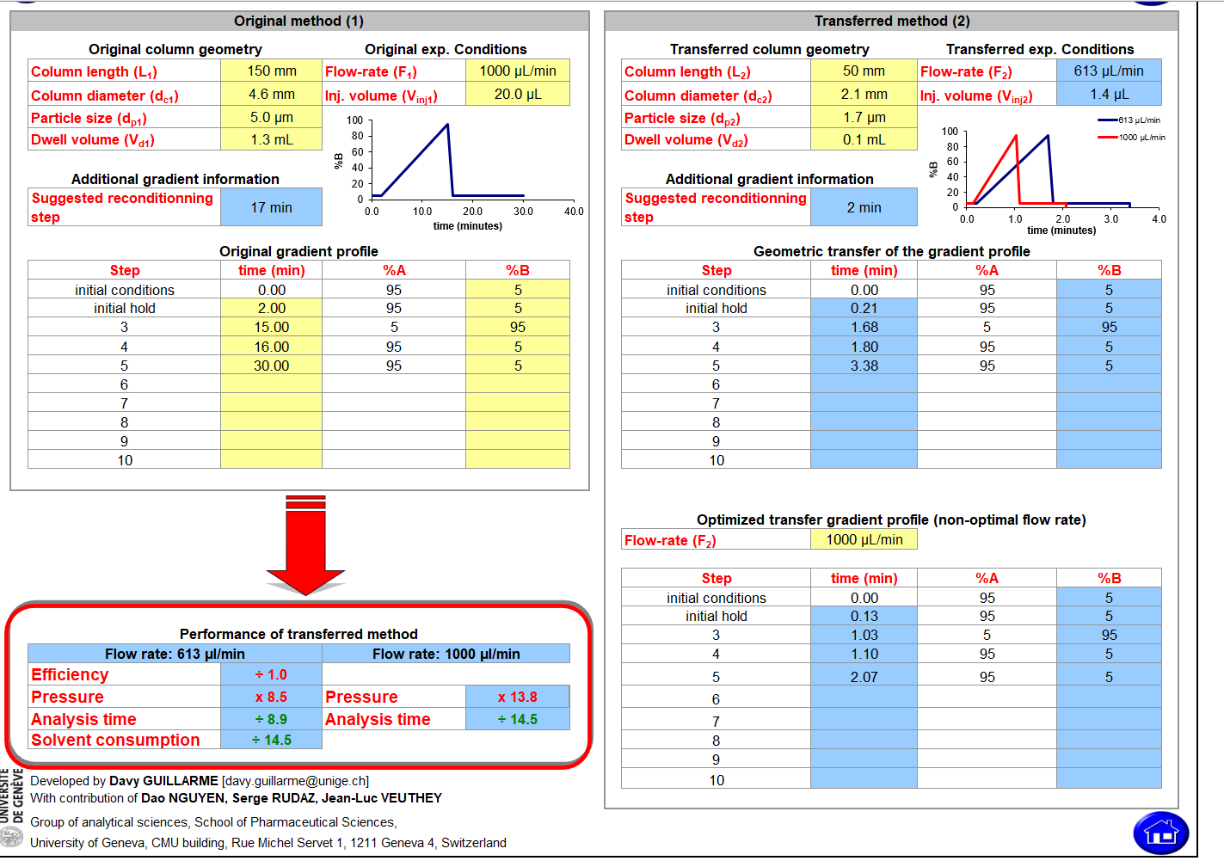

Slide 10
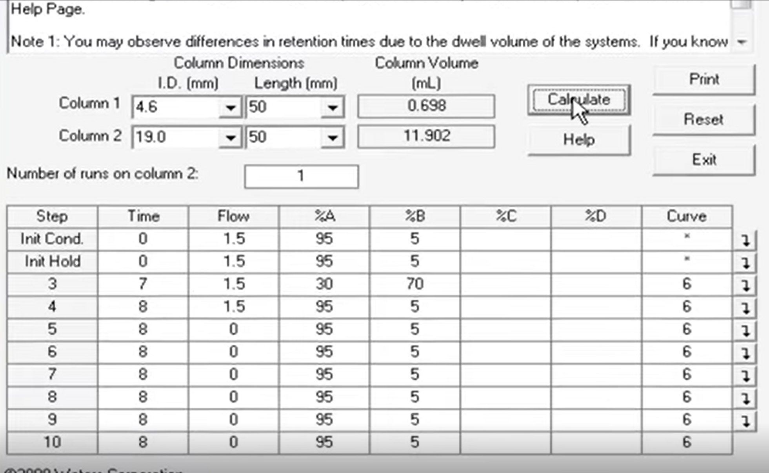
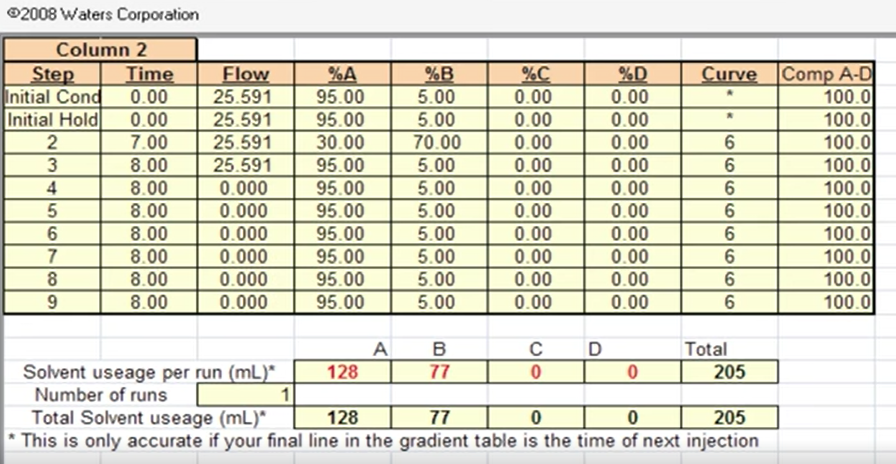
Waters company program

Slide 11
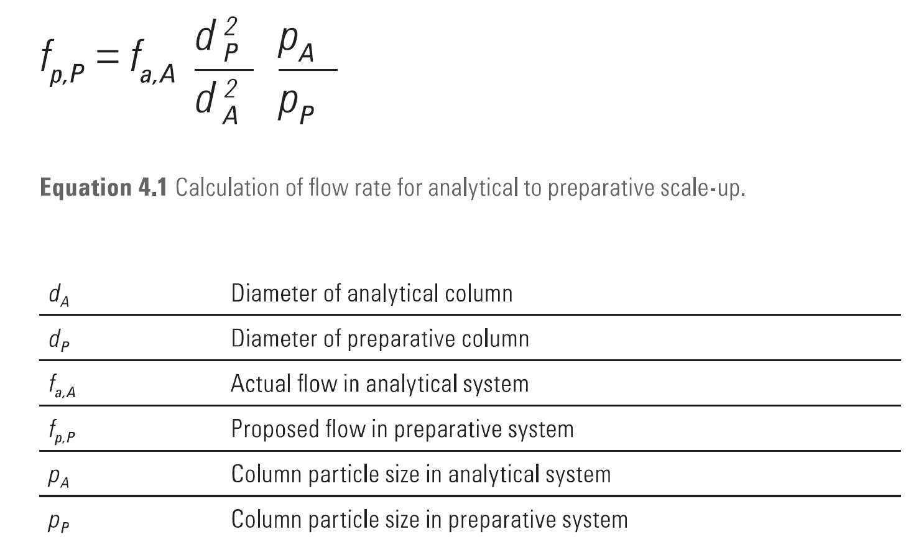
Agilent co.

Slide 12
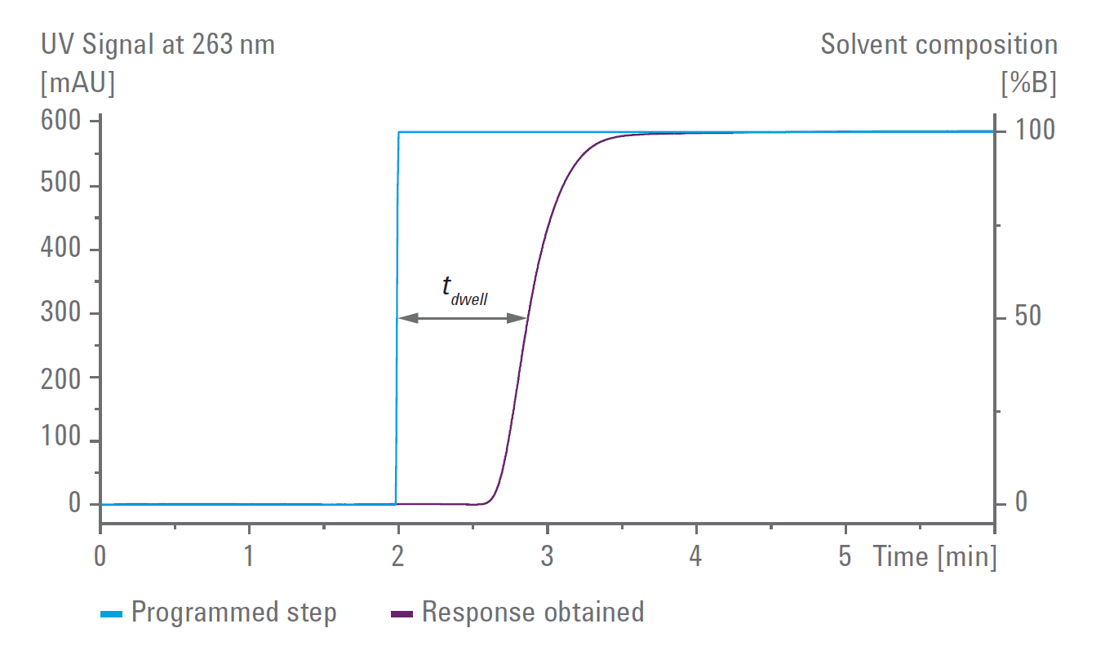
System dwell volume determination for preparative systems.

Slide 13
The process of developing a focused gradient stats with an analytical focusing run using a linear gradient profile from 2 to 98% organic solvent. The analytical scouting run gives us the retention time of the target compound. The exact gradient conditions at elution of the individual target compound are calculated from the result of scouting run when dwell volume and column dead volume of the system have been determined beforehand.
The offset time between the programmed solvent and the actual solvent composition at the column head is calculated by dividing combined void volume by the flow rate. The virtual elution point, which reflects the actual solvent composition when the peak has been detected is calculated by determination of the gradient composition after subtracting the offset time from the retention time.

Slide 14
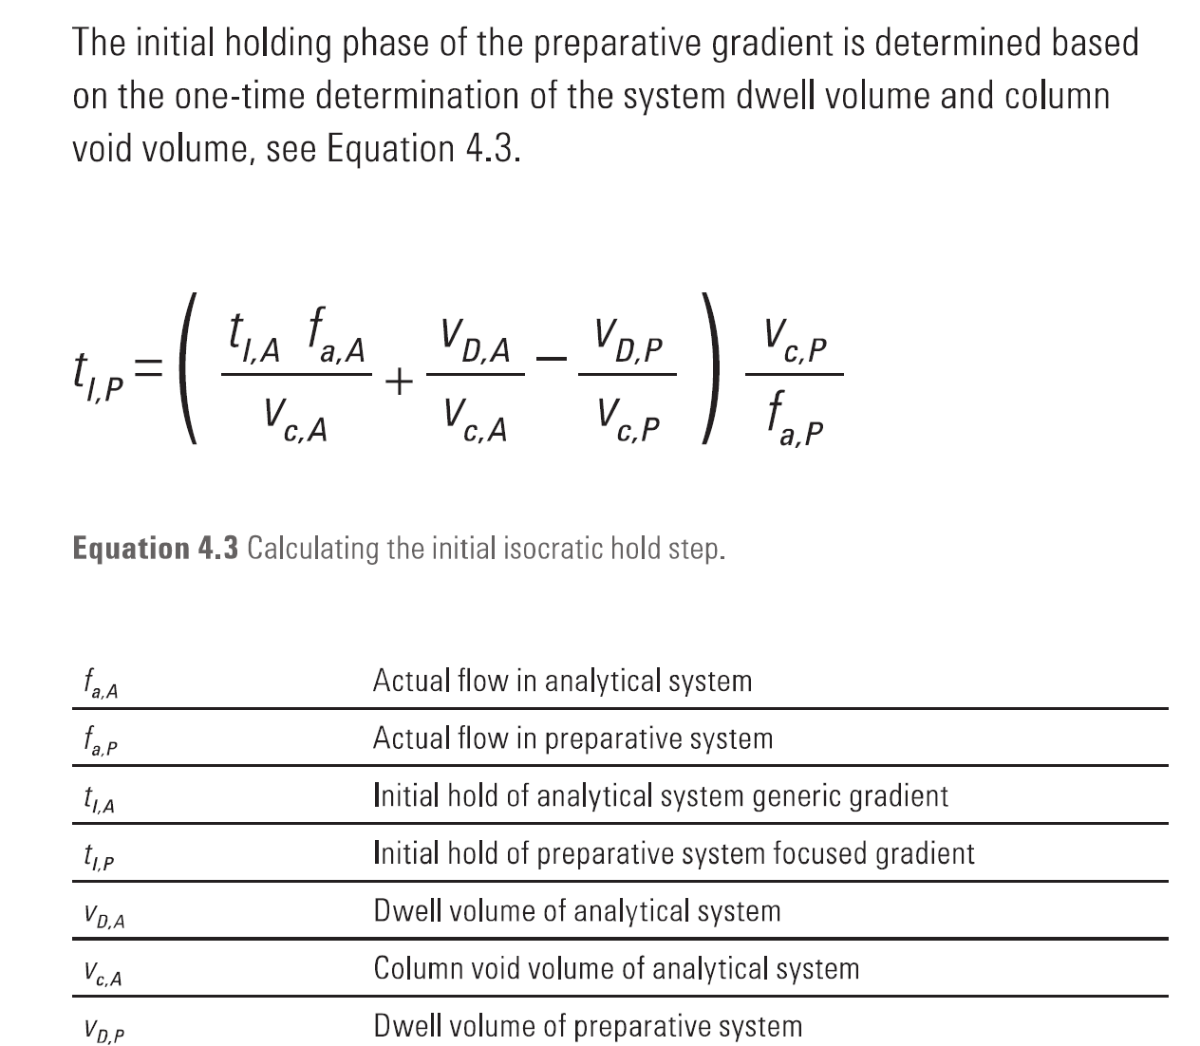
Agilent co.

Slide 15
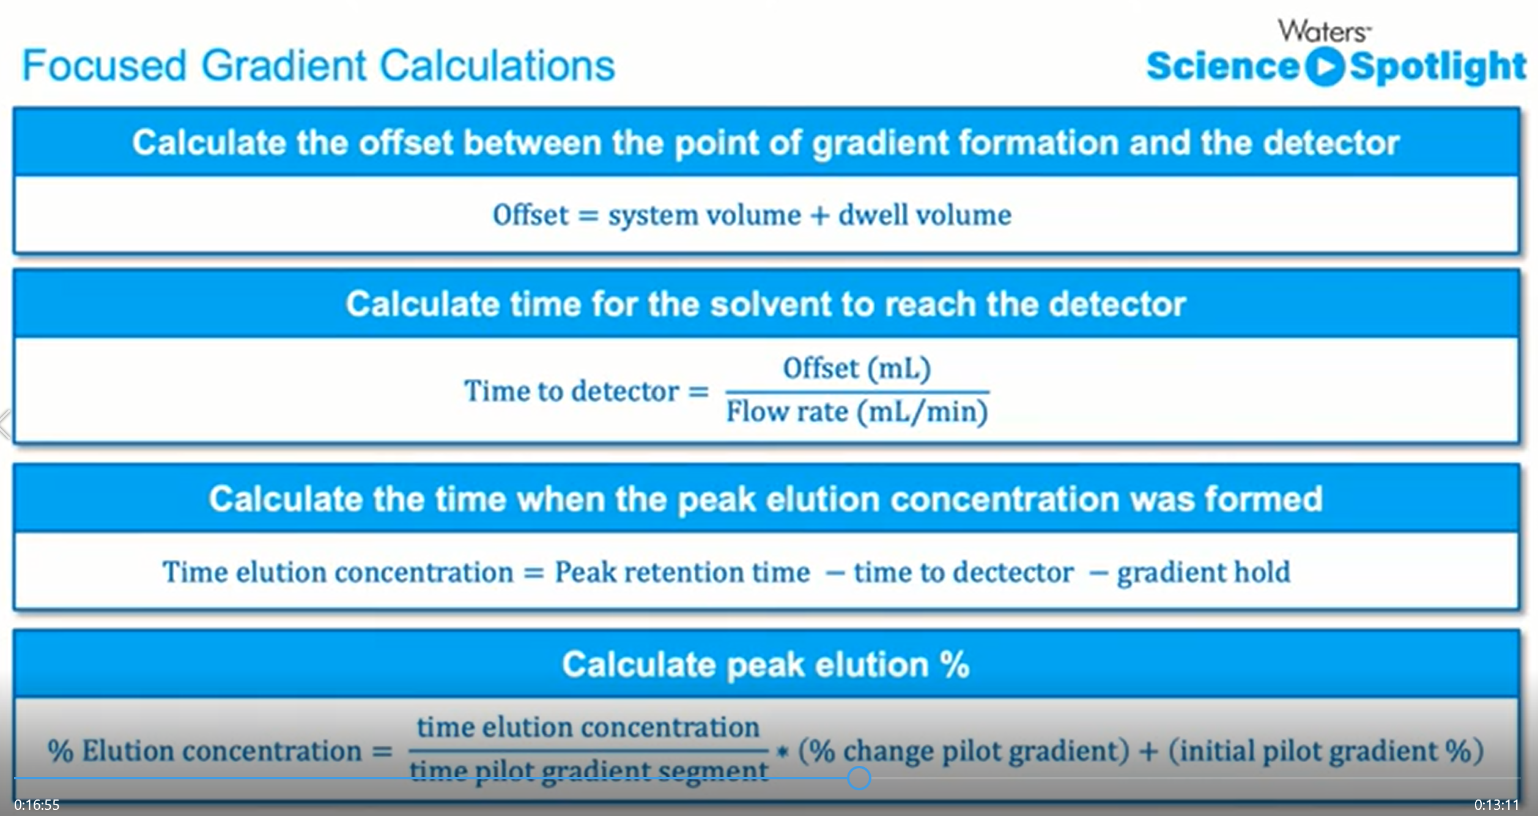

Slide 16
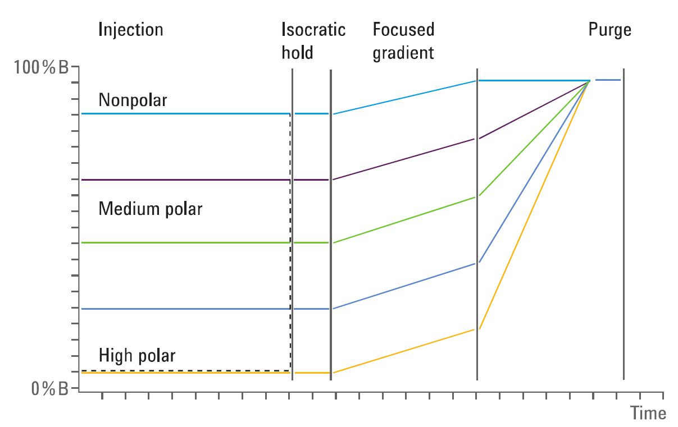
Agilent co.
Focused gradient profiles for target compounds with different polarities.
The dashed line represents an alternative step-gradient profile.

Slide 17
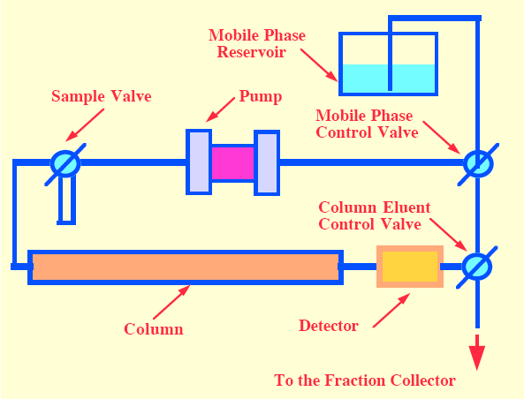
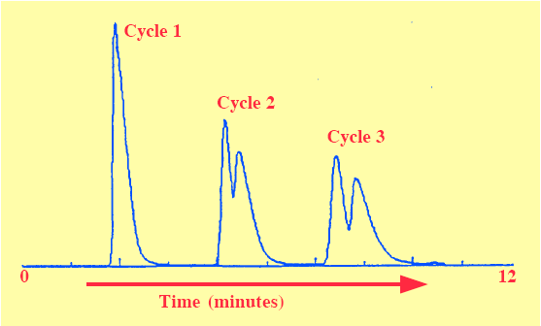
Recycling Development

Slide 18
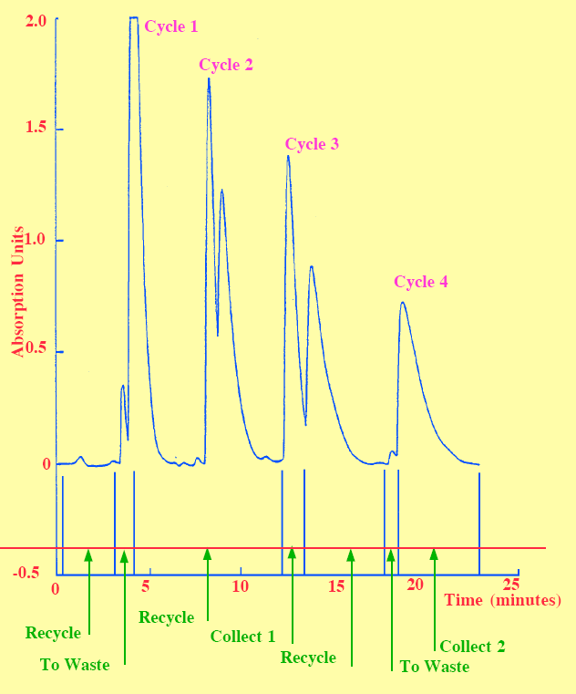
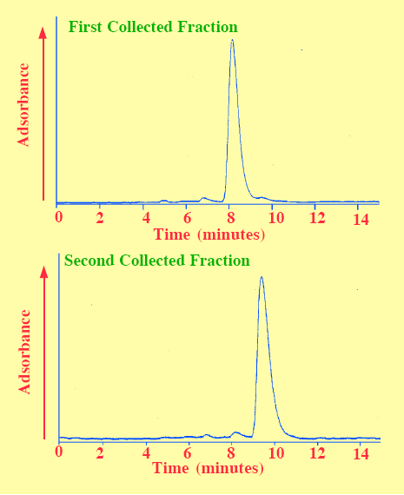

Slide 19
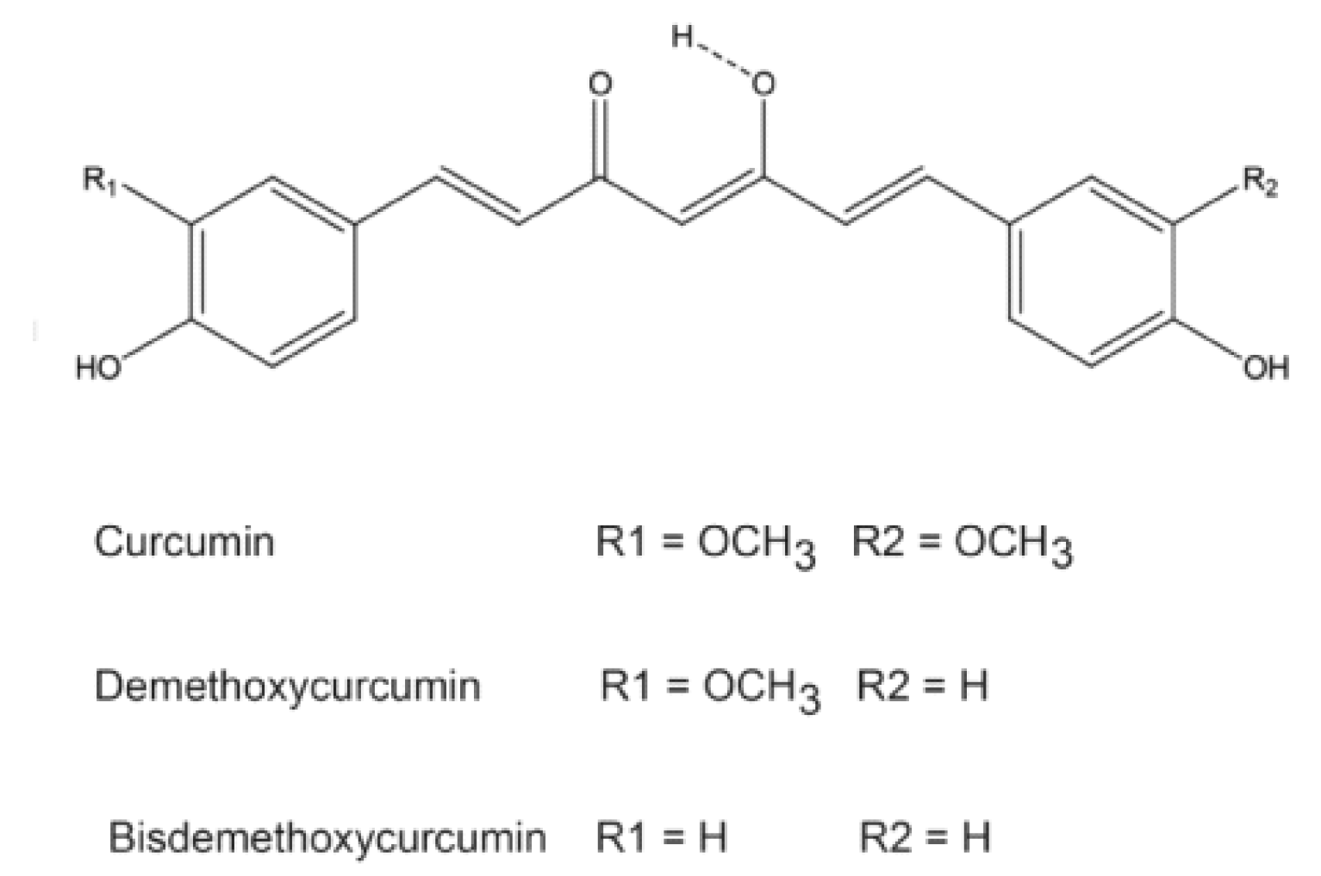
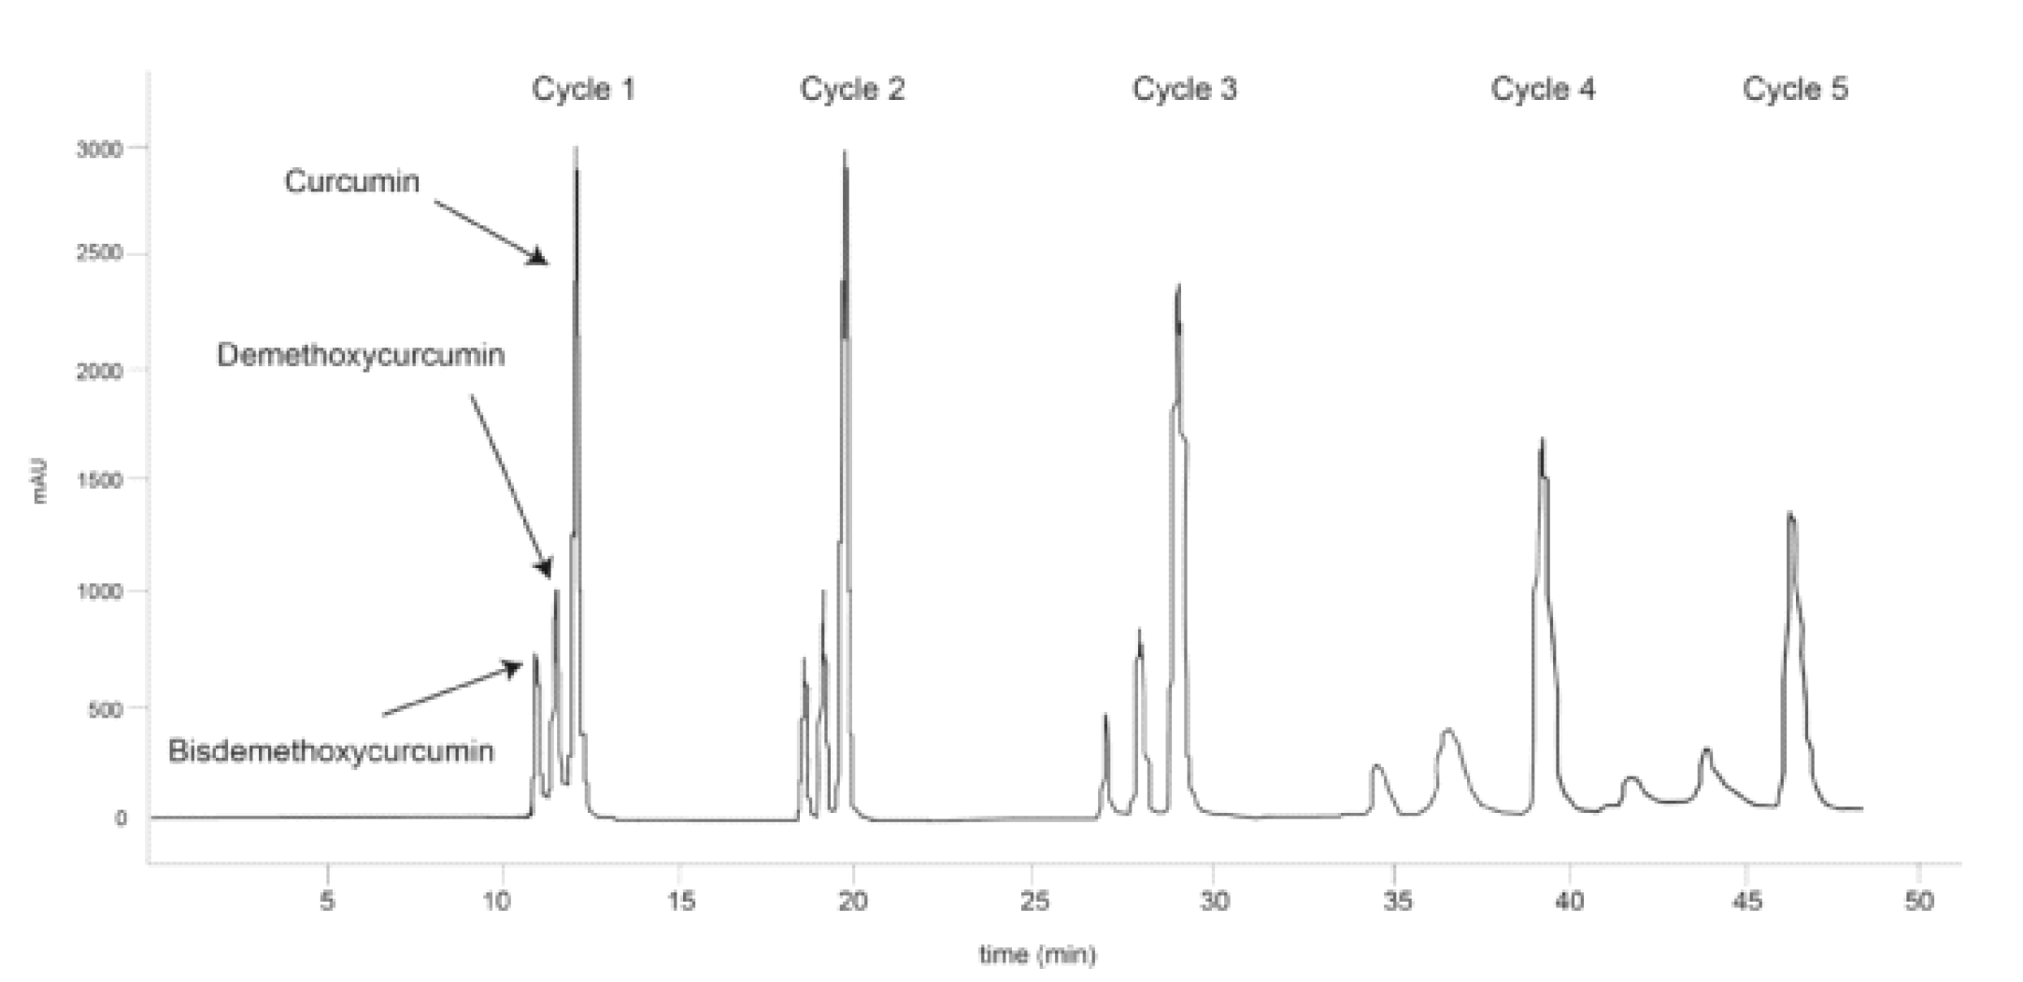
S. Mollayi, et al, Acta Chromatographia, 27 (2015) 387-398.

Slide 20
LC × LC

Slide 21
Multi-modal and mixed-bed separations are often confused.
2D LC or LC×LC method which either combination of two columns with different stationary phases or by use of two columns with the same stationary phase running under different mobile phases.
Mixed-bed stationary phases where a mixture of two stationary phases are packed into a single column (or columns are coupled), or where the stationary phase shows multiple retention mechanisms.

Slide 22
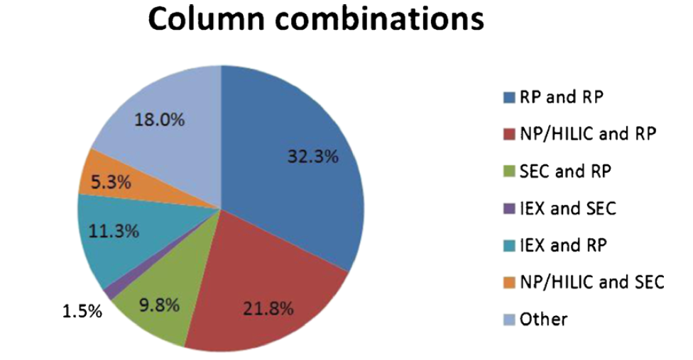
Column combinations in LCxLC systems (up to May 2014)

Slide 23
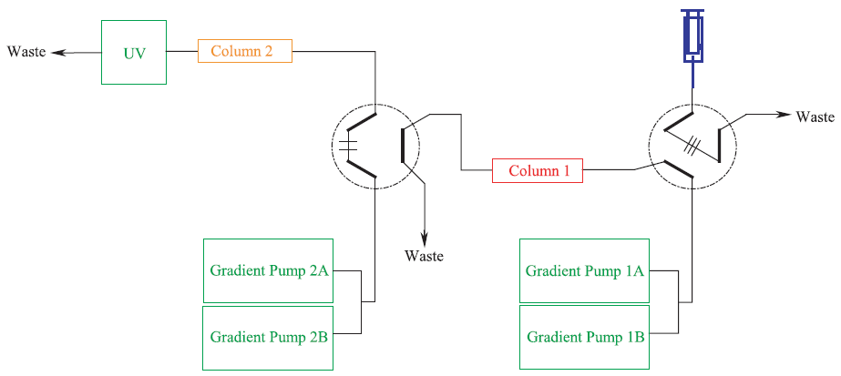
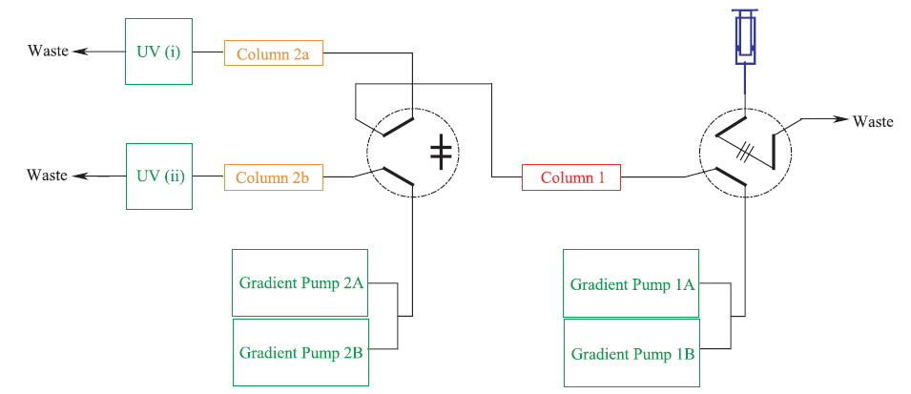

Slide 24
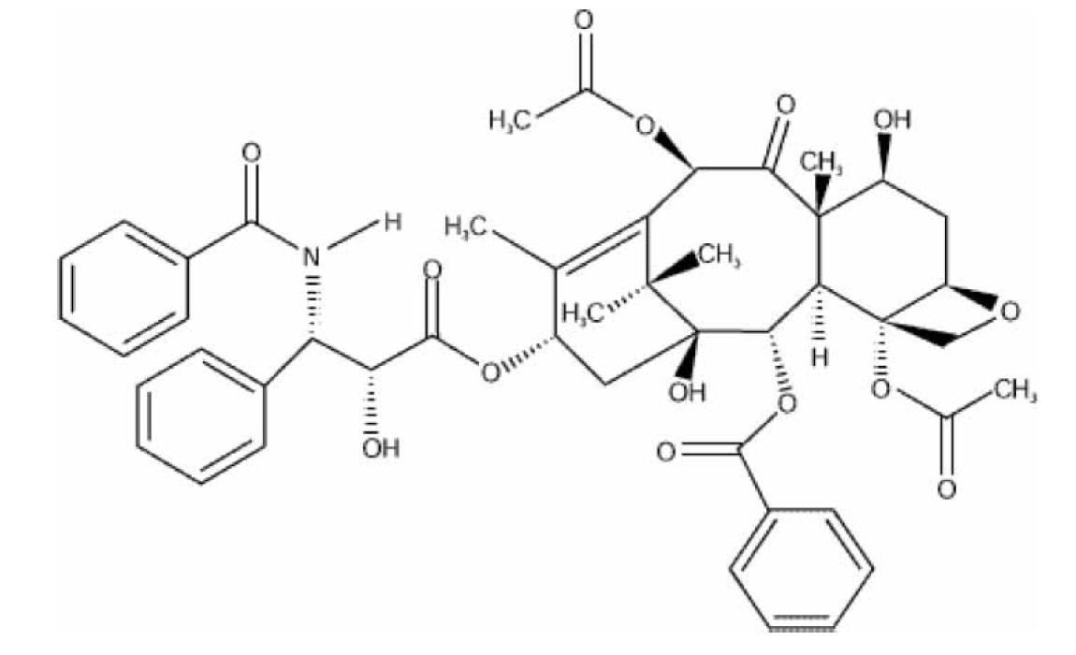
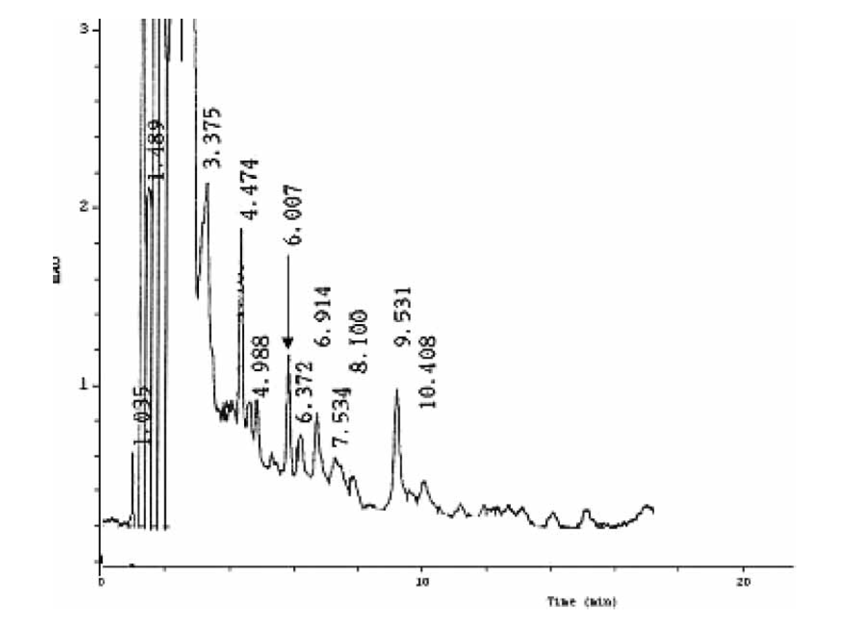
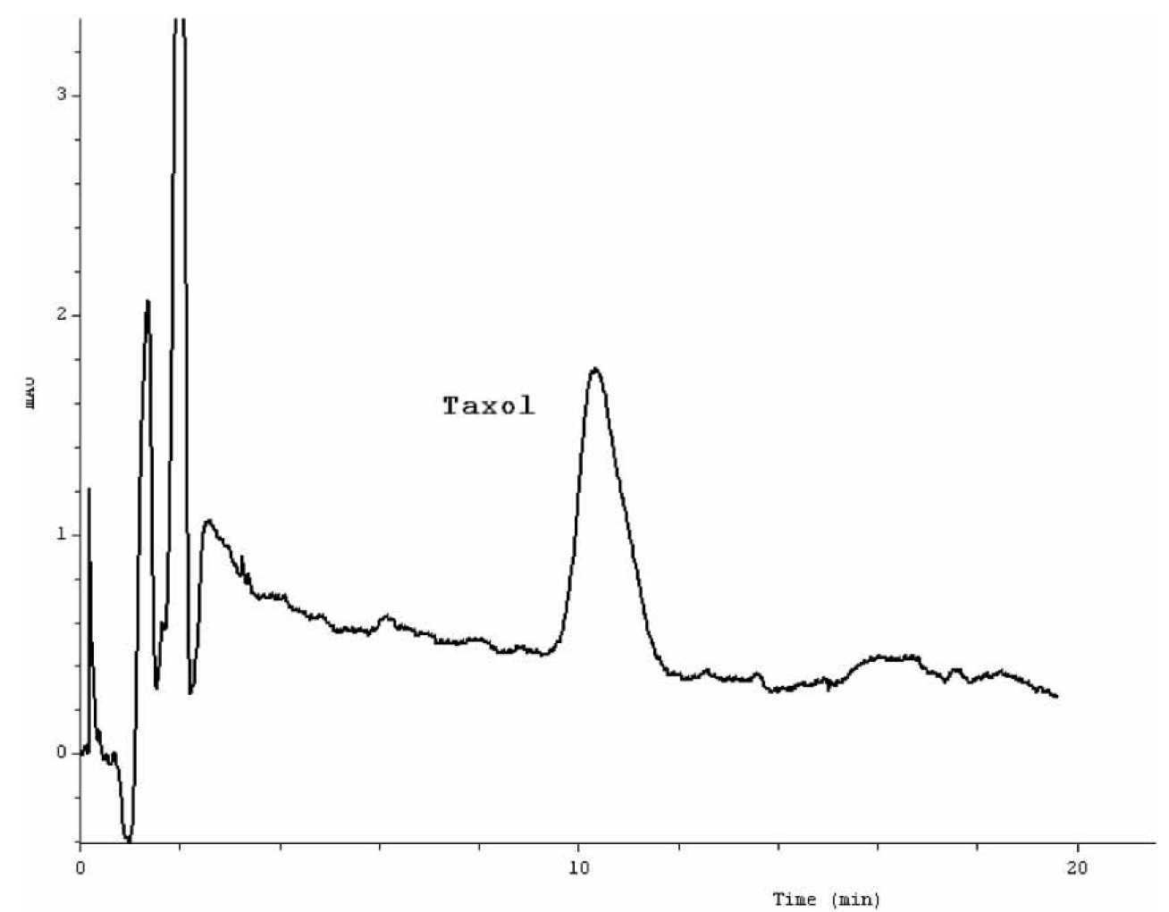
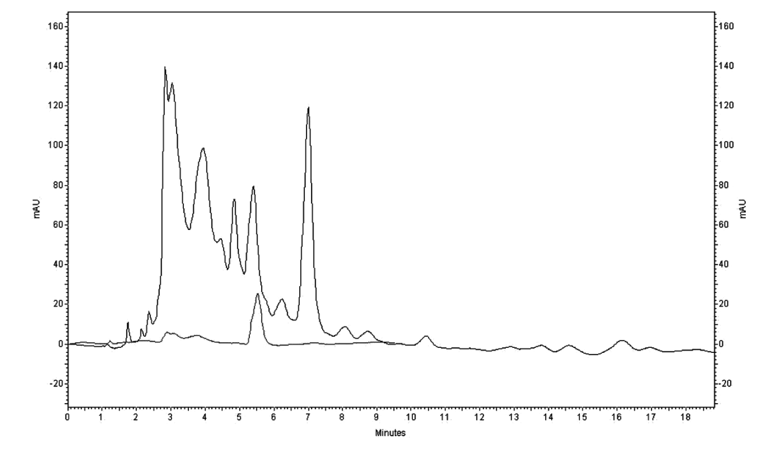
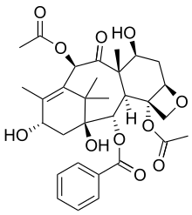
Paclitaxel structure
A. Ghassempour, et al., Journal of Liquid Chromatography & Related Technology, 31(2008) 382-394.
10-Deacetylbaccatin III structure
A. Ghassempour, et al., Journal of Liquid Chromatography & Related Technologies, 32, (2009) 1434-1447.

Slide 25
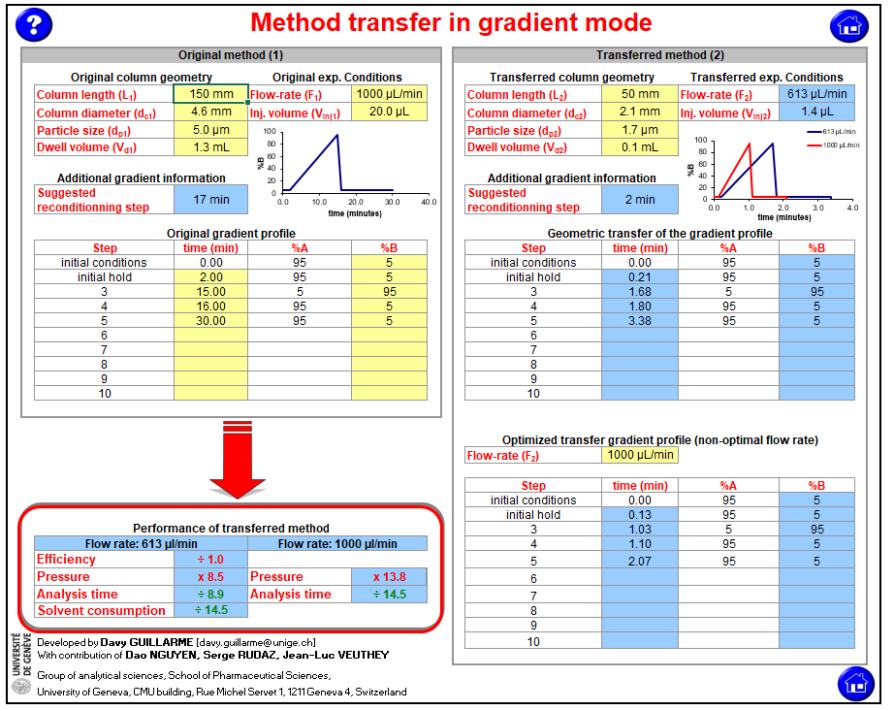
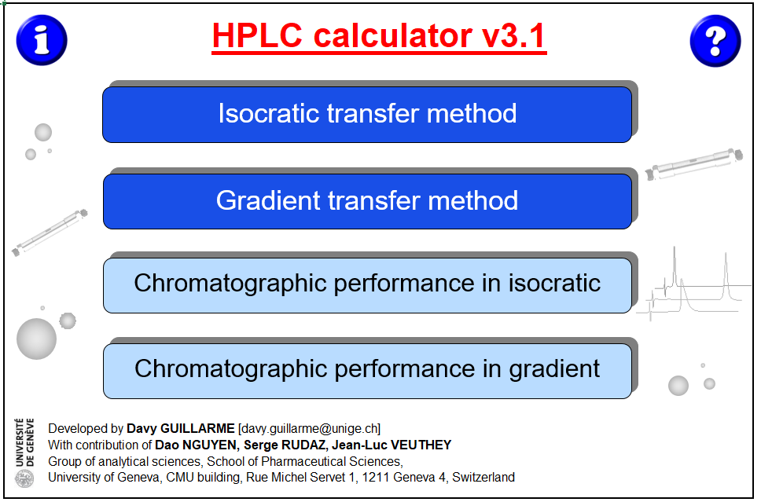
HPLC calculator: software for chromatographic performance evaluation and HPLC method transfer
https://ispso.unige.ch/labs/fanal/hplc_calculator:en

Slide 26
Analytical Optimization

Slide 27
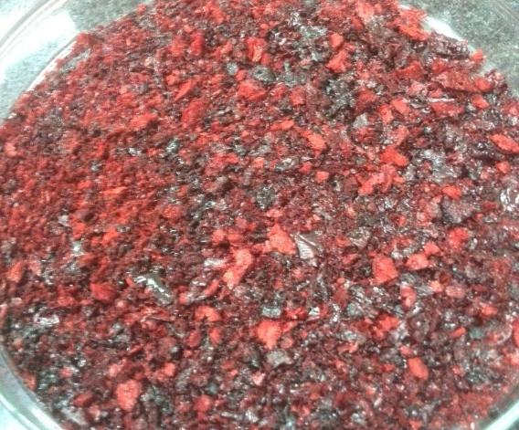
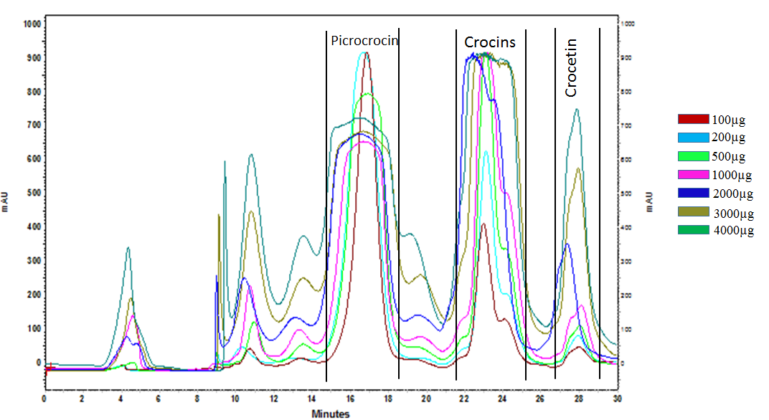
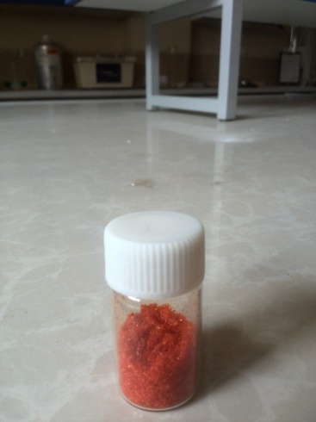
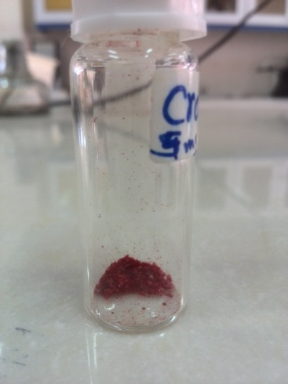
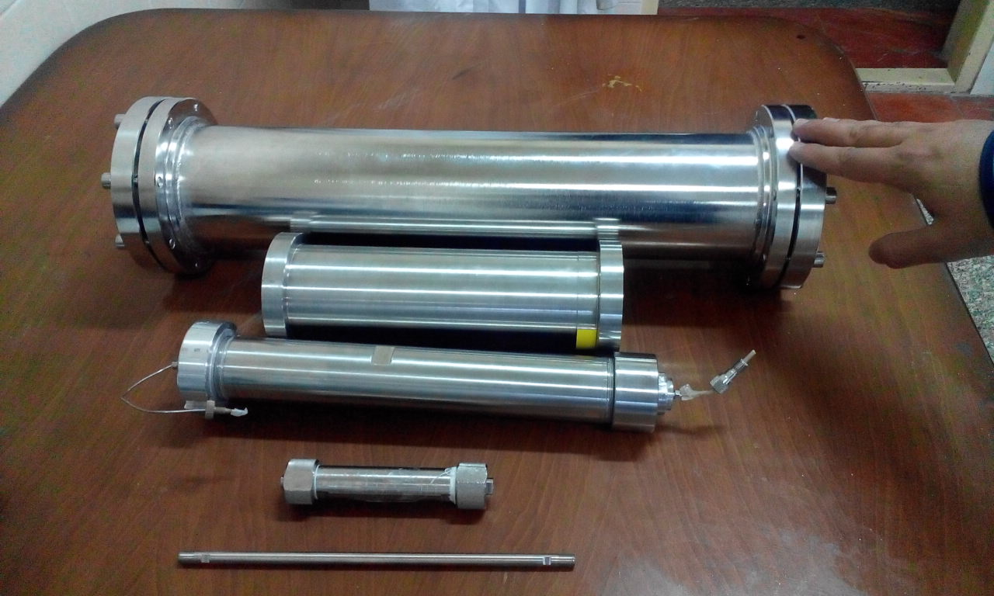
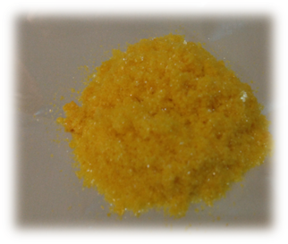
Preparative isolation optimization
Total extract
Total crocins
Crocin I
Picrocrocin

Slide 28
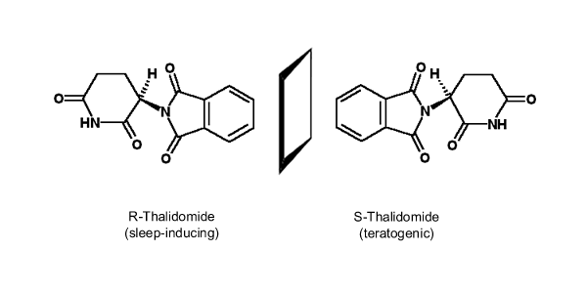

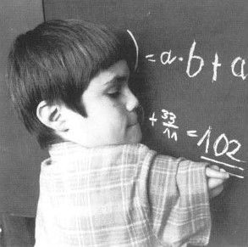
Thalidomide was widely marketed in over 46 countries as a sleep aid. Its use during pregnancy was responsible for over 10,000 children born with profound birth defects. Thalidomide would have been approved in the United States were it not for the vigilance of a medical officer, Frances O. Kelsey.
The public health catastrophe prompted stronger regulation (Kefauver–Harris Amendment of 1962) for demonstrating the safety of a product prior to marketing. Although it was commonly thought the toxicity resided solely with the S(−) form of thalidomide, several in vitro studies showed that the drug could racemize quickly in various aqueous media. Metabolic inversion has been observed with other compounds, such as 2-arylpropionic acid (2-APA) and mandelic acid.

Slide 29
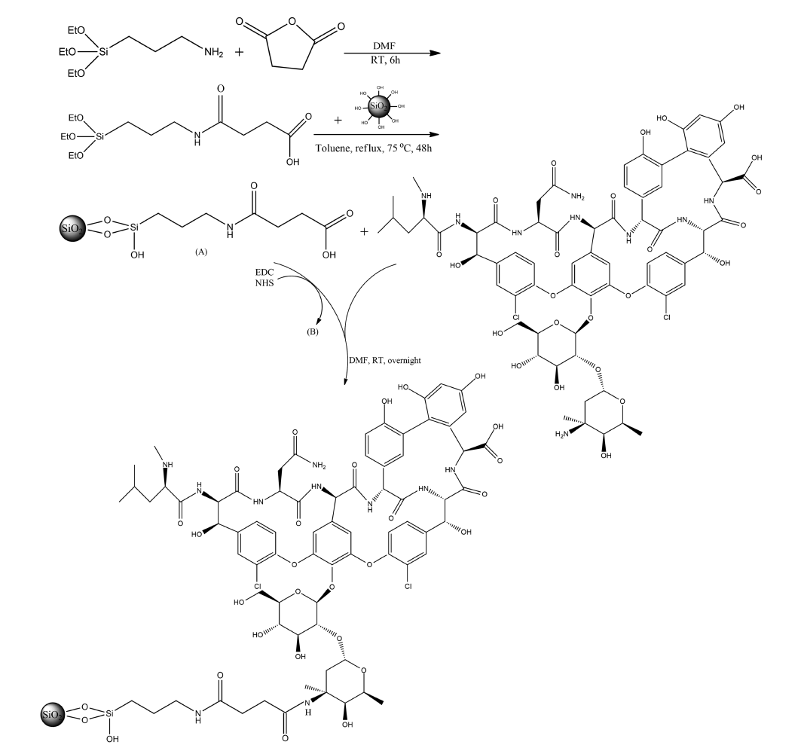
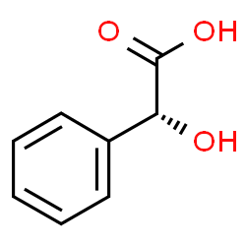
Mandelic acid
Synthesis of vancomycin chiral stationary phase

Slide 30
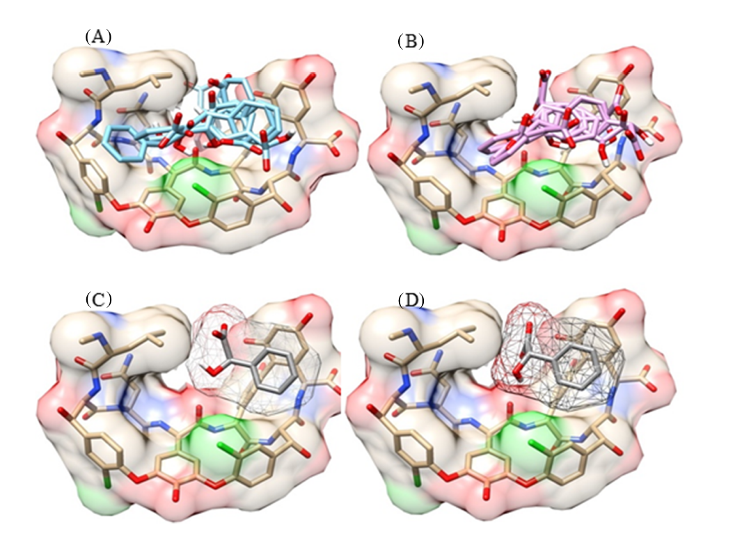
The docking result of mandelic acid with vancomycin. (A) Different available binding sites for R and (B) S mandelic acid
enantiomers. (C, D) The representative R and S ligands were compared. The molecular surface of vancomycin is colored by element

Slide 31
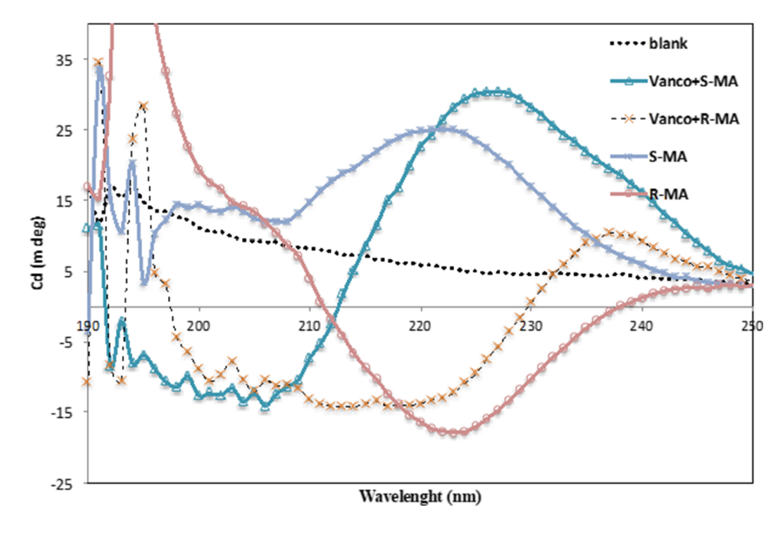
Circular dichroism (CD) spectra of vancomycin with mandelic acid enantiomers, (S)-(+)-mandelic acid (S-MA), (R)-(−)-mandelic acid (R-MA), and vancomycin (vanco)
M. Shahnani, et al, Chirality 2020, DOI: 10.1002/chir.23273

Slide 32
Three Scale Up Methods:
Stack Injection
Counter Current Chromatography
Simulated Moving Bed Chromatography (SMB)

Slide 33
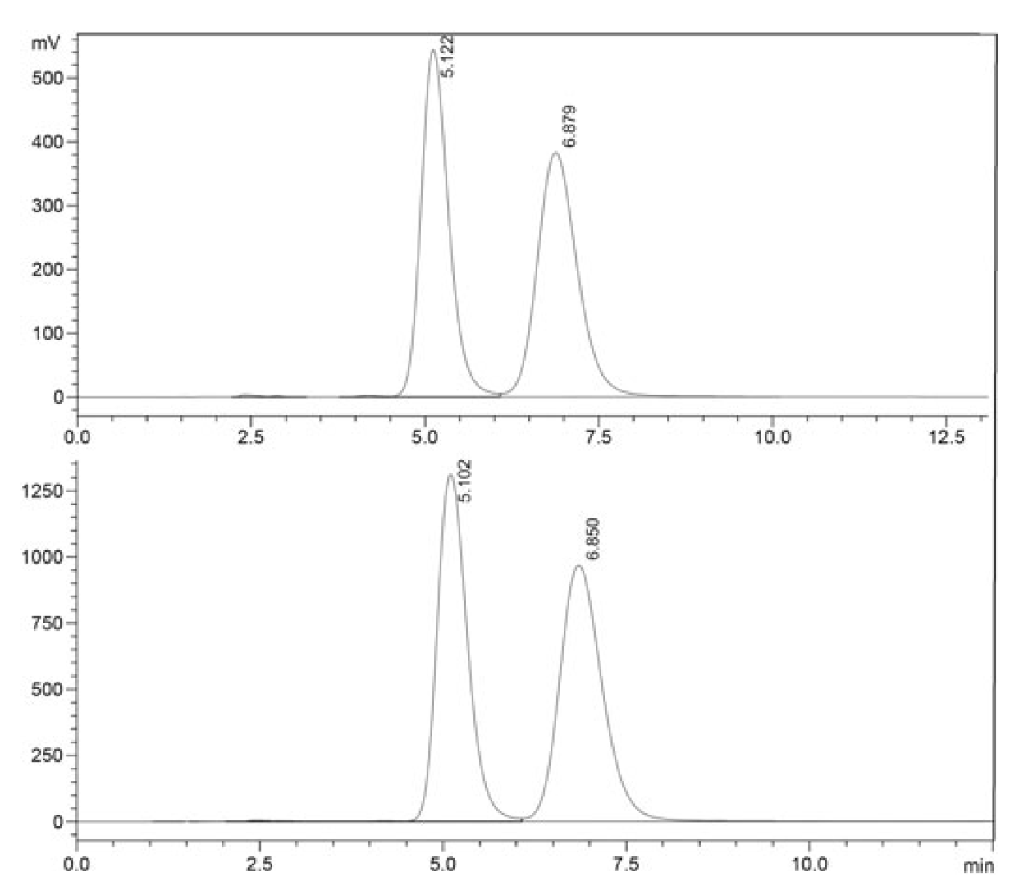
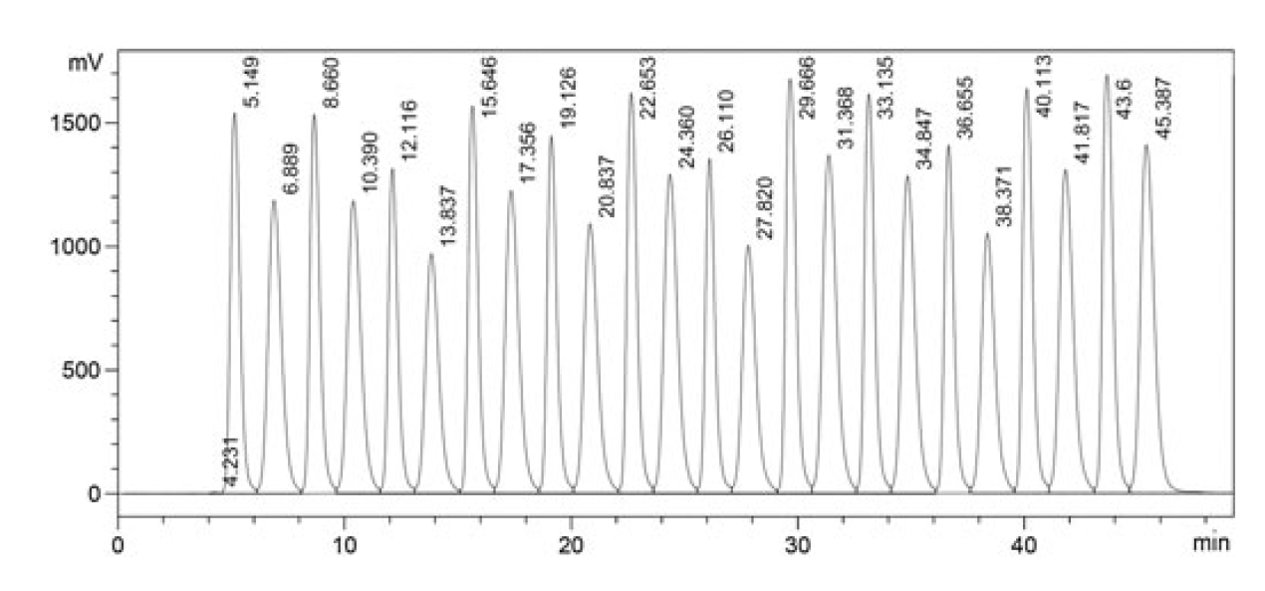
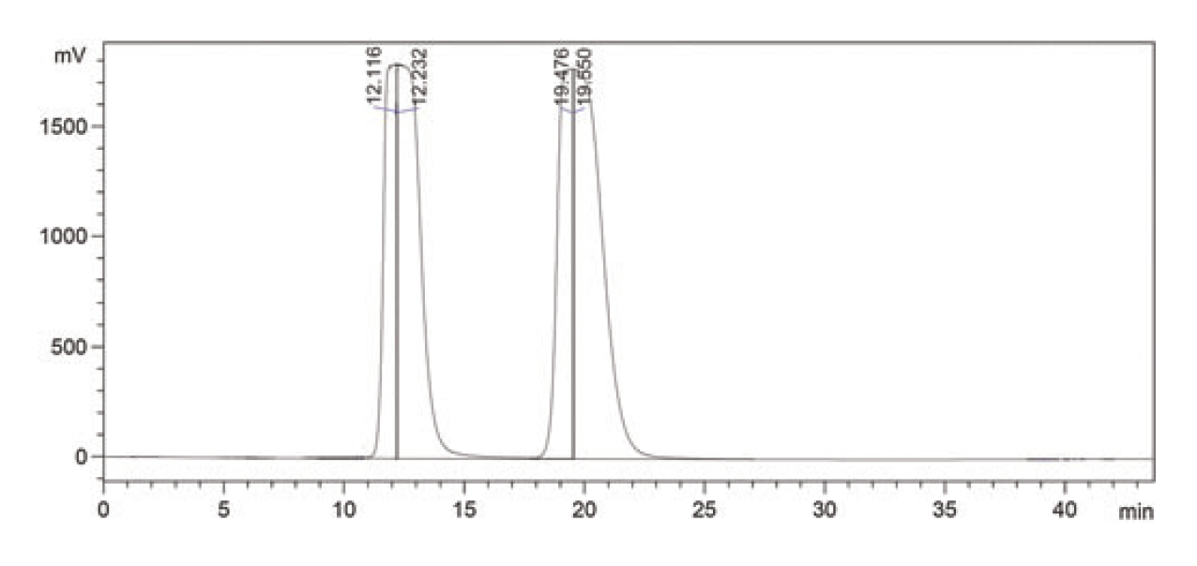
Chromatograms of 1000 ppm (up) and 3000 ppm (down) of propranolol in F = 1 mL min⁻¹ and MP composition of 40% 2‐propanol, 0.6% DEA, related to minimizing RT in Rs ≥ 1.7 (sample solvent was identical to the MP)
Chromatograms for 3000 ppm of propranolol in stacked injection mode (F = 1 mL min⁻¹ and MP composition was 40% 2‐propanol, 0.6% DEA in n‐hexane; sample solvent was identical to the MP)
Overloaded chromatogram for 20,000 ppm of propranolol in F= 1 mL min⁻¹ and MP composition of 10% ethanol
and 0.60% DEA in n‐hexane, related to maximizing Rs (sample solvent was identical to the MP)
M. Taheri, et al., Chirality 29 (10) (2017) 579-588.

Slide 34
Continuous Countercurrent Chromatography
Basic Principle
Feed
stationary column
Mobile Phase
A sample is injected in the centre of a stationary column
The two components move at different speeds and are separated
If we now move the column from right to left, at a speed halfway
between that of the solutes, they now move in different directions ...

Slide 35
Continuous Countercurrent Chromatography
Basic Principle
Feed
column
Mobile Phase
The two solutes now move in different directions relative to a stationary
observer. If the column is very long, the bands will continue to separate.

Slide 36
Continuous Countercurrent Chromatography
Basic Principle
Feed
column
Mobile Phase
If we continue to add sample at the center, the components will continue
to separate

Slide 37
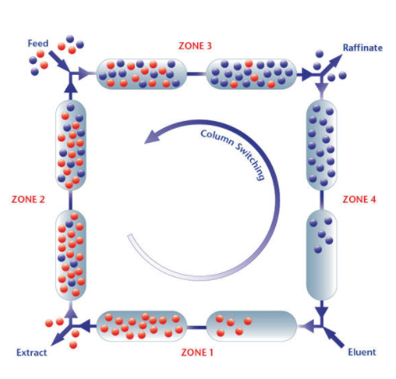
Simulated Moving Bed Chromatography (SMB)

Slide 38
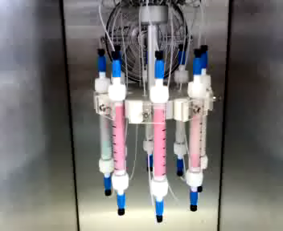

Slide 39

Thank you for your attention

