Slide 1
FPLC
Fast Protein Liquid Chromatography
or
Biochromatography
Alireza Ghassempour
Professor of Analytical Chemistry
Medicinal Plants and Drugs Research Institute
Shahid Beheshti University
Aug. 2022

Slide 2

Biopharmaceuticals - A Global Market Overview
2010-108 $ bln
2020- 497.9 $ bln
2013-199.7$ bln
Free Daily Biotech Industry Newsletter
Therapeutic proteins
Protein Interactions Group, Frederick National Laboratory for Cancer Research, National Cancer Institute, National Institutes of Health, Frederick, MD, USA.

Slide 3
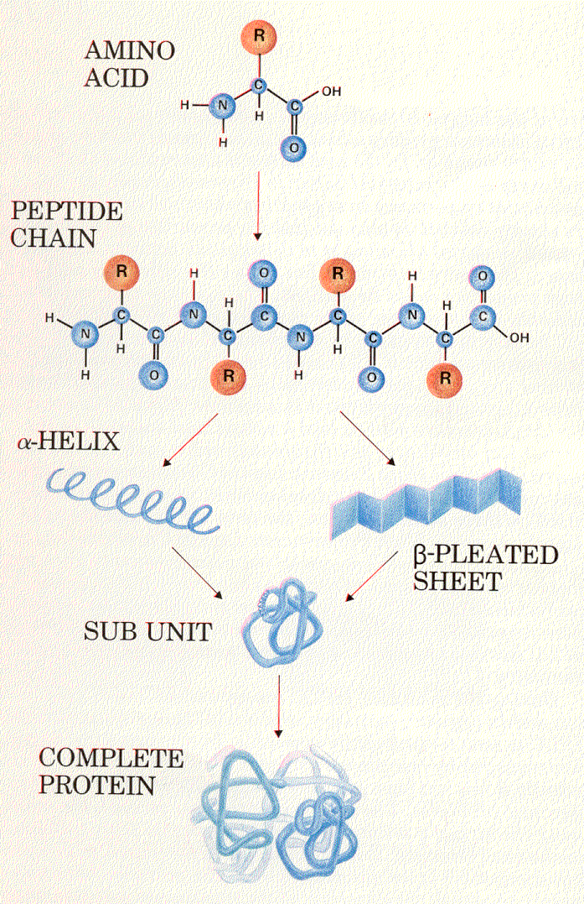
Separation and purification of biomolecules
(proteins, peptides, viruses) under native conditions

Slide 4
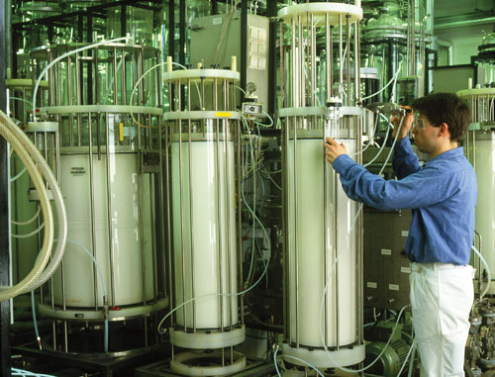
Downstream
Downstream Bottlenecks More than Just Perception
Downstream costs account for nearly 70% of total manufacturing costs
Affinity and bioaffinity chromatography which accounts for almost 35% of the total raw material costs for downstream purification.
It has been stated that over 60% of all purification techniques involve affinity chromatography

Slide 5
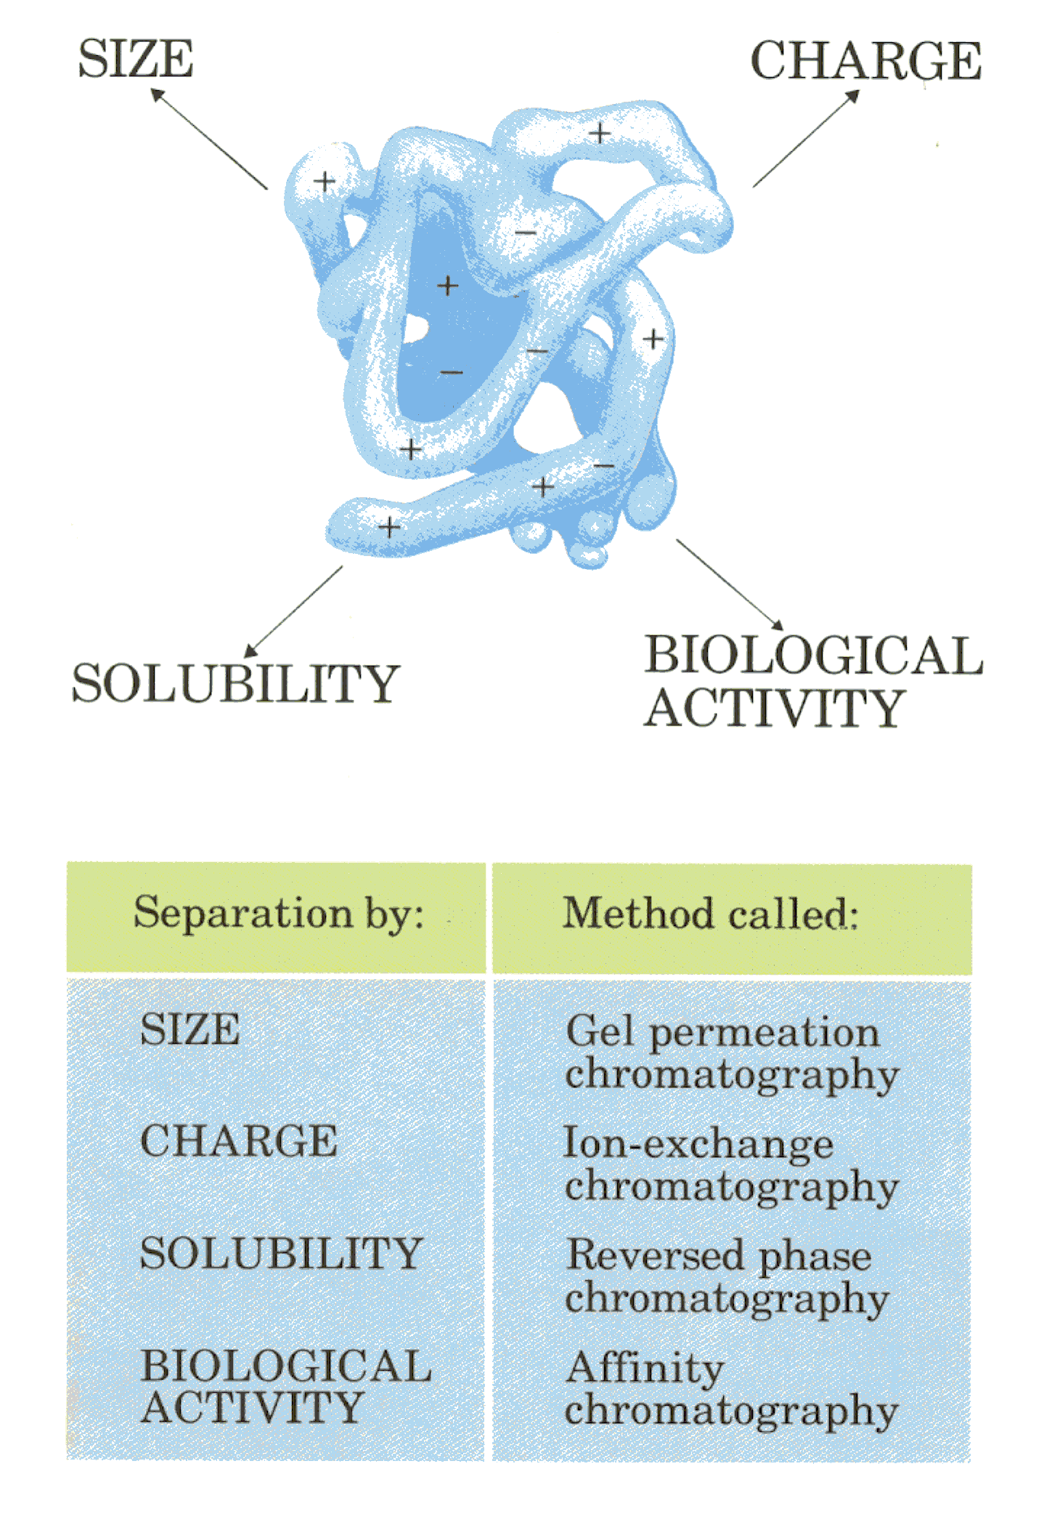

Slide 6
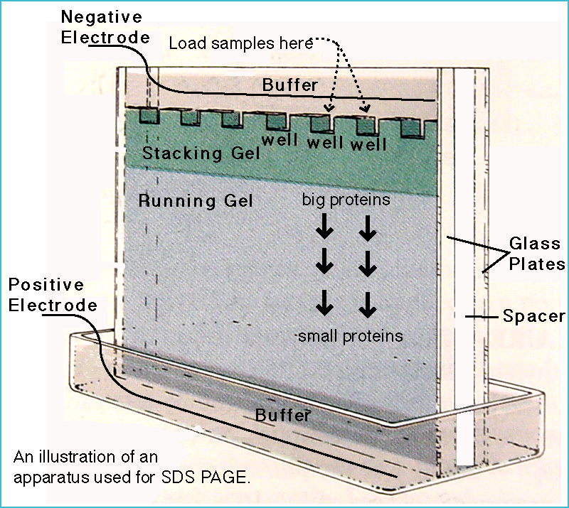
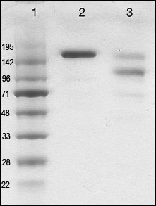
First step:
How can to check the identification and purity of biomolecule?
1st option: SDS-page
Results in
Quality control of human IgE preparation from hybridoma (lane 2) vs. IgE sample purified from myeloma patient serum (lane 3). MW markers are shown in lane 1.
ww2.chemistry.gatech.edu/.../page_protein.htmlFrame entfernen
www.abbiotec.com/image/human-ige-sds-page

Slide 8
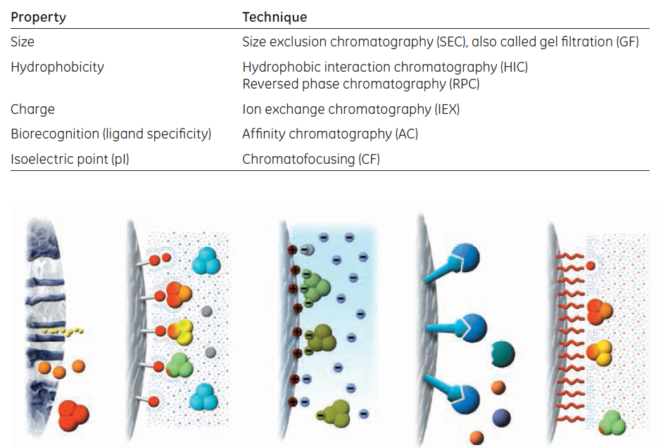
SEC
HIC
IEC
AC
RPC

Slide 9
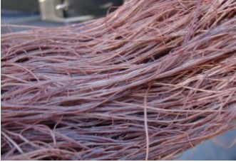
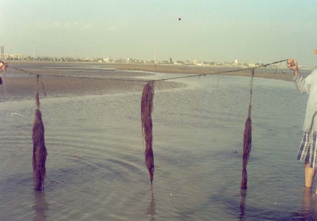
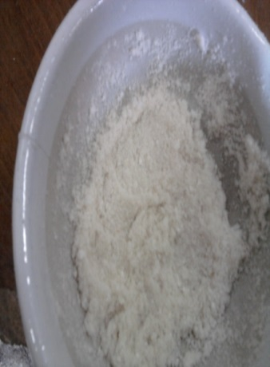
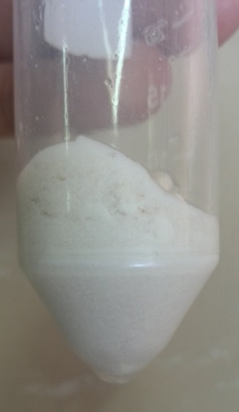
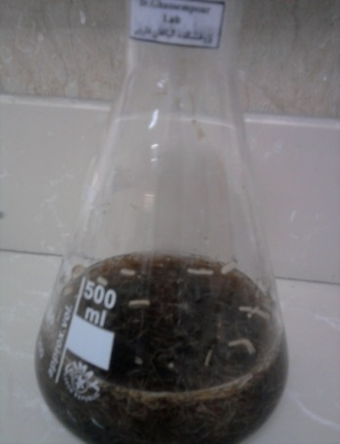
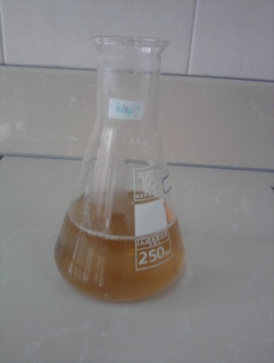
Algae
Agar solution
Agar powder
Agarose

Slide 10
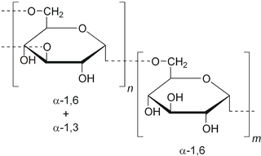
Agarose
Dextran

Slide 11
Sepharose
Sepharose is a bead-formed gel prepared from agarose. In its natural state agarose occurs as part of the complex mixture of charged and neutral polysaccharides referred to as agar. The agarose used to make Sepharose is obtained by a purification process which removes the charged polysaccharides to give a gel with only a very small number of residual charged groups.
Gel structure of agarose.
Cross linking by reaction with 2,3-dibromopropanol under strongly alkaline conditions
Sepharose CL

Slide 12
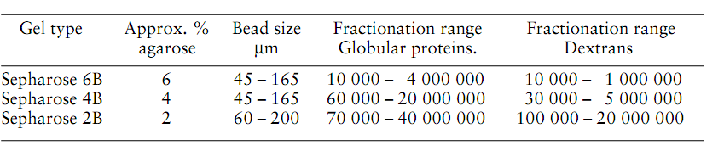
Sepharose

Slide 13
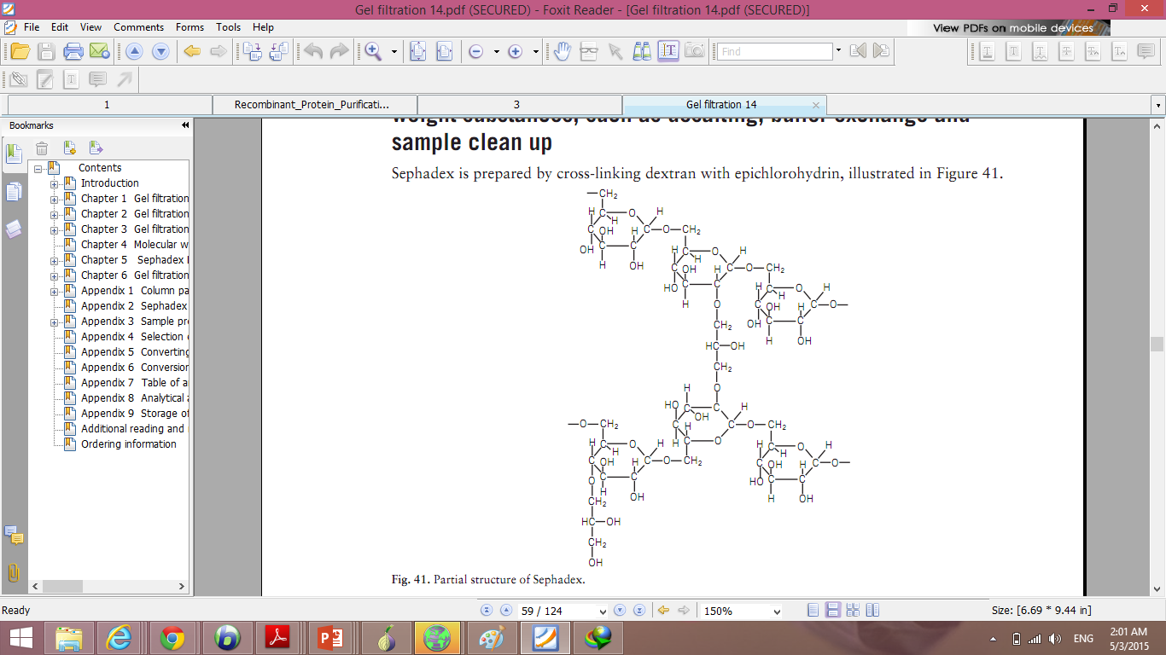
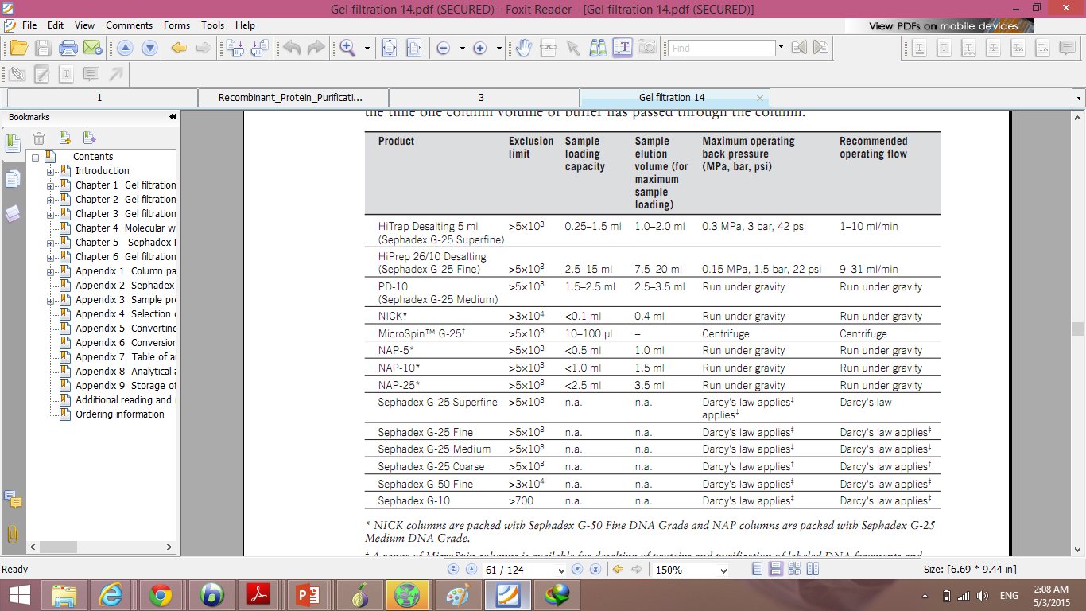
Sephadex

Slide 14
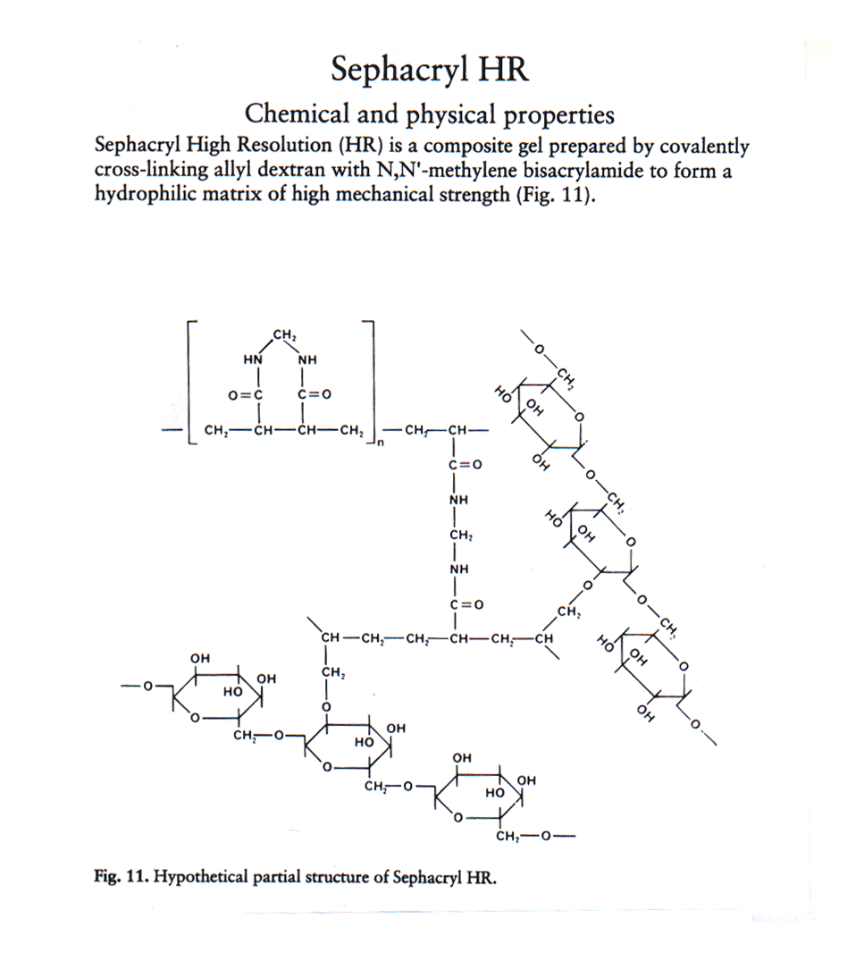
Sephacry HR (derivative of Sephadex)
Sephacryl High Resolution (HR) is a composite gel prepared by covalently cross-linked allyl dextran with N,N’ methylene bisacrylamide to form a hydrophilic matrix of high mechanical strength.

Slide 15
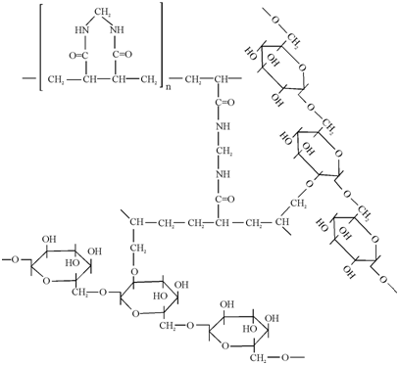
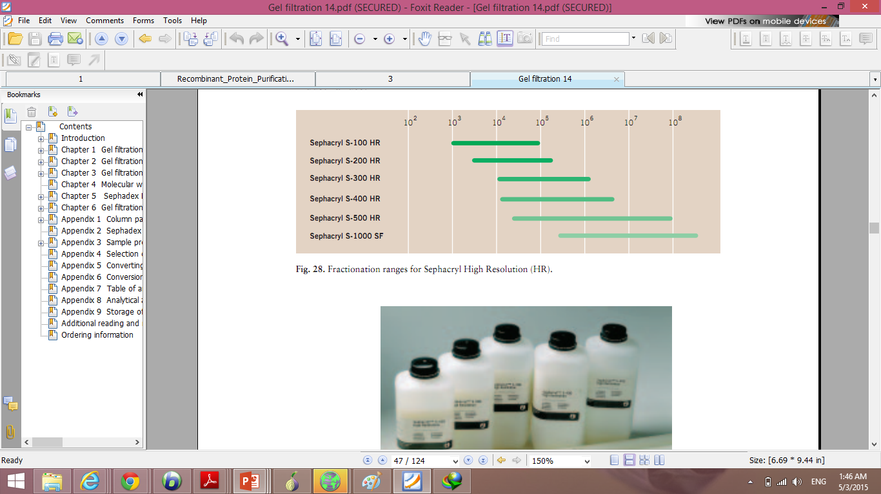
Sephacryl

Slide 16
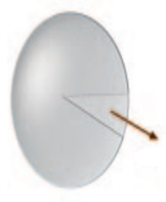
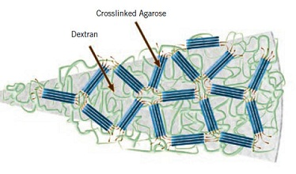
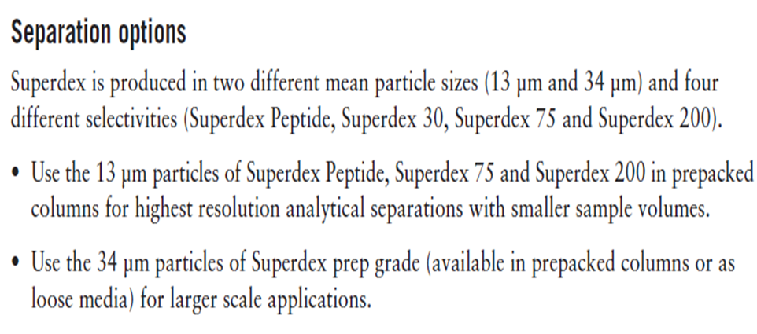
Superdex
Properties:
High capacity at high flow rates
High resolution with short run times and good recovery
Separations can be scaled up to production levels
Prepacked for convenience and reproducibility

Slide 17
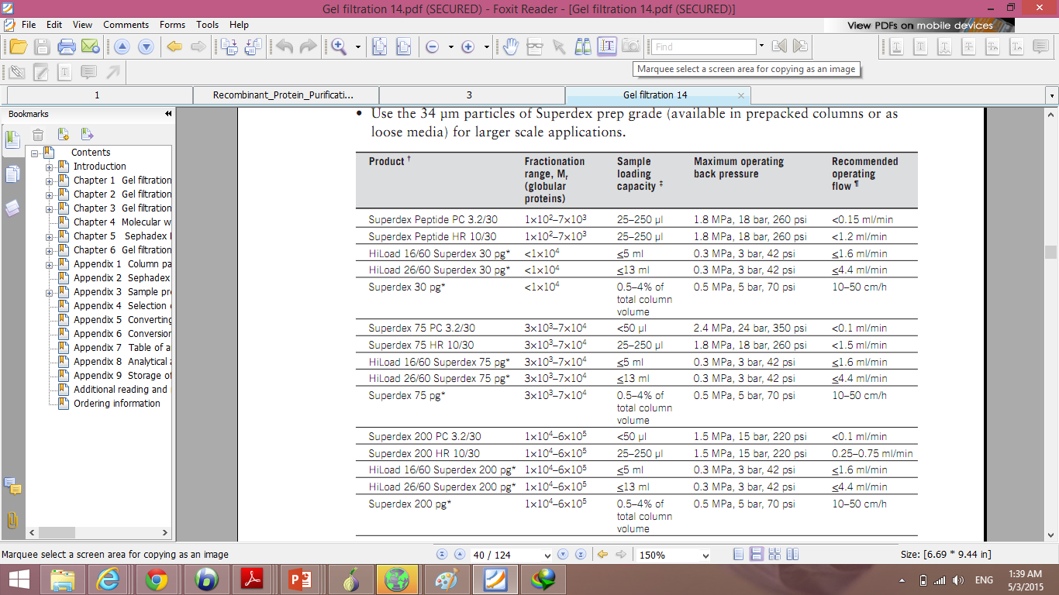
Superdex

Slide 18
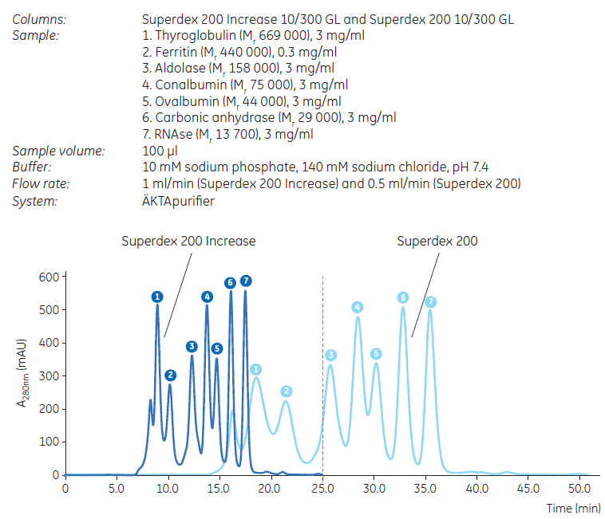
Comparison between Superdex 200 Increase and Superdex 200 (both in 10/300 GL column). Higher resolution and shorter run time is obtained using Superdex 200 Increase.

Slide 19
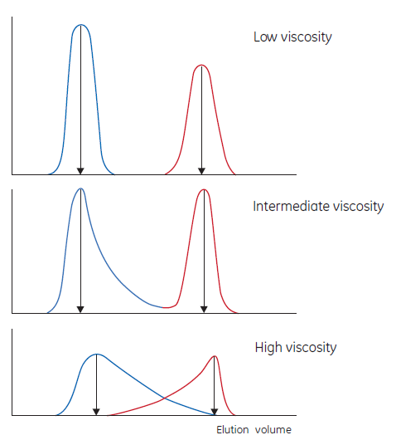
Deteriorating separation caused by increasing viscosity. Elution diagrams obtained when hemoglobin (blue) and sodium chloride (red) were separated. Experimental conditions were identical except that the viscosities were altered by the addition of increasing amounts of dextran.
Use up to 300 mM sodium chloride to avoid nonspecific ionic interactions with the matrix which can be seen as delays in peak elution. Note that some proteins can precipitate in low ionic strength solutions.
Volatile buffers such as ammonium acetate or ammonium bicarbonate should be used if the separated product will be lyophilized.

Slide 20
Siz Exclusion Chromatography (SEC)
and
Gel Permission Chromatography (GPC)

Slide 21
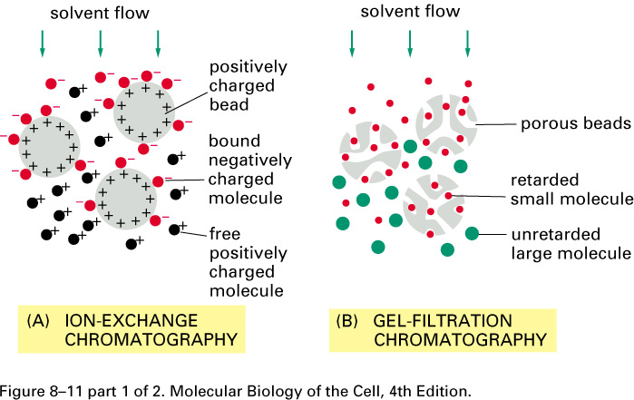
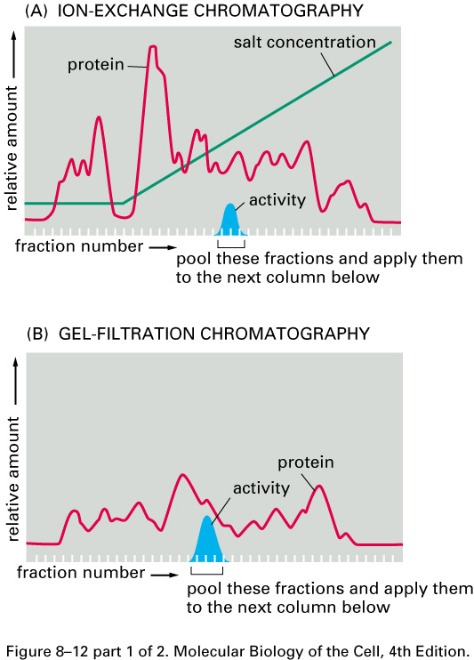
Small molecules diffuse into the gel pores and their flow through the column is retarded
large molecules do not enter the pores and are rapidly eluted in the column's void volume.
separation depends on the difference in the ability of various molecules to enter the pores
molecules separate based on their size as they pass through the column and are eluted in order of decreasing molecular weight.
By varying the degree of cross-linking the gels are optimized for different molecular weight ranges.
Resolution depends on particle size, pore size, flow rate, column length and diameter, and sample volume.
Common applications
fractionation and molecular weight determination of proteins, nucleic acid separation, plasmid purification and polysaccharide fractionation.

Slide 22
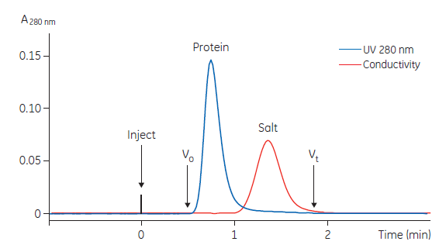
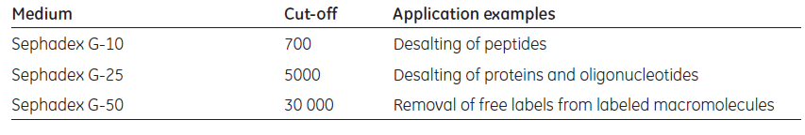
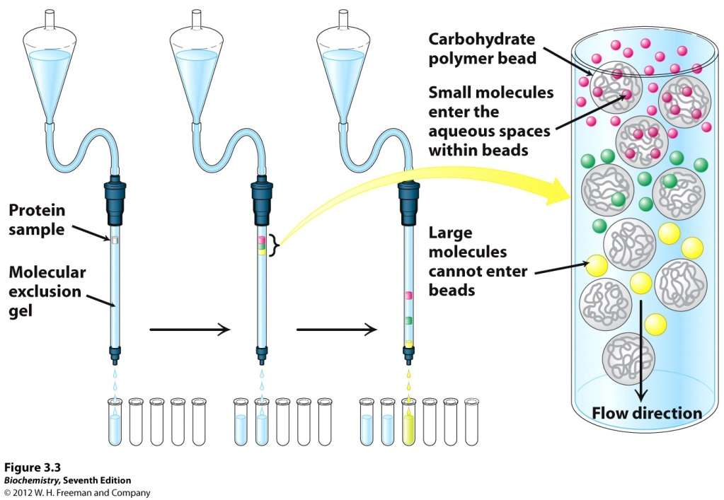
1. Group separations:
Sephadex G-10, G-25, and G-50 are used for group separations.

Slide 23
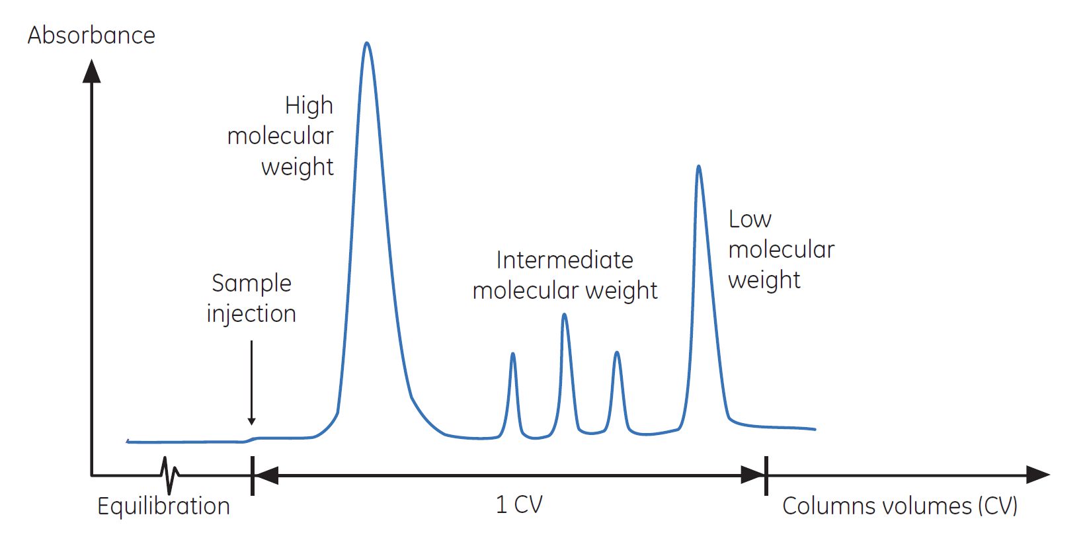
2. High-resolution fractionation of biomolecules:
For group separations, use sample volumes up to 30% of the total column volume.
For high-resolution fractionation, a sample volume from 0.5% to 4% of the total column volume is recommended, depending on the type of medium used.

Slide 24
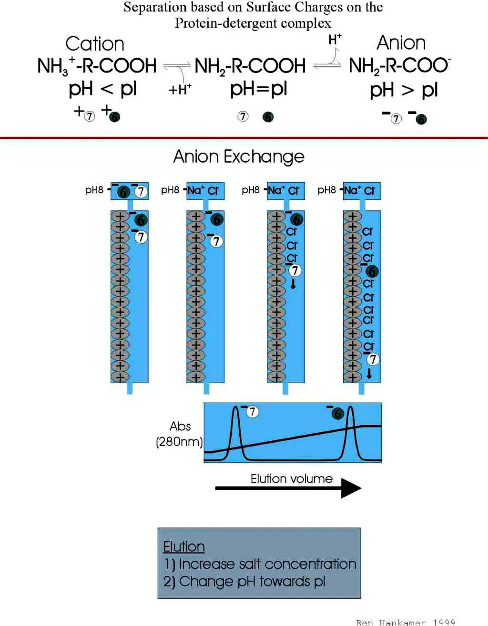
Ion Exchange Chromatography (IEC):
The column contains charged groups that can bind sample ions of opposite charge, and the mobile phase is usually an aqueous solution of a salt plus buffer; IEC is useful for separating ionizable samples such as acids or bases, and especially for the separation of large biomolecules (e.g., proteins and nucleic acids).

Slide 25
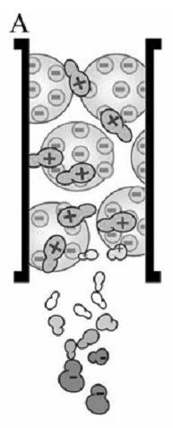
Ion exchange chromatography
Separates compounds based on their net charges
Negatively or positively charged functional groups are covalently bound to a solid support
type of charged group one choses depends on the net charge of the protein which in turn depends on the pH
IEC is the most commonly used technique today for the separation of macromolecules
1. Equilibration of the ion exhanger in a buffer in such a way that the molecule(s) of interest will bind in a desirable way.
2.a) Solute molecules carrying the appropriate charge are bound reversibly to the gel.
b) Unbound substances are washed out with the starting buffer.
3. Elution with a gradient of e.g. NaCl
4. Substances that are very tightly bound are washed out with a concentrated salt solution

Slide 26
Different Parts of FPLC instrument
A standard FPLC consist of:
1. Pump
2. Internal computer
3. Monitor
a) UV and Conductivity flow cells b) Conductivity meter
4. Mixer
5. Injection Valve
6. Sample loop
7. Column
8. UV detector
9. Fraction collector
10. Flow Restrictor
11. Plotter
12. On-line Filter

Slide 27
Comparison
Like HPLC, FPLC has:
Pump
Mixer
Injection Valve
Sample loop
Column
UV detector
ÄKTA FPLC
Monitor :
UV
Conductivity
pH
Mixer
Filter
Gate
But:
Monitor
Fraction collector
Flow Restrictor
UV and Conductivity flow cells
pH meter
Injector
Flow Restrictor
Pump A
UV Flow cell
Pump B
Conductivity flow cell

Slide 28
Pump
can run a constant percentage of two combined buffers or a gradient between the two buffers over time
flow rate :
a few mL.min⁻¹ L.min⁻¹
(in bench-top systems) (for industrial scale purifications)
The wide flow range makes it suitable both for analytical and preparative chromatography

Slide 29
Monitor
monitoring module measures and reports:
UV/Vis absorption, pH, and conductivity in liquid flow cells
It consists of :
control unit
optical unit with lamp assembly
two flow cells, a conductivity flow cell with temperature sensor, and a pH flow cell with pH electrode
UV and Conductivity flow cells
Depending on the sample amount applied and the size of the column, the type of UV flow cells are determined.
UV
Cond.
pH

Slide 30
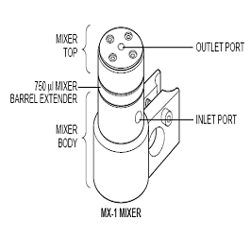
Conductivity meter
The conductivity meter is the small black tube connected after the UV detector.
It is also adjusted from a small unit above the main FPLC computer.
NaCl is an electrolyte
Mixture
Powered and controlled from the pump.
All buffers used are mixed in a single chamber.
Three interchangeable mixing chambers are used for optimal mixing over the entire flow rate range.

Slide 31
Injection Valve
The pumps are connected to valves which send the buffers in the desired direction
three different operating positions are used:
Load position: filling a loop with sample or running buffer to a column.
Injection position: injecting contents of the sample loop onto a column
Purge position: purging lines to waste without removing the column from the system.
All the samples are loaded by a syringe into the sample loop.
Sample loop
come in a variety of sizes based on your sample size
Use the sample loop closest to the volume of your sample.
There are 25 µL, 50 µL, 100 µL, 200 µL, 500 µL and 8mL sample loops.

Slide 32
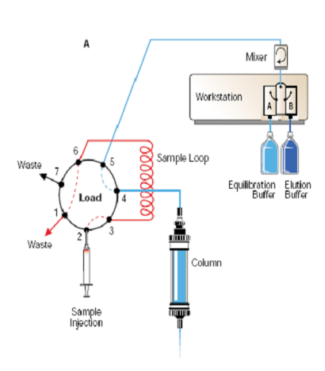
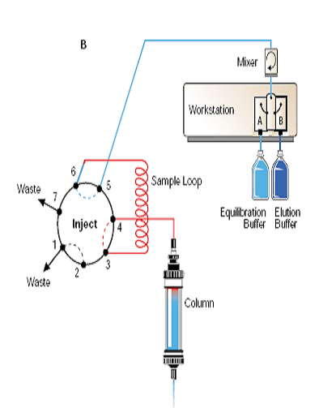

Slide 33
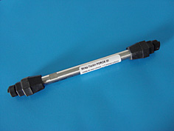
Column
There are various columns used in FPLC
Columns used with an FPLC can separate macromolecules based on:
Size: gel filtration (size exclusion)
charge distribution: (ion exchange)
Hydrophobicity: (hydrophobic interaction)
biorecognition (as with affinity chromatography)
The columns used in FPLC are:
large (mm id) tubes that contain small (µm) particles or gel beads as stationary phase
The chromatographic bed is composed by the gel beads inside the column

Slide 34
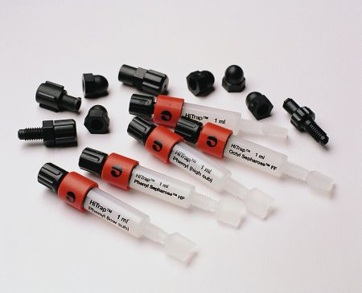
A resin is used in a column
The resin binds to certain proteins
There are different resins for different substances you want to purify
stationary phase employed range from large bead resins (good for fast flow rates and little to no sample clarification at the expense of resolution) to small bead resins (for best possible resolution with all other factors being equal)

Slide 35
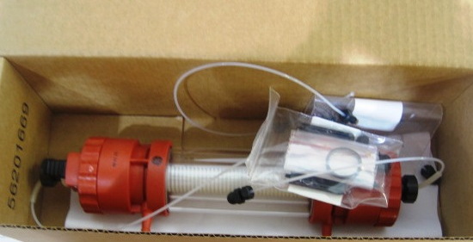
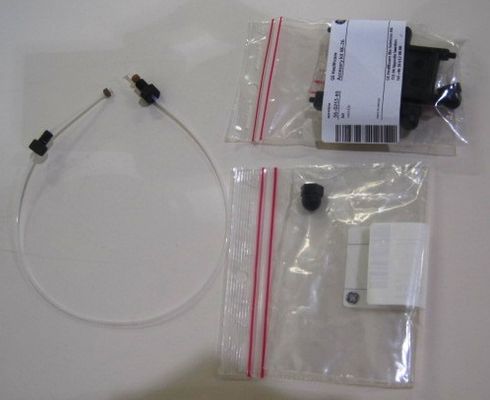
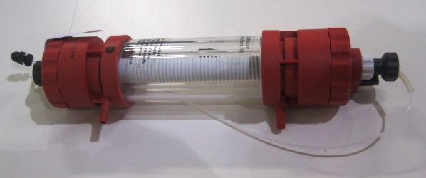
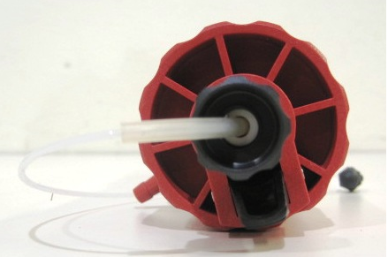
$733.59

Slide 36
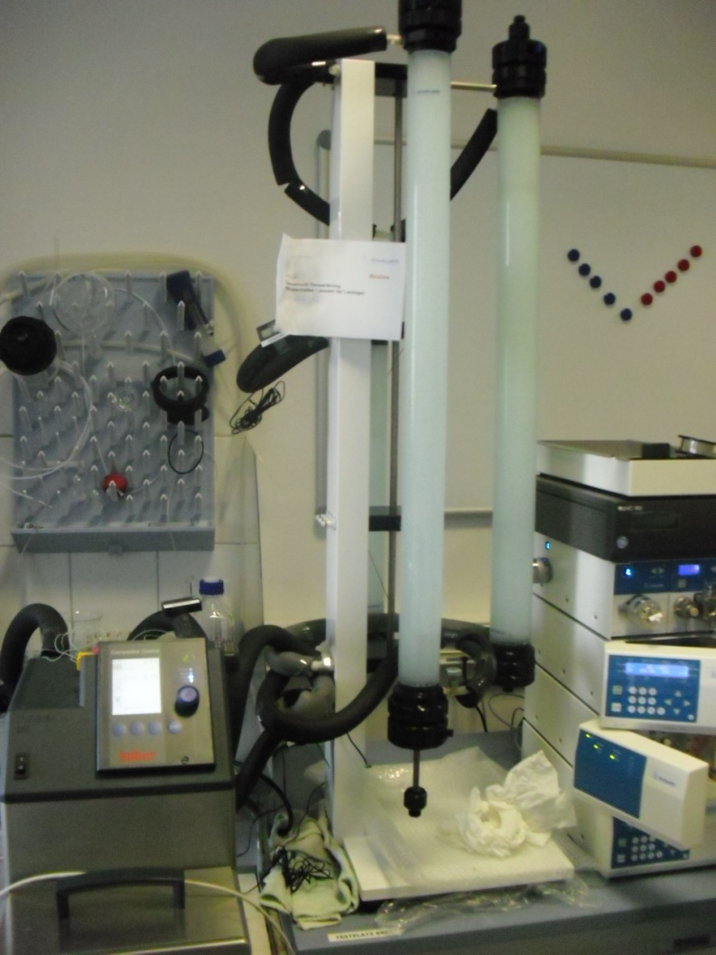

Top feature: benchtop cooling
Cooling by liquid is re-
liable and cost effective
→ complete benchtop
cooling at 4° ±1°C

Slide 37
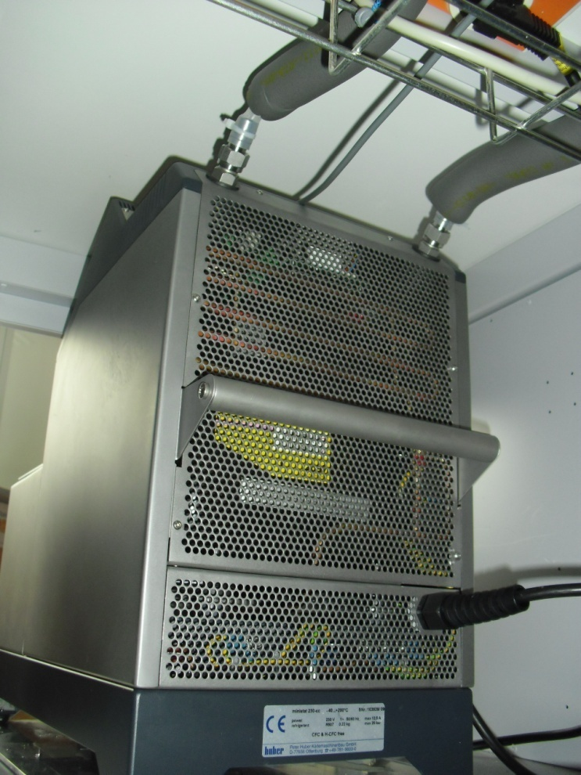
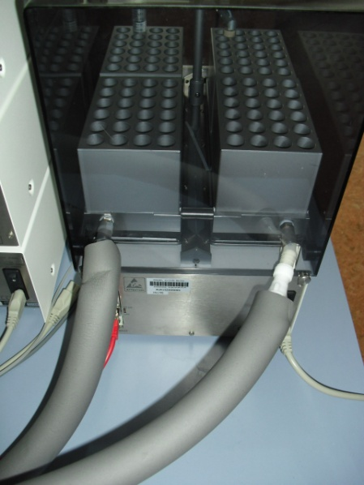
Strategies for system cooling

Slide 38
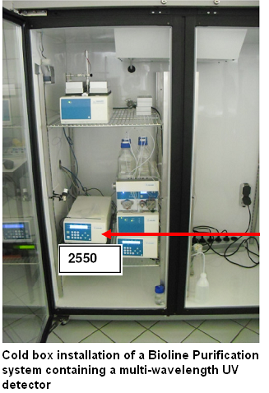
Strategies for system cooling
Cold room
Cold box

Slide 39
Top feature: Column technology: Bioline with KNAUER Biofox = pressure filling
Notes:
39

Slide 40


Razi Vaccine and Serum Research Institute
Medicinal Plant and Drug Research Institute
Purification Non-Structural Proteins (NSP) from Free Foot and Mouth (FMD) Virus

Slide 41
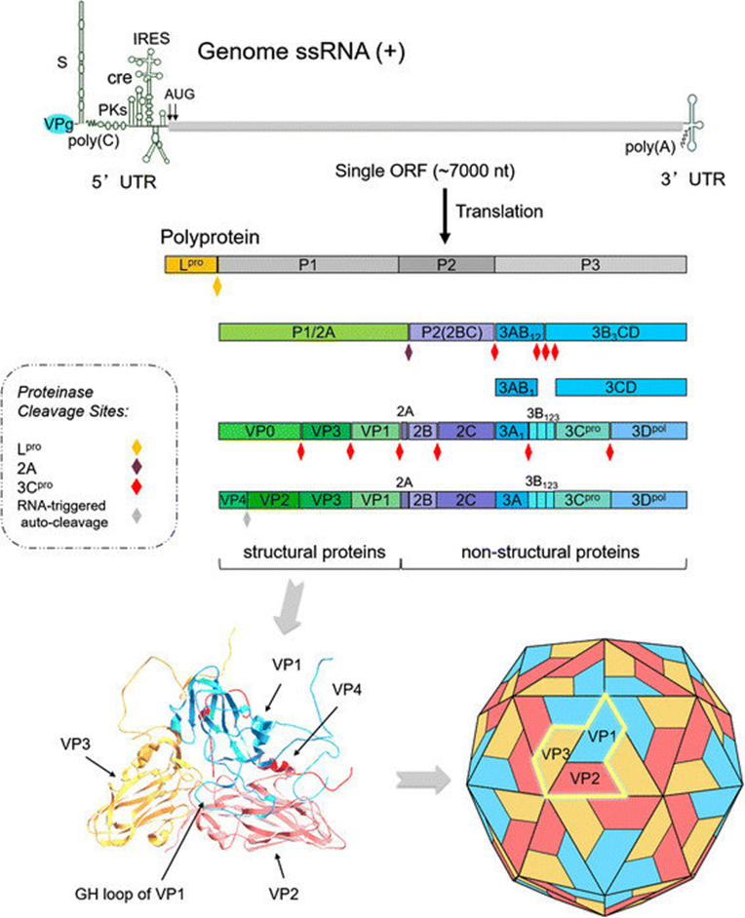
The FMDV genome consists of about 8,200 nucleotides and has the following 3 components: a 5′-untranslated region (5′-UTR), an open reading fragment (ORF), and a 3′-UTR.
The ORF encodes a polyprotein (4 structural and 11 non-structural proteins) that forms the following 4 fragments after the primary cleavage: the L (inhibits guest protein synthesis), the P1-2A, the P2BC, and the P3.
After the secondary cleavage and the maturation cleavage, 4 structural proteins (VP4, VP2, VP3, and VP1) and 8–9 non-structural proteins (Lab/Lb, 2A, 2B, 2C, 3A, 3B1, 3B2, 3B3, 3C, and 3D) are formed.
The FMDV particle is roughly spherical in shape and about 25–30 nm in diameter. It consists of the RNA genome surrounded by a protein shell or capsid.
The capsid is composed of 60 copies of the capsomers which having a relatively smooth surface.
Each capsomer consists of four structural polypeptides, VP1, VP2, VP3 and VP4.
The VP1, VP2 and VP3 are exposed on the surface of the virus while VP4 is located internally.
The G-H loop of VP1 constitutes a major antigenic site and also contains the conserved RGD (Arg-Gly-Asp) triplet critically involved in binding to cellular receptors of the integrin family, including αvβ3.

Slide 42
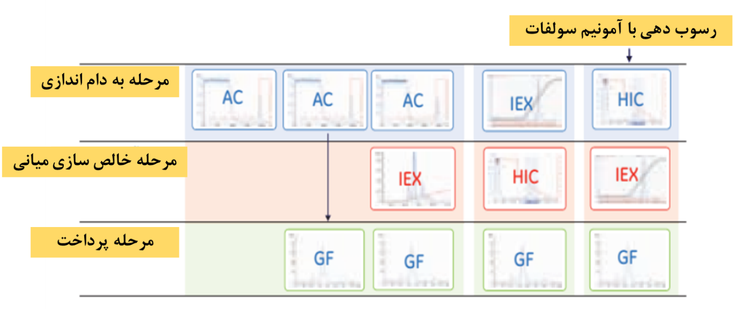
Downstream Processing in Vaccine Production
Ammonium sulfate Precipitation
Capturing Step
Intermediate Step
Polishing
Step

Slide 43
Dynamic Binding Capacity and Virus Recovery on Different Chromatography Supports for Different Virus (-like) Materials.

Slide 44
A Snapshot of 2D-IEX×SEC Approach for Purification FMDV Vaccine
Capturing Step
Sephacryl S-400 HR
Capturing Step
Q-Sepharose Virus licensed
Intermediate Concentration Step
Ultrafiltration
Intermediate Concentration Step
Ultrafiltration
Final Polishing Step
Superdex 200 perep grade
Final Polishing Step
Superdex 200 perep grade

Slide 45
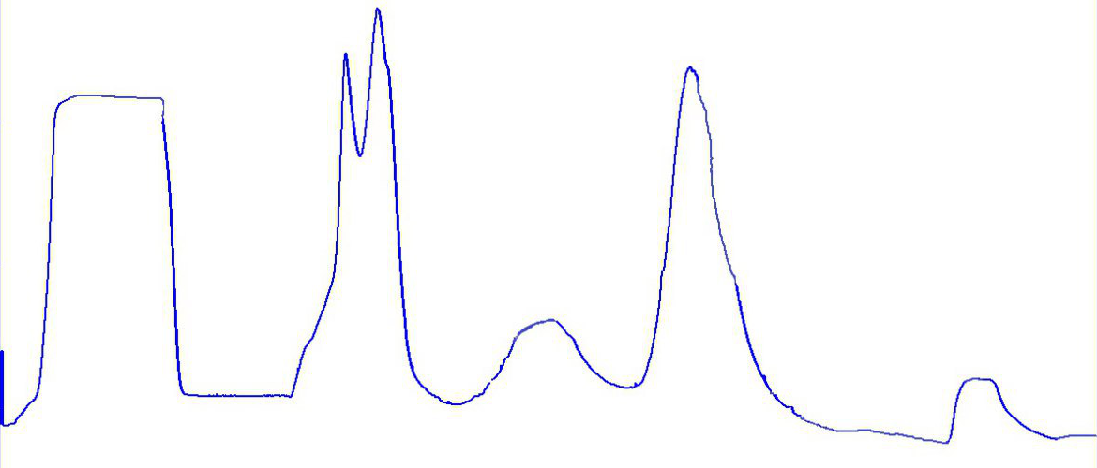
Performance of Ion-exchange Chromatography for Capturing Step
200
Collected fraction
150
(mAU)
100
Absorbance
50
0
0
50
100
Time
(min)
150
200
Volume of injection: 50 ml
Column type: XK (1.6×400 cm)

Slide 46
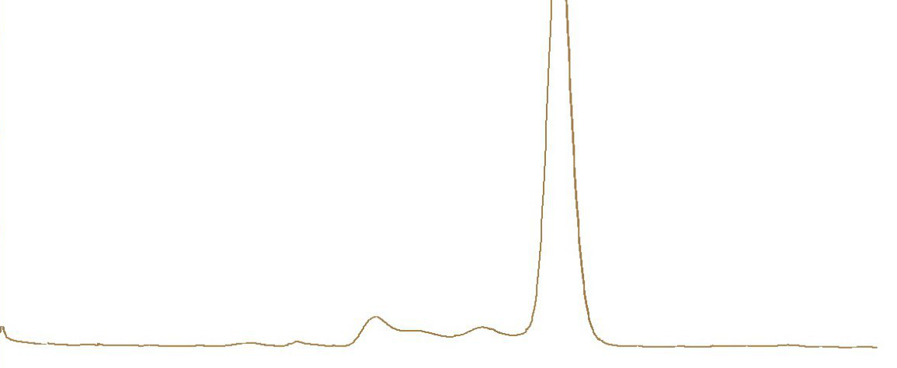
Performance of Sup-200 prep grade for Final Polishing Step
BSA
Volume of injection: 4 ml
Column type: XK (2.6×600 cm)
150
(mAU)
100
Absorbance
50
Virus
rDNA
Immunoglobulins
0
0
20
40
Time
(min)
80
100
120

Slide 47

Fingerprint HPLC Elution Profiles of FMDV During Purification Procedure
BSA & Immunoglobulins
100
Low molecular weight impurities
Virus
(mAU)
50
Absorbance
rDNA
0
0
10
15
Time
(min)
20
25
30

Slide 48



Characterizing Purified Foot and Mouth Diseases Virus Particles
by
2D-IEX×SEC
A
B
C
Density distribution
Particle Size/ nm
TEM
SDS-PAGE
DLS

Slide 49
A Snapshot of Performance 2D-IEX×SEC Approach for Purification FMDV Vaccine
Capturing Step
Q-Sepharose Virus licensed
Results
Volume of Injection: (100 ml)
Virus yield: 70 %
Purity of the Final product: 85%
Intermediate Concentration Step
Ultrafiltration
Final Polishing Step
Superdex 200 perep grade

Slide 50

Scale Up of SUP-200 Prep Grade for Final Polishing Step
[mAU]
500
97.4
400
300
4
Absorbance
200
78.2
100
112.0
0
Collected fraction
-100
60
80
100
Time
120
140
160
[min.]

Slide 51


Fingerprint HPLC Elution Profiles of FMDV During Purification Procedure
[mAU]
BSA & Immunoglobulins
Column: OHpak SB-805 HQ
200
10.12
100
Virus
Low molecular weight impurities
Absorbance
rDNA
15.60
0
7.37
16.77
21.47
-100
0
5
10
15
20
25
Time
[min.]

Slide 52



MALDI-TOF-MS Profiles of Pure FMDV Antigens
8713.8164
9071.8516
14006.8964
27987.2598
54032.1289
67576.2969

Slide 53

Thank you for your attention

