Slide 1


Slide 2

Preparative Liquid Chromatography
Alireza Ghassempour
Professor of Analytical Chemistry
Medicinal Plants and Drugs Research Institute
Shahid Beheshti University
Aug. 24, 2022

Slide 3
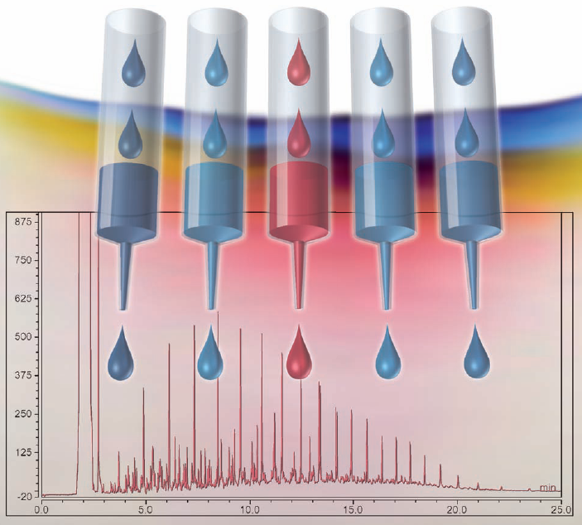

Slide 4
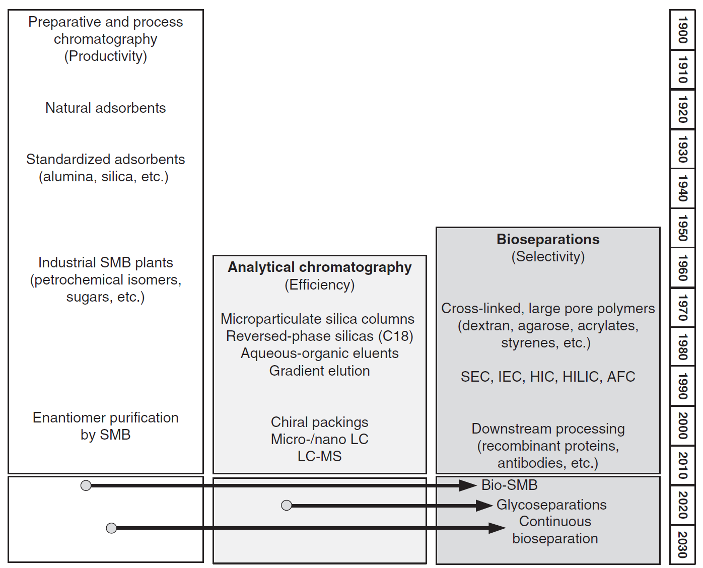
H. Schmidt-Traub, M. Schulte, A, Seidel-Morgenstern, Preparative Chromatography, 2020, Wiley-VCH.

Slide 5
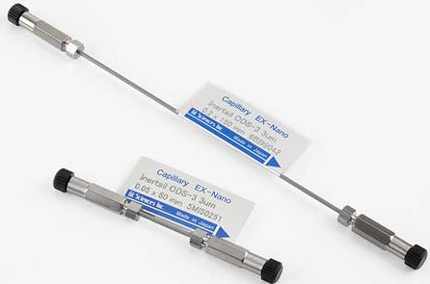
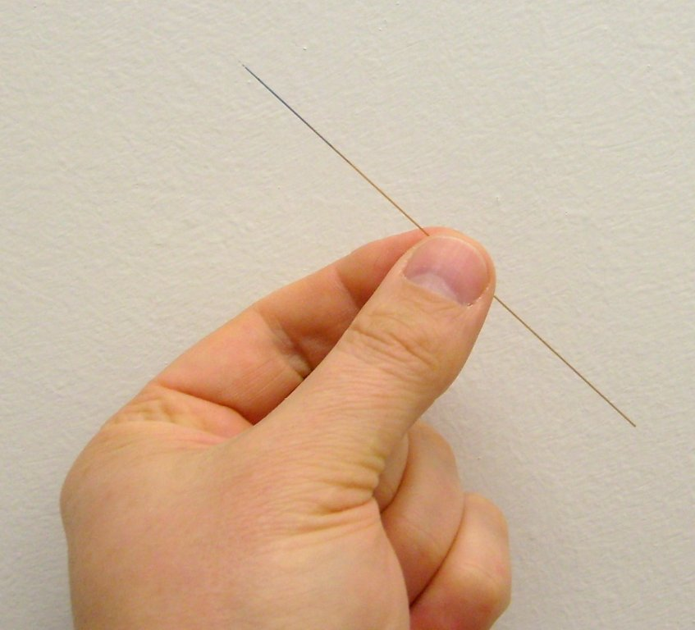
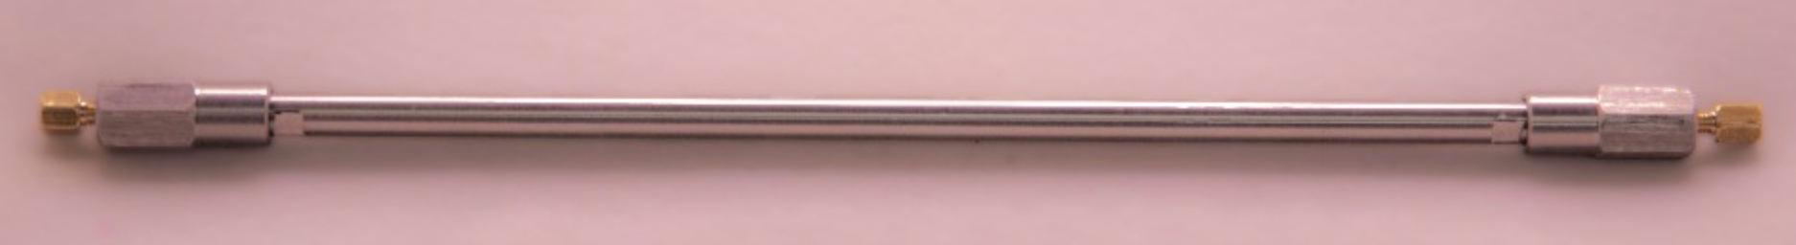
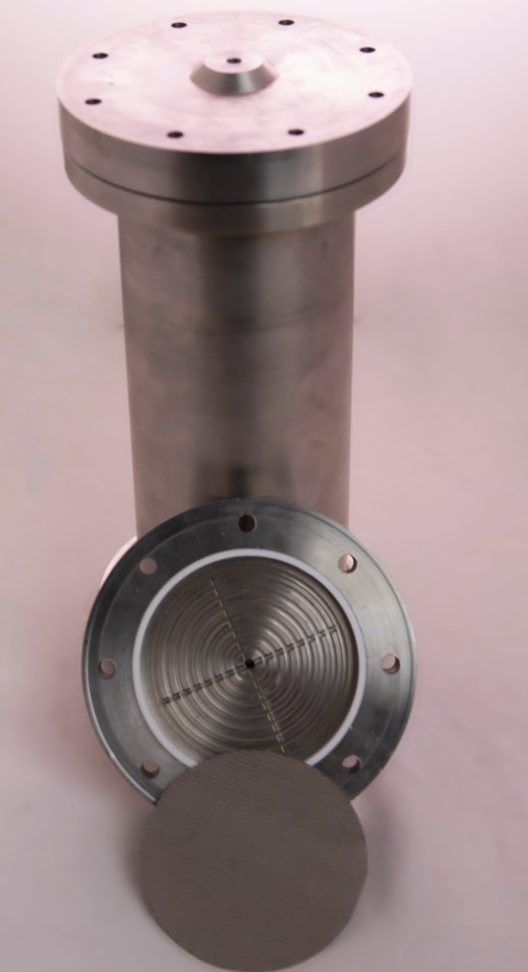
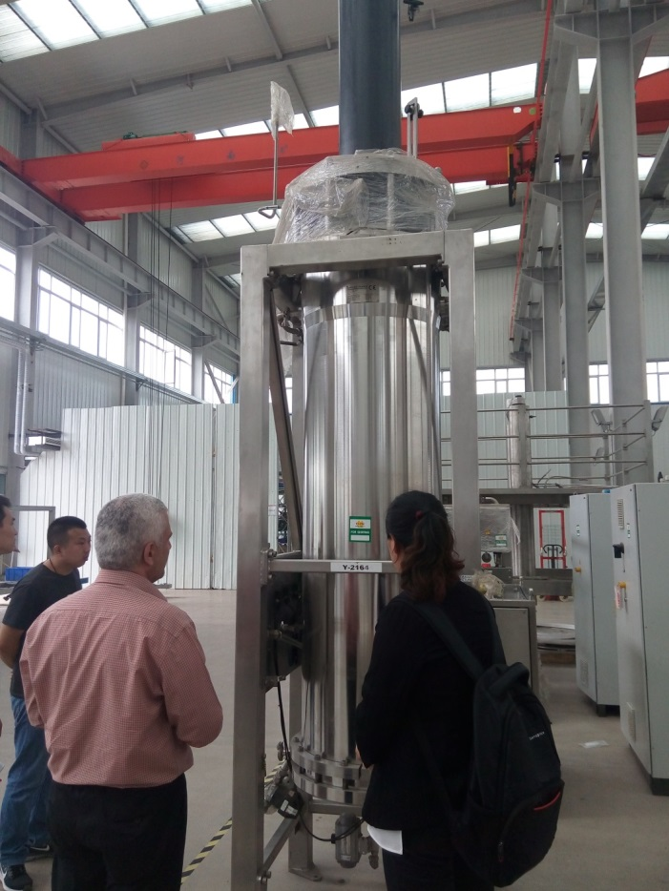

Slide 6
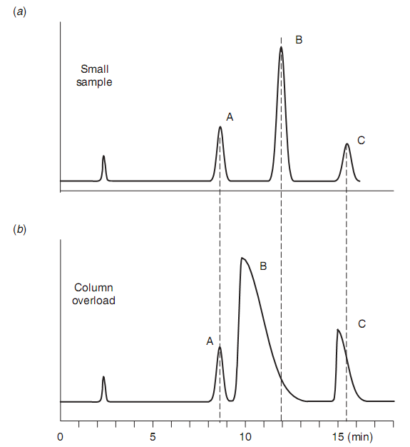
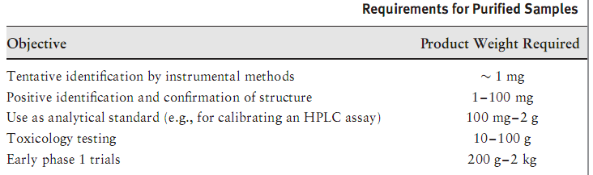
Today half of the purification costs within pharmaceutical or biotechnological separations for instance lie in the chromatography steps, approximately 30% of the total cost, and this increases with the further concentration of the product.
Preparative Chromatography
Edited by Henner Schmidt-Traub, Michael Schulte, and Andreas Seidel-Morgenstern
Wiley 2012

Slide 7
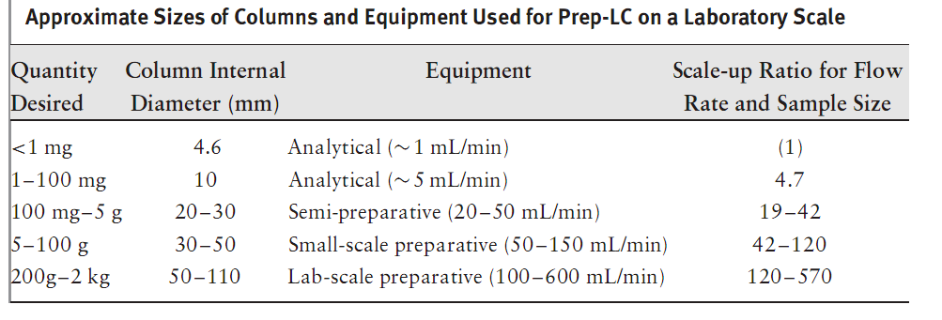

Slide 8
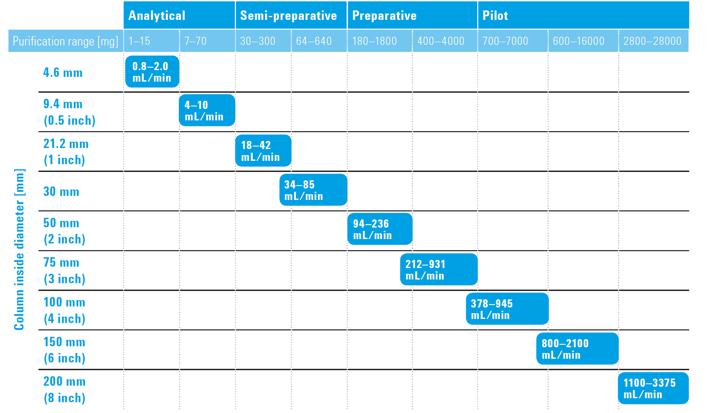
Typically, the amount of crude sample can vary from 0.1 to 1.0 % based on the weight of the sorbent.
Agilent Catalog

Slide 9
Conferences

Slide 10


Slide 11


Slide 12
1. Industrial Case Studies in Protein Chromatography
2. Innovative Stationary Phases and Processes
3A. Fundamentals
3B. Stationary Phases - I
4A. Bioprocesses - I
4B. Natural Products
5. Drug Discovery, Development, and Manufacture
6. New and Refined Modeling Approaches
7A. Peptides, Oligonucleotides, Lipids
7B. Bioprocesses - II
8A. Stationary Phases - II
8B. Bioprocesses - III
9. Continuous and Integrated Processes
10. Fundamentals and Modeling
11. Monoliths and Membranes
12. Virus, VLPs, Bioparticles

Slide 13
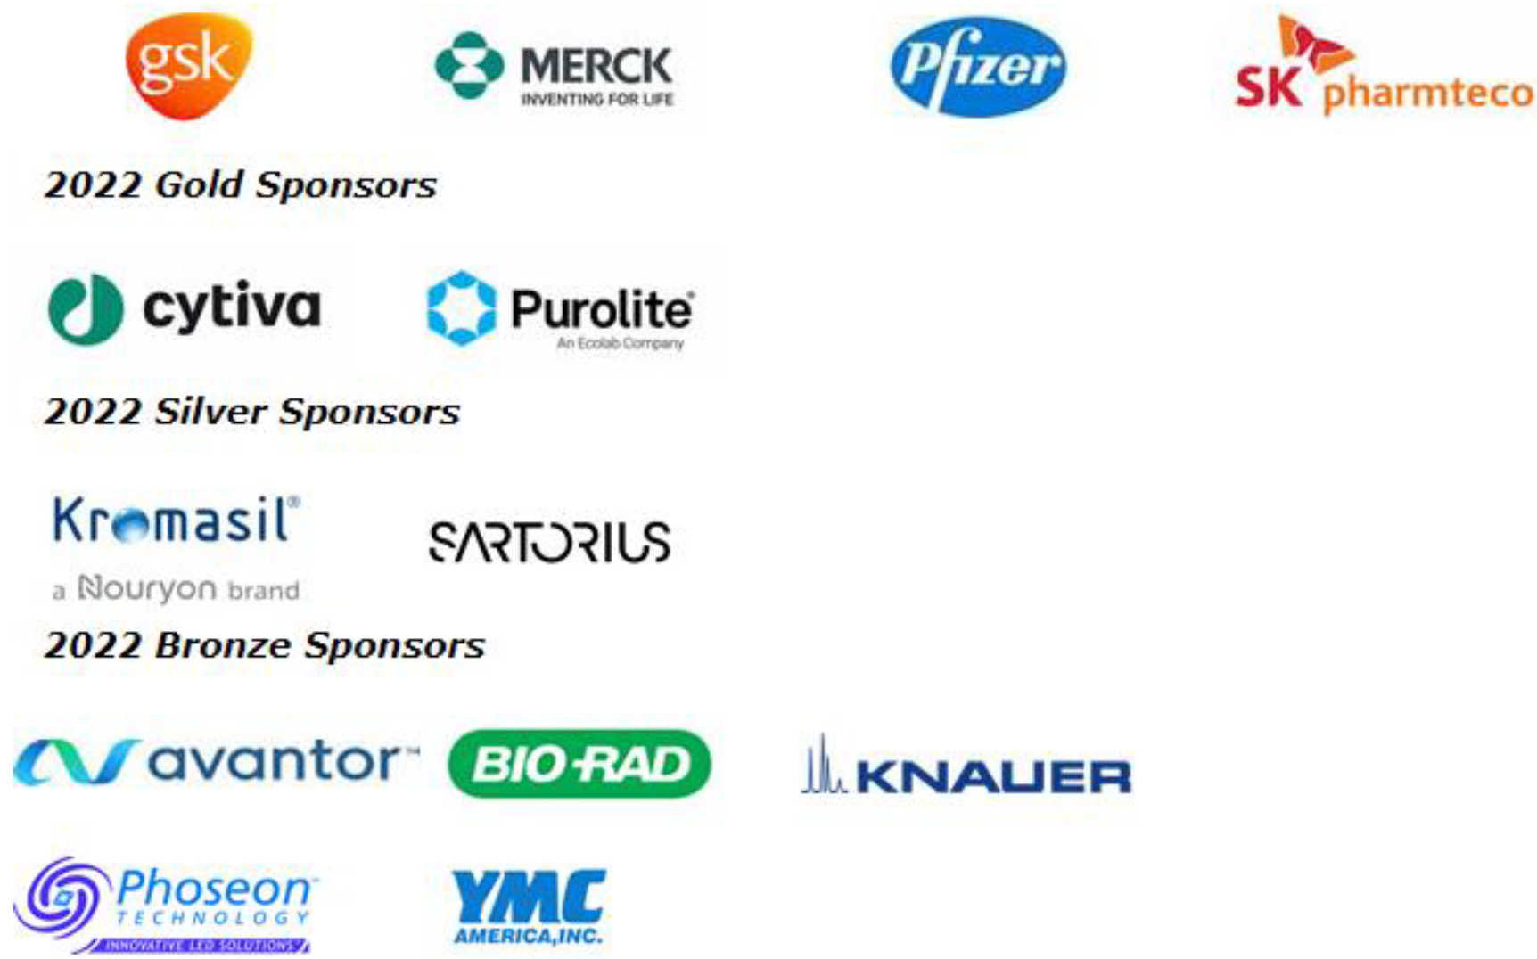


Slide 14
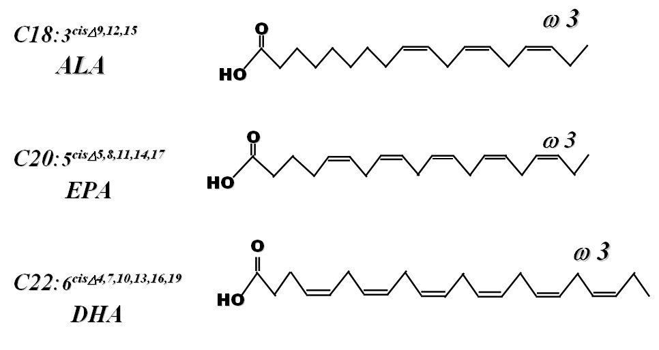
α-Linolenic acid
Eicosapentaenoic acid
Docosahexaenoic acid

Slide 15
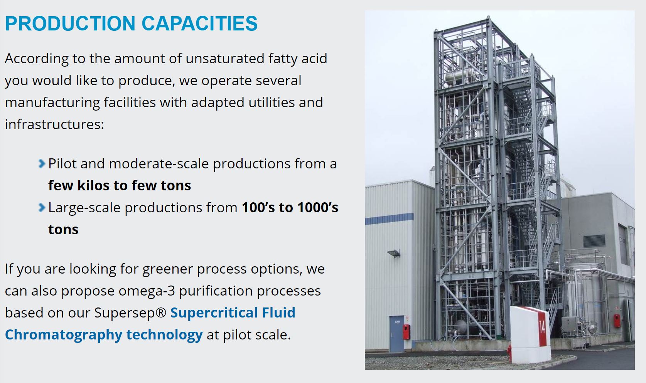
NOVASEP

Slide 17
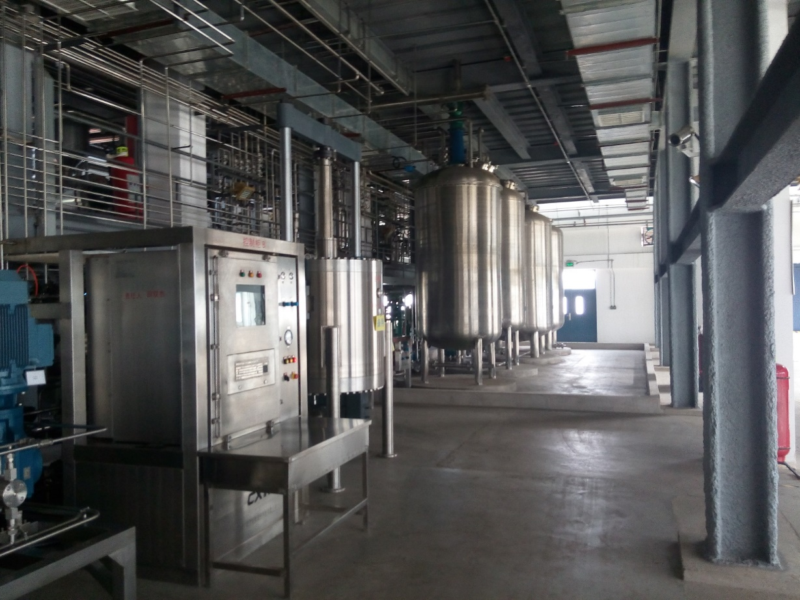
CXTH China Company
Omega 3 from fish oil
Investment: 5 Million $

Slide 18
Brief of Theory

Slide 19
Assumes of Anal. Chromatogr.
The concentration of the solute in the mobile phase is negligibly small.
The flow rate is not perturbed by the presence of the solute.
The elution is an isotherm process.
The physicochemical constant is independent of concentration of solute.
The kinetic of mass transfer between the two phases is rapid compare to the migration of the zone
There is uniform pack as stationary phase
The sample injection band is plug like or at least very narrow compared to the standard deviation of elution band.

Slide 20
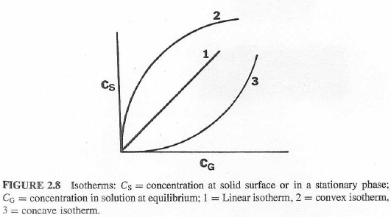
Equilibrium
C_{sp}
K =
C_{sp}=
K
C_{mp}
or
C_{mp}
y =
K x

Slide 21
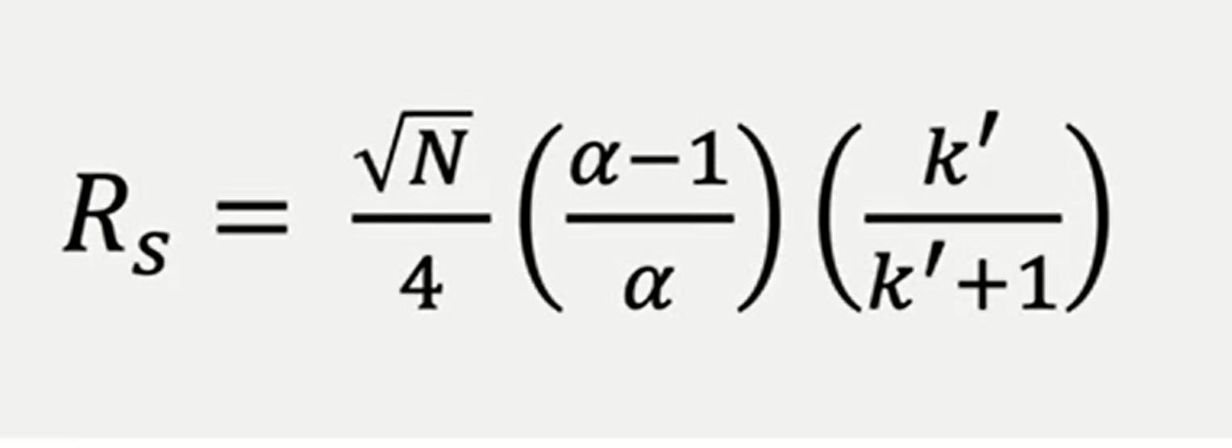
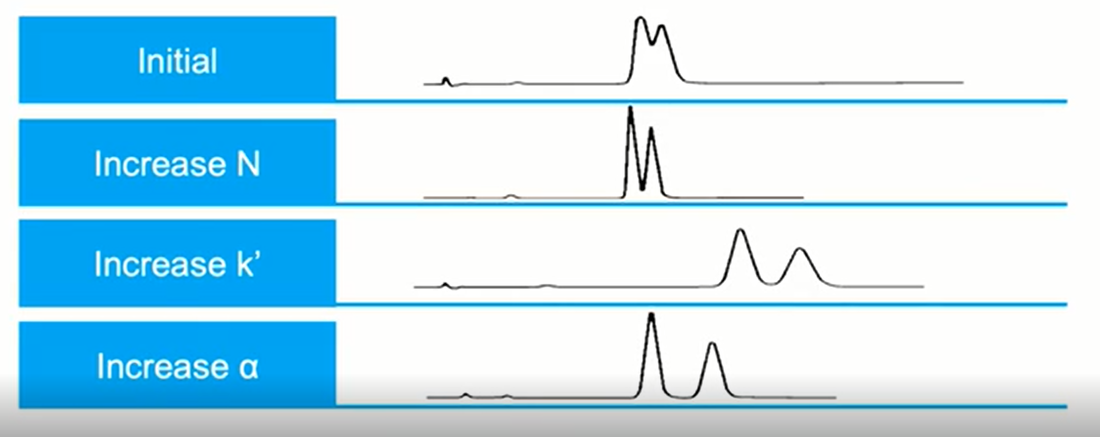

Slide 22
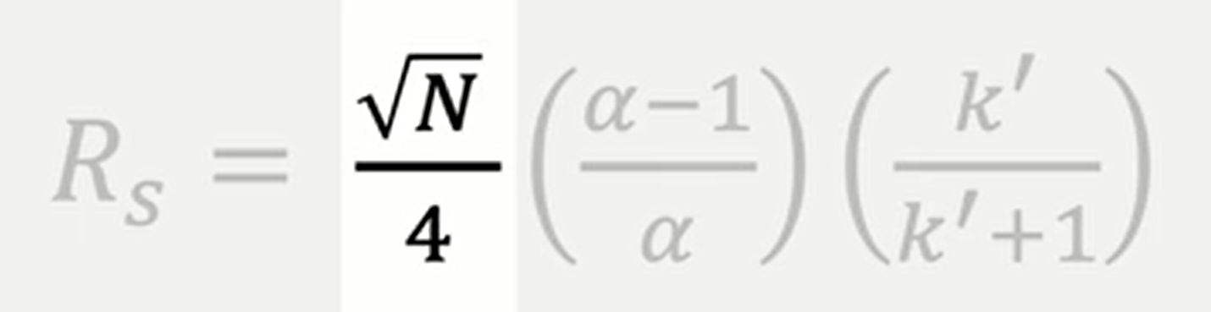
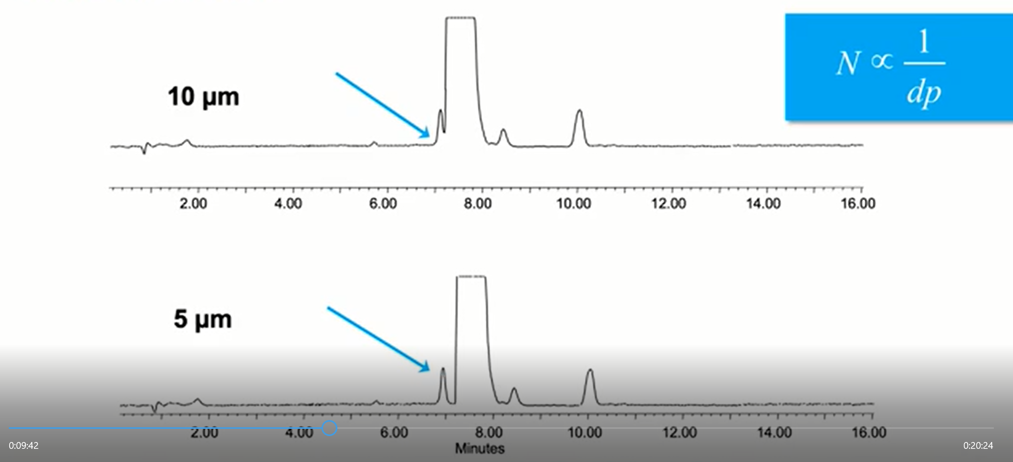
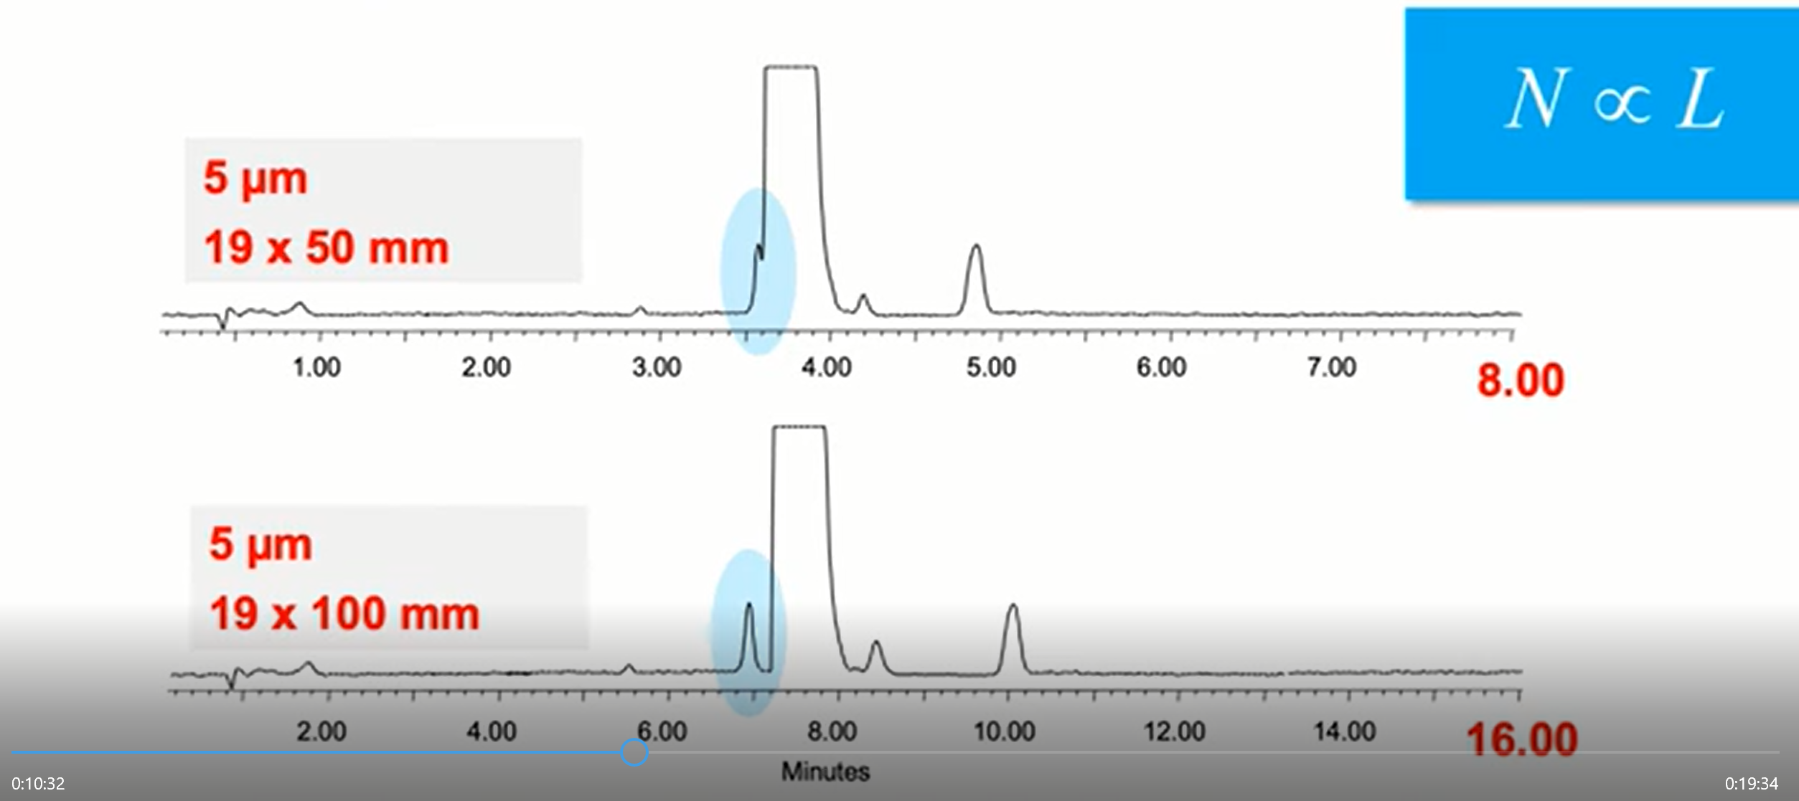

Slide 23
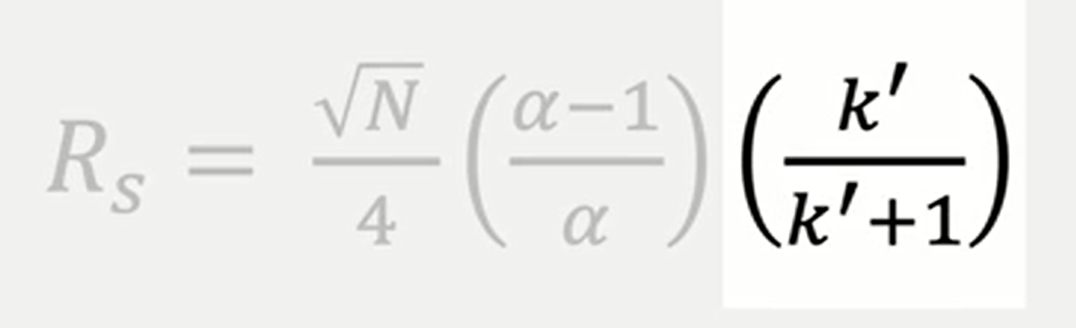
It depends to retention time (capacity factor) that depends to
Stationary Phase
2. Mobile Phase
3. Gradient Elution

Slide 24
1. Stationary Phase
Chromatographic Mode | Comment
Reversed-phase chromatography (RPC) | The column is nonpolar (e.g., C18), and the mobile phase is a polar mixture of water plus organic solvent (e.g., acetonitrile); RPC is the most widely used mode, especially for water-soluble samples.
Normal-phase chromatography (NPC) | The column is polar (e.g., unbonded silica), and the mobile phase is a mixture of less-polar organic solvents (e.g., hexane plus methylene chloride); NPC is used mainly for water-insoluble samples, preparative HPLC, and the separation of isomers.
Non-aqueous reversed-phase chromatography (NARP) | The column is nonpolar (e.g., C18), and the mobile phase is a mixture of organic solvents (e.g., acetonitrile plus methylene chloride); NARP is used for very hydrophobic, water-insoluble samples.
Hydrophilic interaction chromatography (HILIC) | The column is polar (e.g., silica or amide-bonded phase), and the mobile phase is a mixture of water plus organic (e.g., acetonitrile); HILIC is useful for samples that are highly polar and therefore poorly retained in RPC.
Ion-exchange chromatography (IEC) | The column contains charged groups that can bind sample ions of opposite charge, and the mobile phase is usually an aqueous solution of a salt plus buffer; IEC is useful for separating ionizable samples such as acids or bases, and especially for the separation of large biomolecules (e.g., proteins and nucleic acids).
Ion-pair chromatography (IPC) | RPC conditions are used, except that an ion-pair reagent is added to the mobile phase for interaction with sample ions of opposite charge; IPC is useful for the separation of acids or bases that are weakly retained in RPC.
Size-exclusion chromatography (SEC) | An inert column is used with either an aqueous or organic mobile phase; SEC provides separation on the basis of molecular weight and is used mainly for large biomolecules or synthetic polymers.

Slide 25
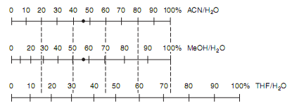
Solvent-strength nomograph for reversed-phase HPLC (adapted from. Two mobile phases of equal strength (46%ACN and 57%MeOH) marked by,as an example.
2. Mobile Phase

Slide 26
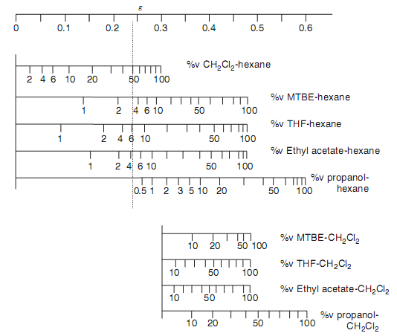
Solvent nomograph for normal-phase chromatography and silica columns.

Slide 27
As a rule of thumb, the retention factor k′ of strongly bound and thus later-eluting solutes should not be larger than 10. This corresponds to an elution volume of less than 10 column volumes.
As a result of gradients, retention times and in particular the differences between first and last eluting peaks, i.e. cycle times, can be decreased. Connected with gradients the peaks become sharper and narrower. Gradient elution is frequently applied for screening of complex mixtures to obtain information on the number and polarity of the components.

Slide 28
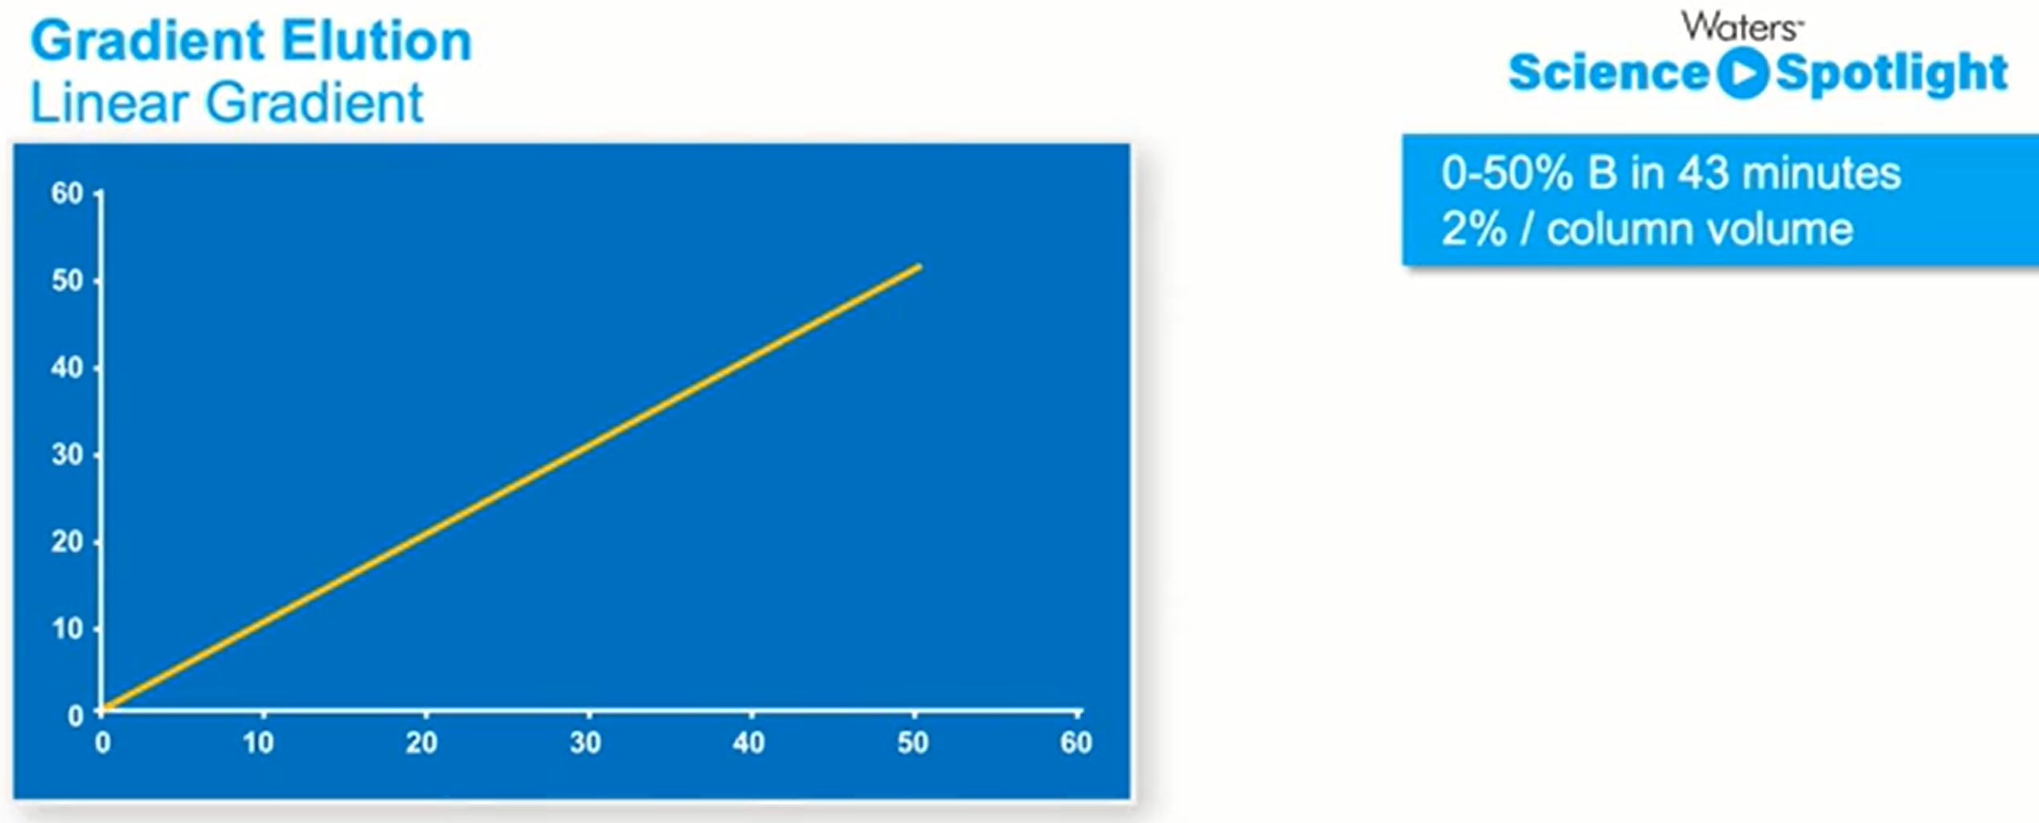
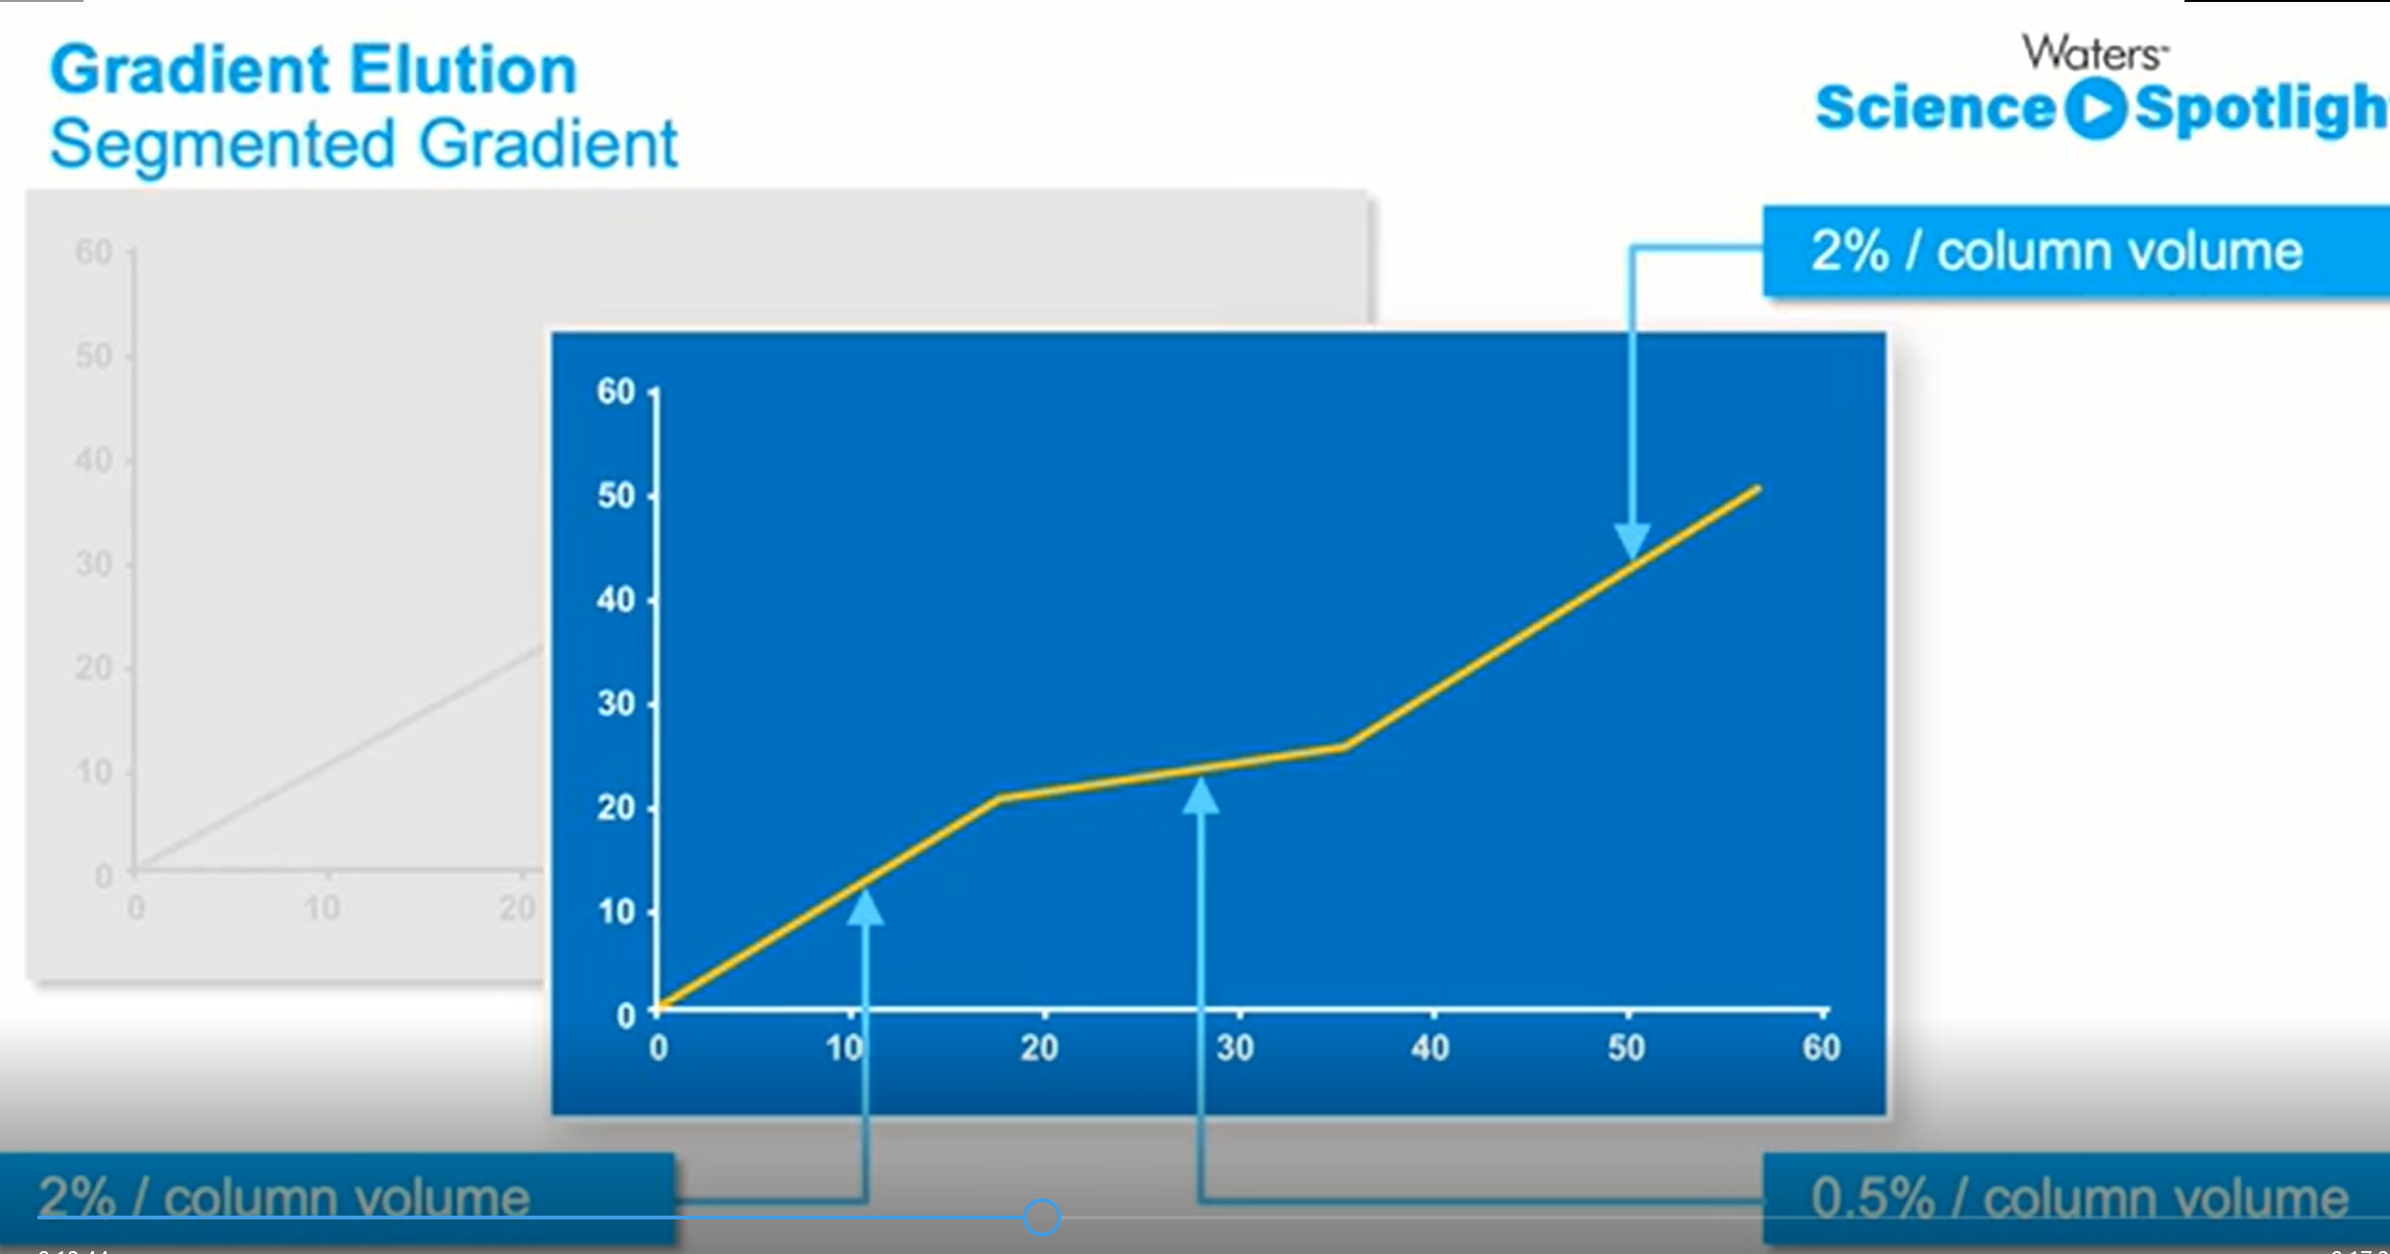
3. Gradient Elution

Slide 29
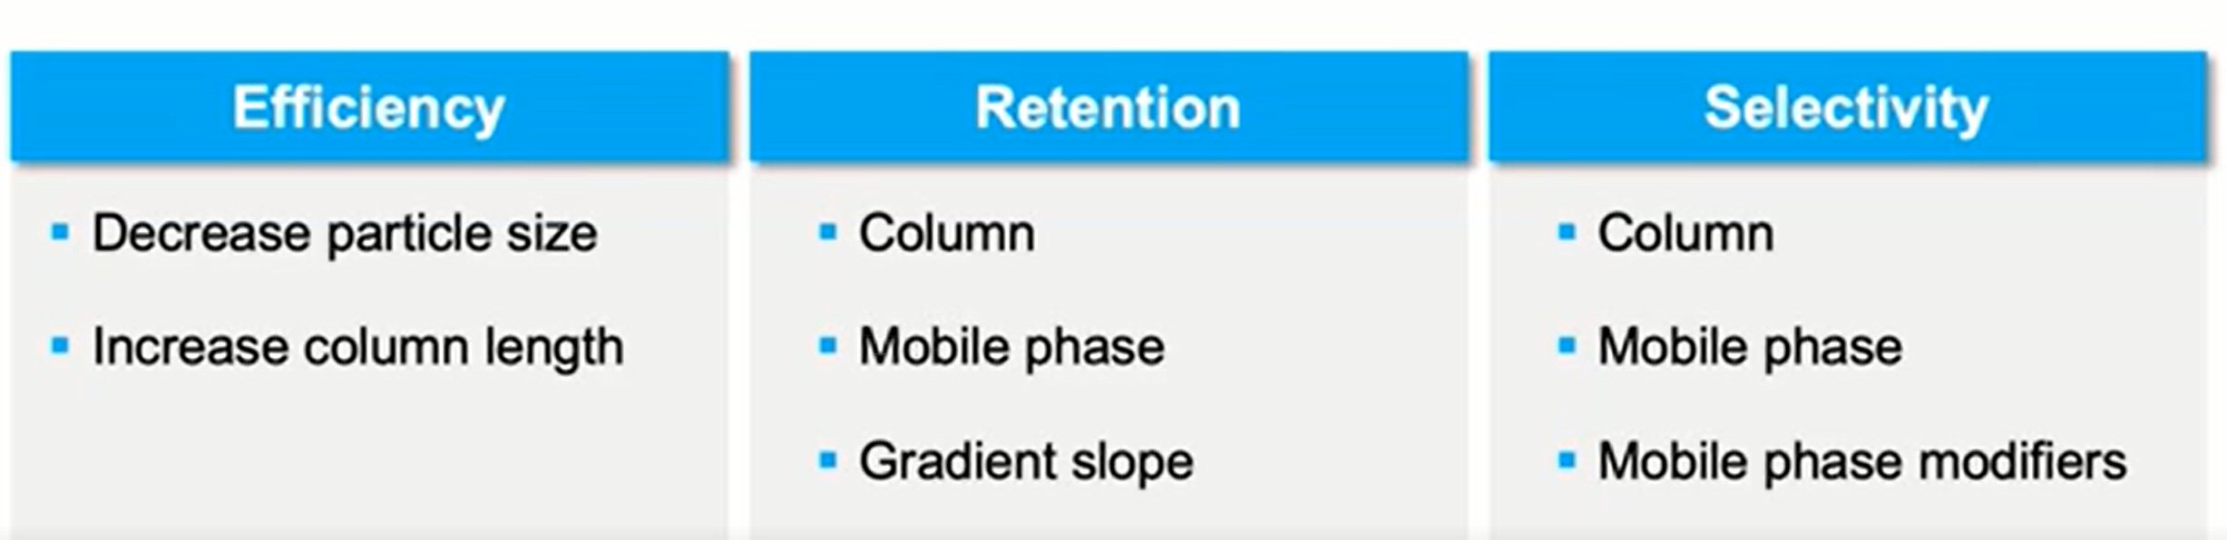

Slide 30
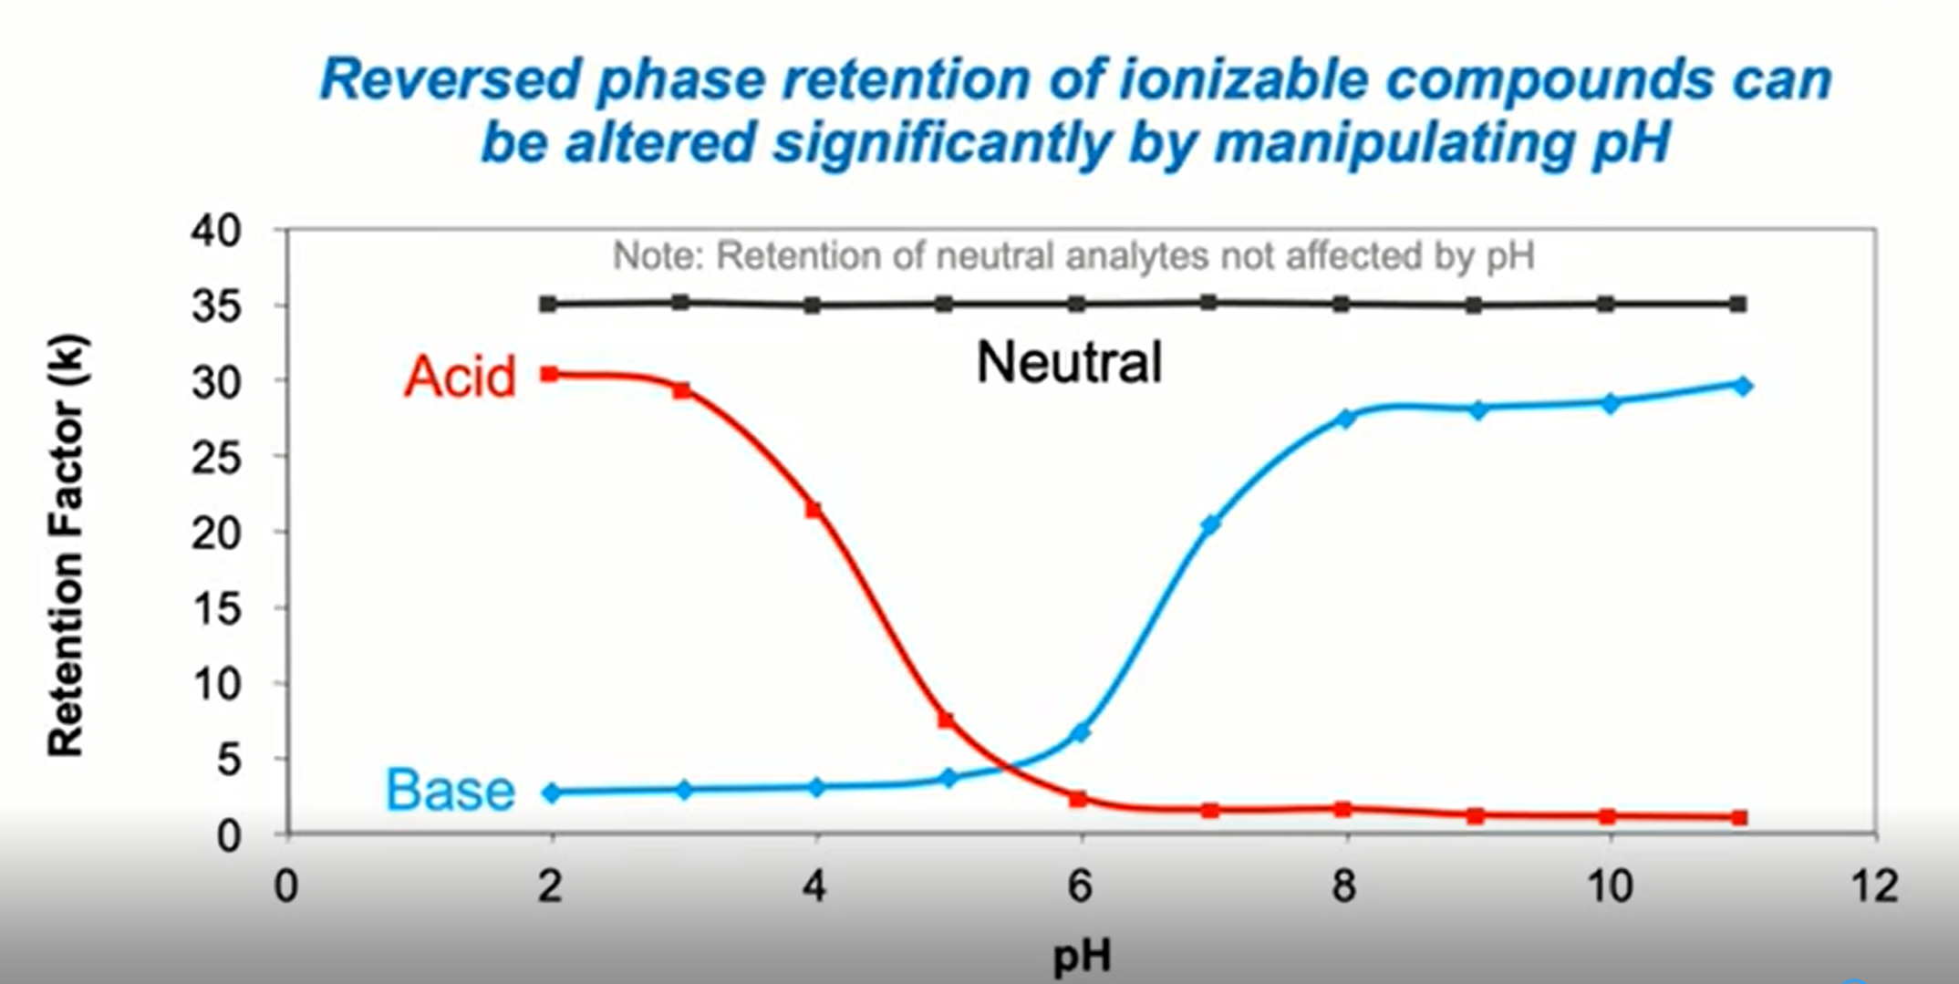

Slide 31
Other Parameters and Conditions

Slide 32
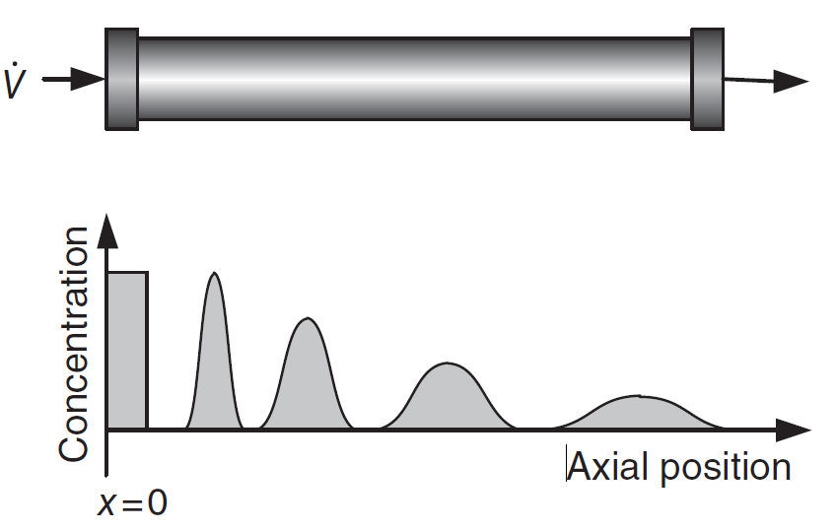
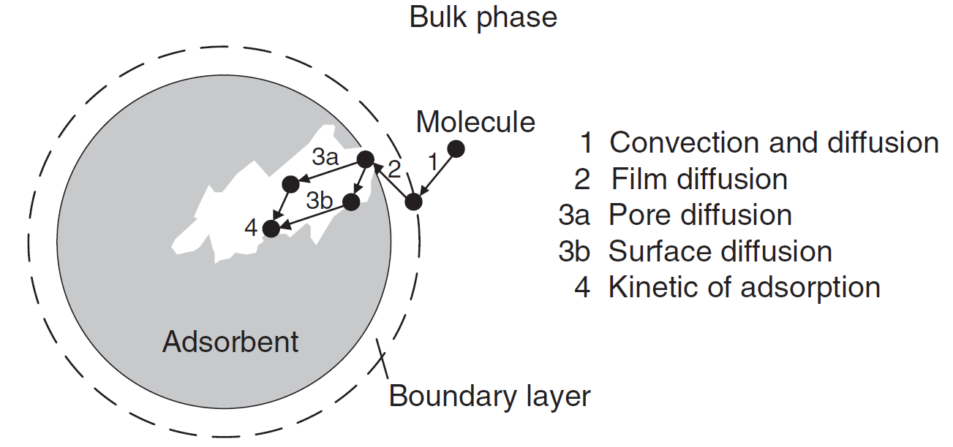
Band broadening in a column
due to axial dispersion.
Mass transfer phenomena during the adsorption of a molecule.
H. Schmidt-Traub, M. Schulte, A, Seidel-Morgenstern, Preparative Chromatography, 2020, Wiley-VCH.

Slide 33
The process of chromatographic separation can be defined by Thermodynamic and Kinetic parameters (four conditions):
Linear Ideal Chromatography
Linear Non-ideal Chromatography
Non-linear Ideal Chromatography
Non-linear Non-ideal Chromatography

Slide 34
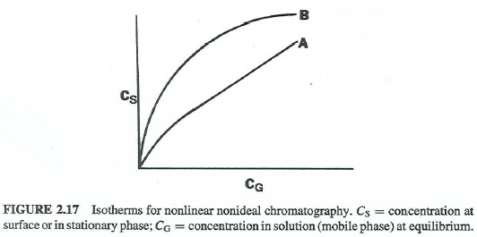
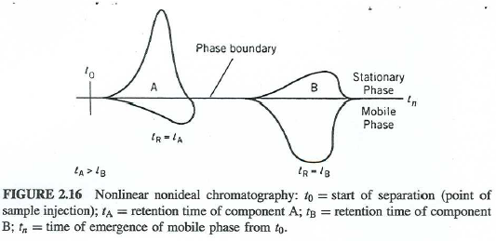
Non-linear Non-ideal Chromatography

Slide 35
Definition of Isotherms
The behavior of single components as well as their mixtures has to be known over a wide concentration range.
The dependencies of equilibrium loadings q_{i} on the concentrations of the solute in the fluid phase surrounding the adsorbent particles at constant temperature are called the adsorption isotherms.
H. Schmidt-Traub, M. Schulte, A, Seidel-Morgenstern, Preparative Chromatography, 2020, Wiley-VCH.

Slide 36
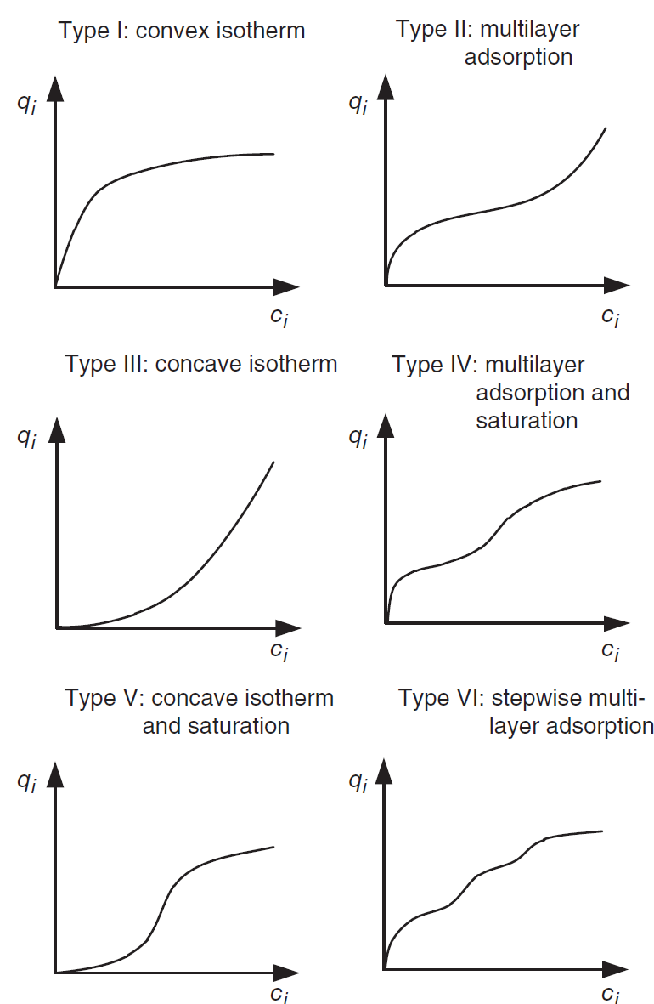
Different types
of courses of adsorption
isotherms.

Slide 37

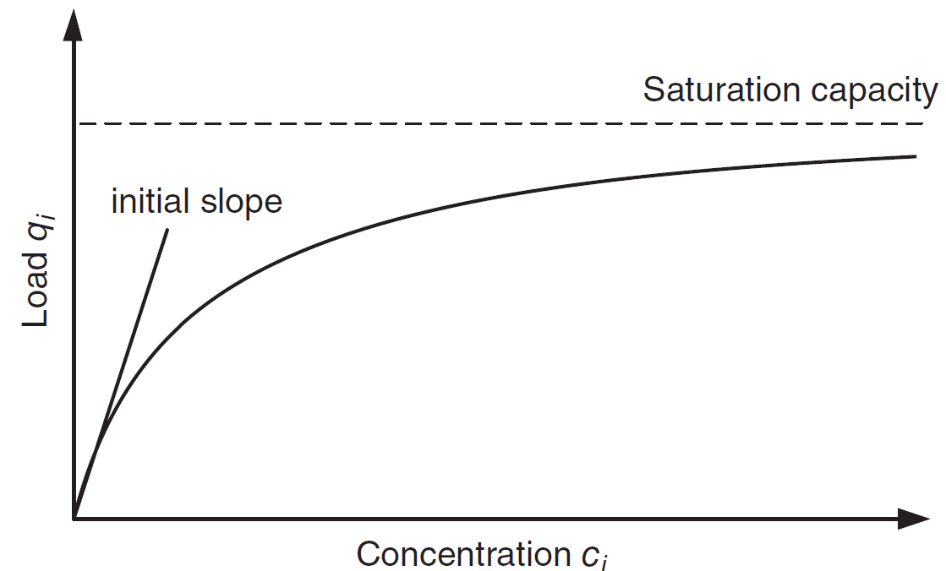
Single-component adsorption isotherm
This is the most common type (Langmuir, 1918), which describes many situations encountered in preparative chromatography.
Increasing the concentration of the solute in the mobile phase above certain limits does not anymore cause an increase of the amount adsorbed onto the stationary phase.
Only in the very first low mobile phase concentration region there is a linear relationship. This region is used for quantitative analysis in analytical chromatography, because only in this region.
Single component
Langmuir isotherm.

Slide 38
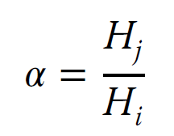
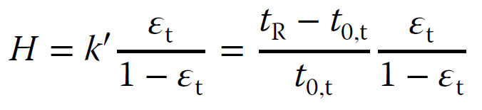
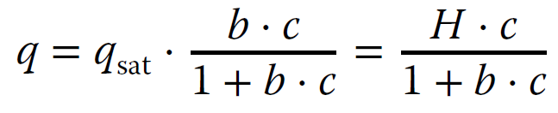
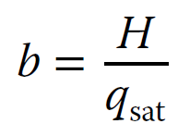
Henry coefficient H, the total porosity, and the corresponding capacity factor, which can be determined from the measured retention time of a substance and the column dead time.
Langmuir-type isotherms:
• All adsorption sites are considered energetically equal (homogeneous surface).
• Each adsorption site can only adsorb one solute molecule.
• Only a single layer of adsorbed solute molecules can be formed.
• There are no lateral interferences between the adsorbed molecules:

Slide 39
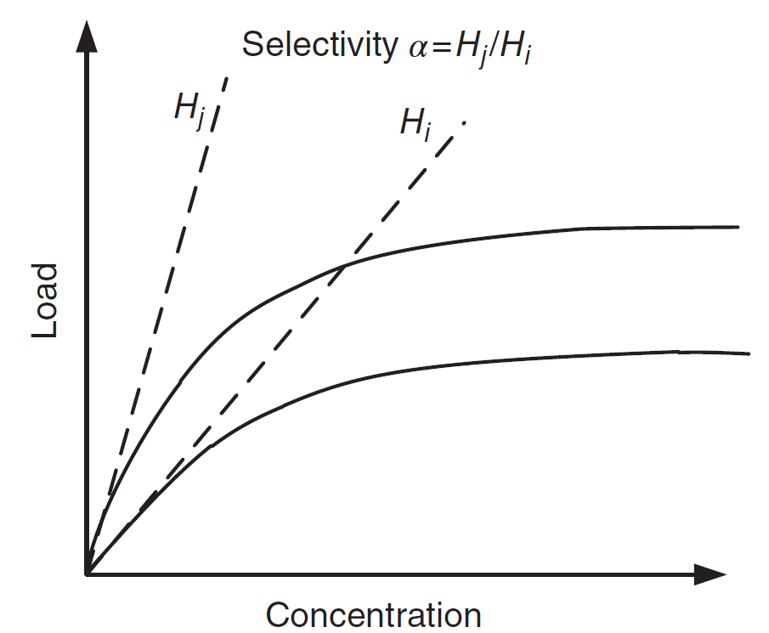
Initial slopes of the isotherms
for two different components.

Slide 40
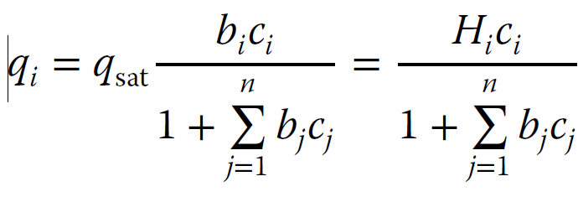
Multicomponent Isotherms Based on the Langmuir Model
If mixtures of solutes are injected into a chromatographic system, not only interferences between the amount of each component and the adsorbent but also interferences between the molecules of different solutes occur.
The competition can be included in the denominator of the multicomponent Langmuir isotherm equation:
A prerequisite for Eq. is the equality of the maximum loadability qsat of all n solutes. In the case of different loadabilities for the different solutes q_{sat, i} ≠ q_{sat, j}, Eq. up.

Slide 41
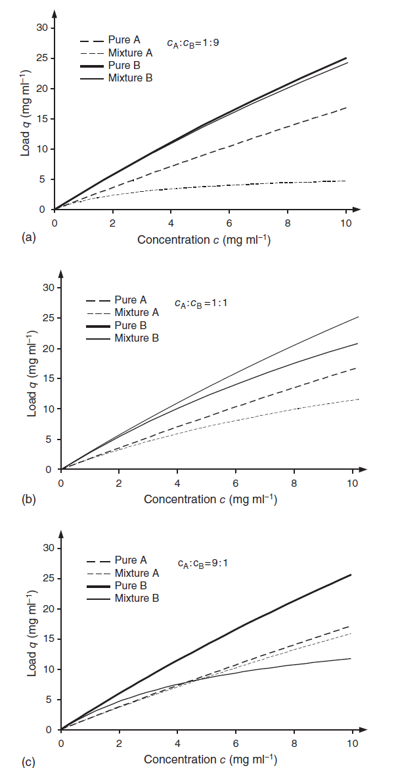
Single-component Langmuir isotherms and multicomponent Langmuir isotherm
for different mixture compositions.
a) 1 : 9, b) 1 : 1, c) 9 : 1.

Slide 42
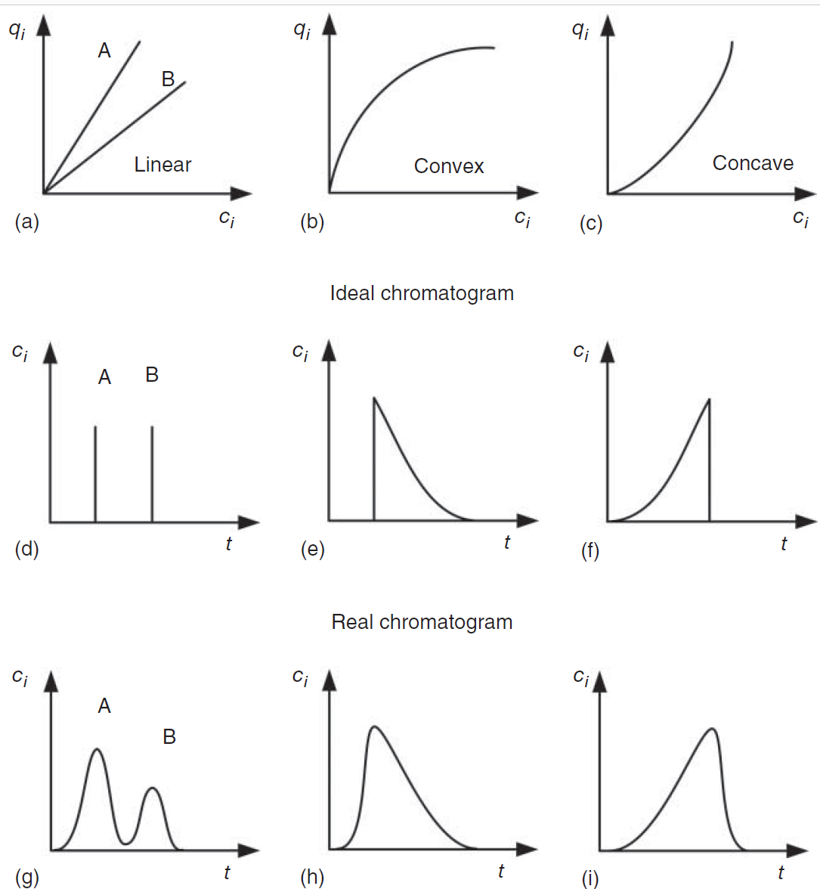
Relation Between Isotherms and Band Shapes
Influence of the course of the equilibrium isotherms on the shapes of
chromatographic elution profiles, a) types of isotherm, b) ideal chromatograms, c) real
chromatograms.

Slide 43

Overloading
To increase productivity, samples are applied on the column with much higher injected amounts than in analytical chromatography.
A column is sometimes called overloaded by analytical chemists when the injection causes a 10% decrease in the retention factor k′ or a 50% decrease of the plate number N compared to analytical conditions.
A more suitable measure of overloading is provided by the loading factor, which is the ratio of injected sample amount to the corresponding column saturation capacity. It should be emphasized that the productivity optimum of preparative chromatography is typically found beyond the so-called touching band situation for
which still 100% yields at 100% purity are possible.

Slide 44
Volume Overloading
Volume Overload is a kinetic effect and is related to zone spreading. When it take place, the contribution of the inject volume to band spreading is comparable to dispersion due to the column.
The sample concentration, however is sufficiently low to avoid departure from linearity of the sample distribution isotherm (linear Chromatography).
Mass Overloading
Mass overload (or better, concentration overload) is a thermodynamic effect related to the nonlinearity of the distribution isotherm (nonlinear chromatography).
Under these conditions, retention times and peak shapes depend on the quality of sample injected.

Slide 45
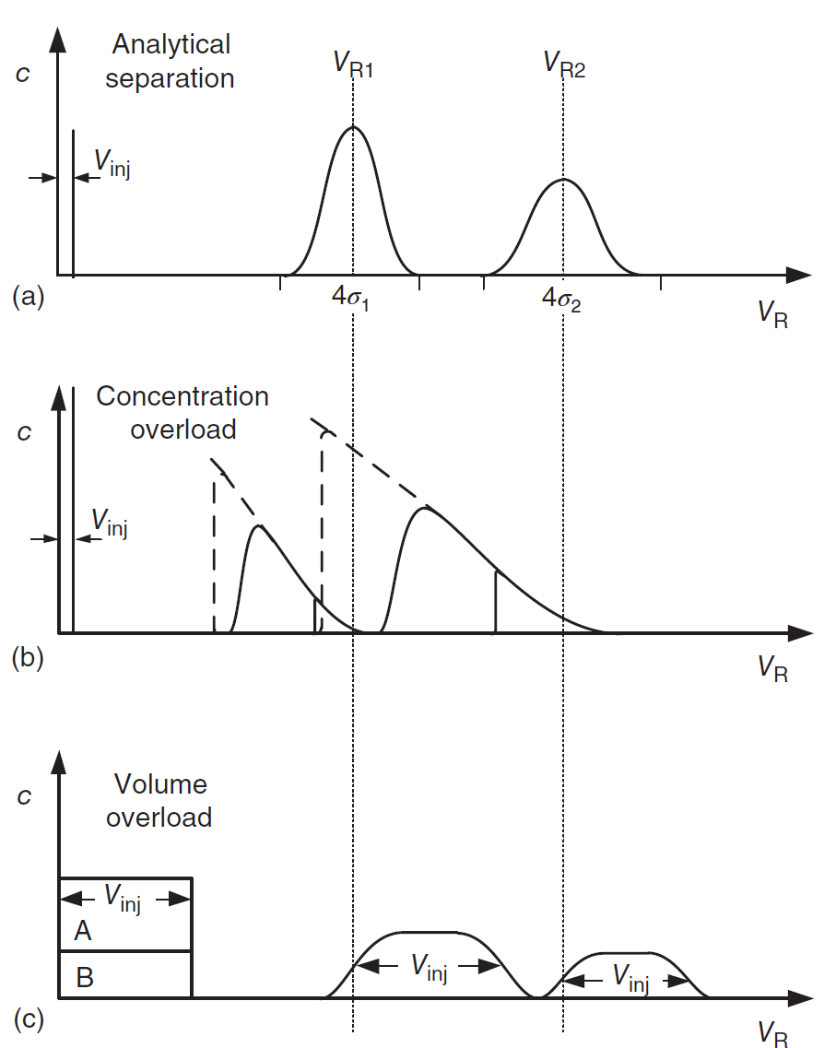
Illustration of different types of overloading chromatographic columns.
a) analytical case, b) concentration overloading, c) volume overloadin

Slide 46
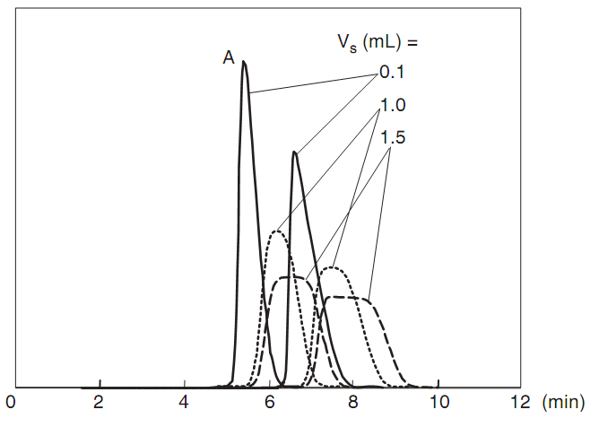
Chromatograms illustrating the effects of volume overload on the separation of
two adjacent peaks. Sample volumes:____, 0.1 mL; ......, 1.0 mL; _ _ _, 1.5 mL. Simulation for a column 250 × 4.6 mm operated at 1 mL/min, two components at 1:1 composition, k(A)= 1.0, selectivity α = 1.5, N = 1000. The two peaks are moderately mass-overloaded.
• a change in the mobile phase
• a change in the sample solvent
• an increase in column temperature

Slide 47
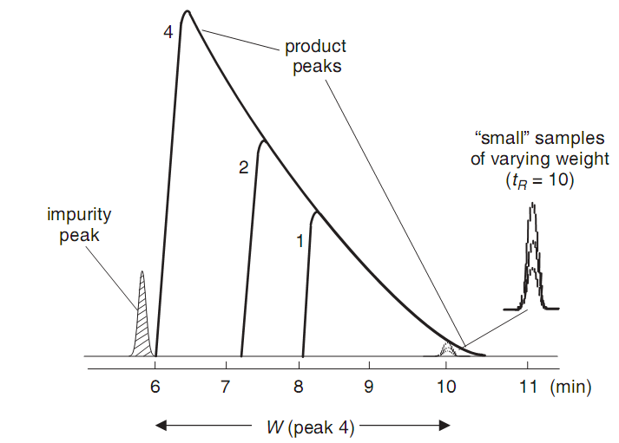
Effect of sample weight on peak shape for overloaded separation

Slide 48
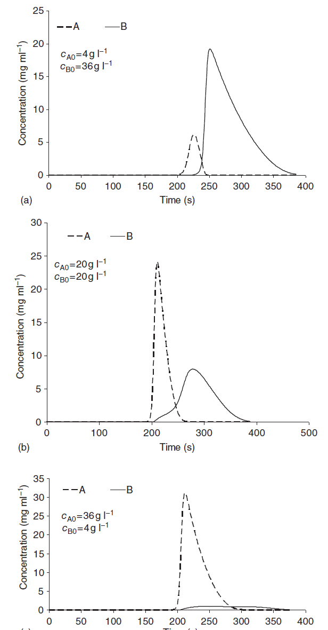
Elution profiles for different mass ratios of the feed mixtures. a) 1 : 9, b) 1: 1, c) 9 : 1.

Slide 49
Effect of physical parameters on preparative chromatography efficiency:
Loading capacity
Particle size
Column length
Throughput

Slide 52
15 µm Analytical
15 µm
40-63 µm
150 µm

Slide 55
Brief Instrumentation

Slide 56
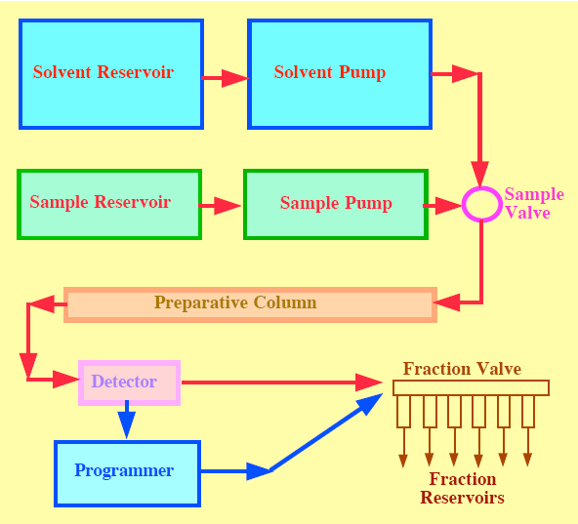
Preparative Chromatography Apparatus

Slide 57
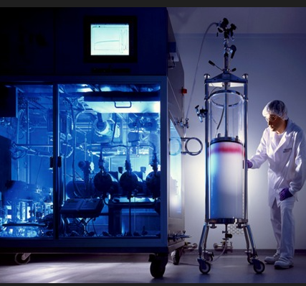
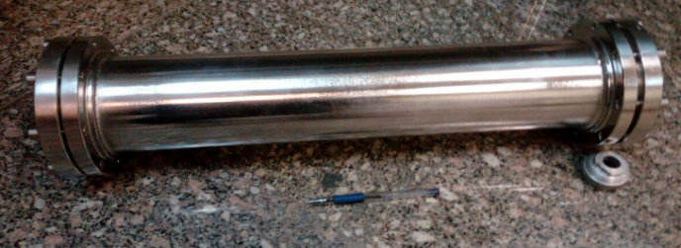


Slide 58
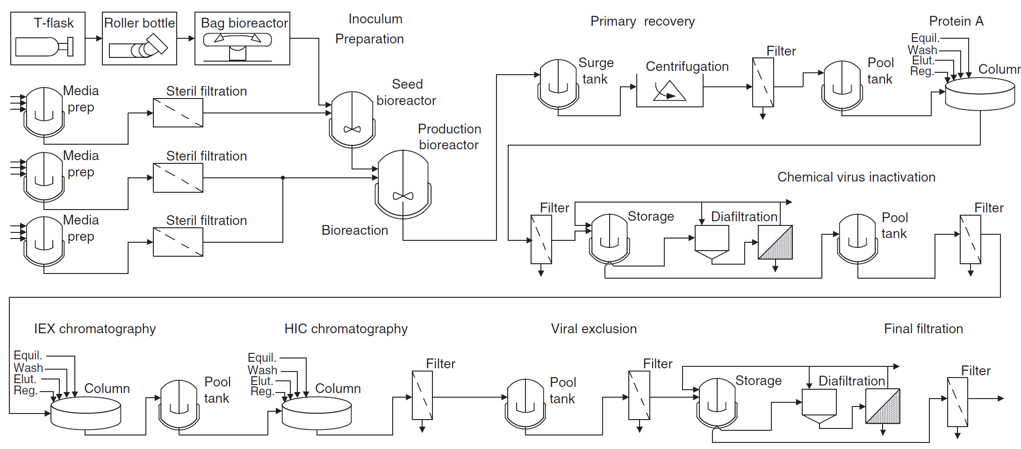
Principle of monoclonal antibody production.

Slide 59
Pump

Slide 60


Low Pressure Pump
High Pressure Pump

Slide 61

Different volumes in beds packed with porous particles.

Slide 62

H. Schmidt-Traub, M. Schulte, A, Seidel-Morgenstern, Preparative Chromatography, 2020, Wiley-VCH.

Slide 63

Illustration of chromatography with tracer components and the relevant retention times.
In normal phase chromatography, toluene or 1,3,5-tri-tert-butylbenzene is often used, while in reversed phase chromatography uracil is typically selected as the tracer component of choice.

Slide 64

The total retention time of a nonretained substance depends on the holdup time within the column itself, t₀, as well as on the additional holdup time in the system or plant, t_{plant}, which is, for instance, influenced by pipe lengths and diameters and pump head volumes (if the sample is introduced via a pump).
The sum of solid volume and pore volume gives the volume of the stationary phase, which, subtracted from the column volume, leads to the interstitial volume

Slide 65

An alternative method for reliable determination of total porosities can be used for small-scale columns. As long as a column can be weighed exactly, the mass difference of the same column filled with two solvents of different densities can be used to determine the porosity. The column is first completely flushed with one solvent and then weighed; afterward, the first solvent is completely displaced by a second solvent of different density. For normal phase systems, methanol and dichloromethane can be used; for reversed phase systems, water and methanol are quite commonly employed. The volume of the solvent, representing the sum of the interstitial volume and the pore volume, is determined by Equ.:
Notes:
High-efficiency adsorbent particles are very often spherical and monodisperse in order to reduce pressure drops. In this case void fractions for spherical particles lie theoretically in the range 0.26<𝜀e <0.48, and mean values of 𝜖e of approximately 0.37 can be roughly applied (Brauer 1971). Particle porosities lie in the range 0.50<𝜀p <0.90, meaning that 50–10% of the solid is impermeable skeleton.
Total porosities are often in the range 0.65<𝜀t <0.80.With monolithic columns these total porosities can lie in the range 0.80<𝜀t <0.90. In case of large porosities, sufficient stability of the bed has to be ensured.

Slide 66


Gradient profile for an analytical scouting run using a 4.6 mm id column, comprising injection, optional Isocratic hod, gradient slope and purge phase.
Gradient Profile after scale up to 21.2 mm id column, comprising a extended isocratic step to compensate to the difference in dwell volume between the analytical and preparative system.

Slide 67
Injection

Slide 68
Loop Injection
Care should be taken when choosing a larger loop, as peak spreading in an open tube is proportional to the sixth power of tube i.d. Thus, when the loop diameter is increased, the injected sample plug may exhibit increased tailing and broadening. The use of a longer (vs. wider) sample loop will also increase the width and tailing of the sample plug, but usually to a lesser degree.

Slide 70
This injection technique can be applied when sample tends to precipitate on contact with the mobile phase. Plugging of injection needle and capillary can be possibly avoided. By programming the autosampler, The sample can be embedded or sandwiched between two plugs of an appropriate solvent that avoids precipitate in the sample loop. DMSO or solvents immicible with water can be used. For analytical injection the volume of injected DMSO has to be as low as possible. We recommend using two 5-µL plugs. As a rule of thumb for preparative injection volume, we recommended using total plug volume of about 10%of the total injection volume Good results can be achieved using dichloromethane as a sandwich solvent.

Slide 72
Injection by Pump
Dedicated prep-LC units usually have a sample-injection pump that is separate from the mobile-phase pump(s). Where the sample volume is limited and the system volume is large, it is better to use manual injection—or aspirate the sample through a small tube directly into the sample pump.
Sample injection is often operated in a stopped-flow mode; the mobile-phase pump is stopped, and the feed pump is actuated to pump the required sample volume directly to the column. This direct, on-column injection with a feed pump eliminates the tailing that may be seen in alternative systems where an injection valve with a large sample loop is used with injection of the entire contents of the loop.

Slide 73

Scheme of conventional column loading (a) and at-column dilution (b).

Slide 74
Detector

Slide 75

Optical system of a diode array detector

Slide 76


Notes:
Mass-selective, evaporative light scattering and refractive index detectors all require make-up solvents for preparative applications.

Slide 77
Column

Slide 78


Slide 79


Slide 80


Frites in Preparative LC
Isobars and streamlines for a cylindrical column outlet.

Slide 81


Schematic of a typical distribution plate

Slide 82


Slide 83

The easiest means of fluid distribution at the column inlet is by using a
high-pressure drop of the packed bed, which forces the fluid inside the inlet frit into the radial dimension.
Cross-section of a column inlet with frit system.

Slide 84
Stainless steel bed supports are used extensively in standard and engineered chromatography columns. In contrast with hydrophobic polyethylene sinters, they are easily “wetted.” The multilayer woven mesh construction offers high porosity and mechanical strength, it may in many cases be cleaned of media particles mechanically or by ultrasonic means.
However, all stainless steel products are susceptible to corrosion when in prolonged contact with chloride-containing solutions and especially at low pH.
In general, properly passivated mesh of Deutsches Institut für Normung (DIN) grade 1.4404 (approximately equivalent to type 316L) is suitable for prolonged immersion in 2M sodium chloride solution at neutral pH and at ambient temperature (approximately 20 ֠C).

Slide 85




Left—Packed bed with Flat Header Design, Right—Packed bed with “Ribbed” Header Design.
Velocity contours in the packed bed for the flat (left) and “ribbed” designs.
Parameters Employed for Model Verification
Tracer transition profiles at the column outlet(s) obtained with the “ribbed” and flat designs.

Slide 86

Flow-cell geometry design and impact on exit velocity

Slide 87

Table below gives some basic information on protein binding for common column construction materials.

Slide 88
Packing Method for
Preparative Column

Slide 89
Outlines
Column Preparation
Slurry Preparation
Dynamic Axial Compression (DAC) Packing
Stall Packing
Combined Method (Stall+DAC)
Vibration Packing

Slide 90
Column Preparation
1) Clean the frits carefully and inspect them for obvious damage.
2) Mount, clean, and examine the column for proper sealing according to the manufacturer’s operation manual.
3) Prior to packing, check and adjust the vertical orientation of the column using a spirit level. Move the piston to its maximum bed length position.
4) Flush the empty column with the slurry solvent prior to use to ensure that the column, column frits, and plumbing are clean and wetted. Empty the column before introducing the slurry suspension.

Slide 91
The chromatography column can be challenged with E-coli, to test cleanability under standard operating conditions. Sodium hydroxide (1 Molar solution) can be used as a sanitizing agent and loaded with a minimum concentration of 105 cfu (colony-forming units) ml⁻¹. The column should be left to incubate overnight at room temperature and washed with two column volumes of 1 M NaOH recirculated for 1 h. After neutralization, the column should be sampled for residual microbial contamination. Sample should be taken from the critical points.

Slide 92

Packing Preparative Columns (Slurry)

Slide 93


Slurry Preparation

Slide 94

For many applications, the system forms the gradient mix by cycling the valve at the ratio required by the process. Simply cycling the valve will result in the proper gradient mix being formed if the mix frequency is properly tuned prior to use. In order to provide a steady flow gradient valves need to have the same inlet pressure; this means that inlet pressure should be controlled by a regulation valve at the tanks outlet.
Pump-based gradient works very well for bench scale equipment and it can be very accurate in a limited flow interval.
Valve-based and pump-based mixing.

Slide 95

Dynamic Axial Compression (DAC) Packing
After the slurry has been transferred into the column the piston is slowly lowered with the top valve open to remove air. When the expelled liquid is free of air bubbles, the top valve is closed
Open the process bottom valve (column outlet) and lower quickly the piston
until the final bed height

Slide 97


Slide 98


Slide 99


Slide 100



Slide 101

Vacuum Packing

Slide 102
Vibration Packing
Vibration packing is the method developed specifically for this type of matrixes. A vibration device applied externally at the column tube generates the right amount of energy to break the bridges (similar to the tap packing at lab scale), allowing particles to settle properly and occupy the minimum bed volume in the column.

Slide 103


Slide 104




Slide 105

Thank You for Your Attention

